Slide 1
© 2020 Quartz Health Solutions, Inc. This PowerPoint is considered confidential and proprietary, and may only be distributed with prior written permission from the Quality Management and Population Health (QMPH) and Legal Departments at Quartz Health Solutions, Inc. The QMPH department can be reached at (866) 884-4601. Statements contained in these materials do not constitute medical advice. Individuals should consult with their doctor for healthcare questions and advice. Quartz is a management and administrative services company which provides services for Quartz Health Benefit Plans Corporation, Quartz Health Plan Corporation, Quartz Health Plan MN Corporation, and Quartz Health Insurance Corporation.

Slide 2

Stress 101 – Tools & Strategy
Stress 101:
Tools and Strategies for
Managing Stress
Kimberly Hein-Beardsley, MS, LMFT, BCC, CHC
Quality Management & Population Health

Slide 3
Stress 101 – Tools & Strategy
Overview
Stress Facts & Stats
Signs and Causes of Stress
Coping Strategies
Relaxation Techniques

Slide 4
Stress 101 – Tools & Strategy
  “I don’t plan to stop burning the
  candle at both ends – I’m here so you
  can tell me where to get more wax.”

Slide 5
Stress 101 – Tools & Strategy
One Nation Under Stress
Worksite Stress Facts:
Up to 60% of all absences are caused by stress.
72% of US workers report emotional stress is pervasive in the worksite.
More heart attacks occur on Monday mornings than any other day of the week.

Slide 6
Stress 101 – Tools & Strategy
Stress Quiz
1. Which day of the week are employees most productive according to corporate executives?
  Monday
  Tuesday
  Wednesday
  Thursday
  Friday

Slide 7
Stress 101 – Tools & Strategy
Stress Quiz
2. A survey from the American Psychological Association found that 73 percent of Americans singled out what as their No. 1 cause of stress?
  Work
  Traffic
  Money
  Family

Slide 8
Stress 101 – Tools & Strategy
What is Stress?
A “perceived” threat (real or imagined) to one’s mind, body, spirit or emotions.

Slide 9
Stress 101 – Tools & Strategy
The Nature Of Stress
There are two kinds of “Distress:”
Acute Stress: Very intense, but short lived (usually around 20 minutes)
  Examples: speeding ticket, flat tire, email spam
Chronic Stress: Not very intense, but it endures for days, weeks, months
  Examples: Job stress, marital stress, financial stress, chronic pain stress

Slide 10
Stress 101 – Tools & Strategy
Signs of Stress
Physical
  Headaches
  Back pain
  Upset stomach
  Sleeping too much or too little
  High blood pressure

Slide 11

Stress 101 – Tools & Strategy
Signs of Stress
Mental
  Restlessness
  Worrying
  Irritability
  Indecision
  Forgetfulness

Slide 12

Stress 101 – Tools & Strategy
Signs of Stress
Behavioral
  Angry outbursts
  Social withdrawal
  Relationship conflicts
  Decreased productivity
  Blaming others
  Overreacting

Slide 13
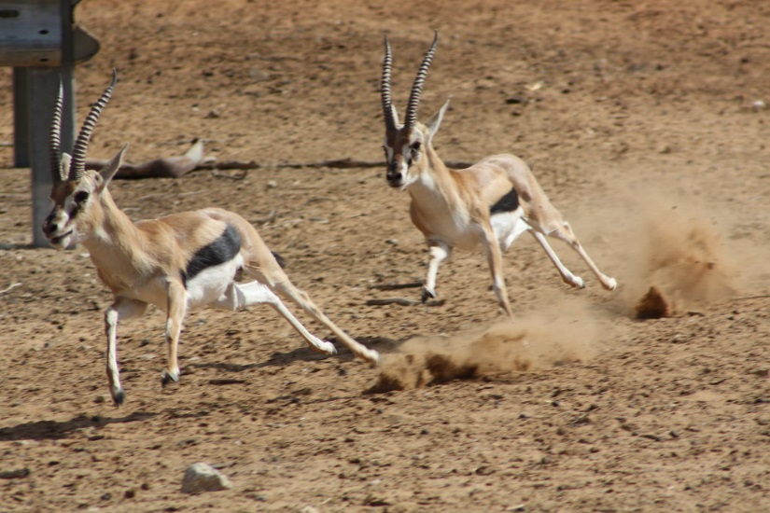
Stress 101 – Tools & Strategy
Stress and “Fight or Flight”
Cortisol = “Stress Hormone”
“Fight or Flight”
Too much can cause:
  Problems with blood sugar
  You to be tired/weak
  Weight gain
  Muscle/joint pain
  Insomnia
  Impaired immune function
  Premature aging

Slide 14
Stress 101 – Tools & Strategy
Short Term Effects of Stress
Increased heart rate
Increased blood pressure
Increased rate of breathing
Increased muscle tension
Increased perspiration
Increased metabolic activity

Slide 15
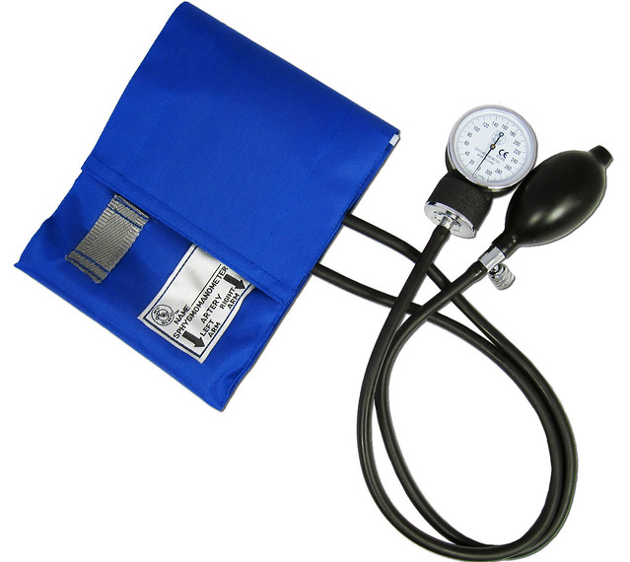
Stress 101 – Tools & Strategy
Long Term Effects of Stress
Hypertension (high blood pressure)
Chronic pain (muscle tension)
Suppressed immune system
Colds and flu
Symptoms of disease or illness
General sense of fatigue
Insomnia
Depression

Slide 16
Stress 101 – Tools & Strategy
Stress and Disease
Eighty percent of visits to primary care physicians are due to chronic stress.
The relationship between stress and disease is no longer thought to be an association, but a direct causal link.

Slide 17
Stress 101 – Tools & Strategy
Controlling the Controllable
Traffic
My attitude
My behavior
My actions
Weather
World events
Globalization
Attitudes of others
Technology
The economy

Slide 18


Stress 101 – Tools & Strategy
Emotional Control
You don’t manage the situations which may be beyond your control. You manage your reaction to them.

Slide 19
Stress 101 – Tools & Strategy
Dealing with Stress
The best stress management program addresses both the causes of stress (coping skills) and the symptoms of stress (relaxation skills) to promote optimal wellbeing.
  Coping skills: Increasing your awareness of the issue and work toward a peaceful resolution.
  Relaxation skills: Returning the body back to a sense of physiological homeostasis.

Slide 20
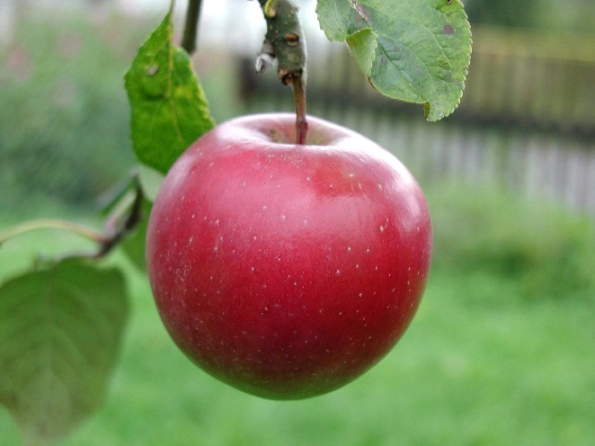
Stress 101 – Tools & Strategy
Tips for Managing Stress
Get moving! Do moderate daily exercise
Eat a well-balanced diet
Limit sugar and caffeine
Avoid tobacco, alcohol and drugs
Get at least 7 hours of sleep at night
Practice deep breathing
At the start of each day, make a list of things to do and then prioritize
Get up and move around once each hour at work
Write a daily positive affirmation on a post-it and read it to yourself at least twice a day
Make time for relaxation: listening to music, meditation or guided imagery, yoga, reading, deep breathing, ...

Slide 21
Stress 101 – Tools & Strategy
Effective Coping Skills
Reframing
Comic Relief
Time Management
Communication Skills
Information Seeking
Journaling
Hobbies
Social Support Groups

Slide 22

Stress 101 – Tools & Strategy
Effective Relaxation Techniques
Physical Exercise
Hatha Yoga
Tai Chi
Meditation (Centering)
Spiritual Practice
Diaphragmatic Breathing
Progressive Muscular Relaxation
Guided Mental Imagery
Music Therapy

Slide 23

Stress 101 – Tools & Strategy
Positive Effects of Techniques
Reduces muscle tension
Builds up body defenses
Prevents burn out
Improved concentration
Greater ability to handle problems
More efficiency in daily activities

Slide 24
Stress 101 – Tools & Strategy
Five Greatest Stress Resistors
Optimistic yet realistic outlook.
Open communication.
Focused attention to priorities.
Openness to learn and try new ways to increase effectiveness.
Healthful, balanced lifestyle.

Slide 25
Stress 101 – Tools & Strategy
Your Plan
What will you do to manage the stress in your life?

Slide 26

Stress 101 – Tools & Strategy
Questions?

