Slide 1
© 2020 Quartz Health Solutions, Inc. This PowerPoint is considered confidential and proprietary, and may only be distributed with prior written permission from the Quality Management and Population Health (QMPH) and Legal Departments at Quartz Health Solutions, Inc. The QMPH department can be reached at (866) 884-4601. Statements contained in these materials do not constitute medical advice. Individuals should consult with their doctor for healthcare questions and advice. Quartz is a management and administrative services company which provides services for Quartz Health Benefit Plans Corporation, Quartz Health Plan Corporation, Quartz Health Plan MN Corporation, and Quartz Health Insurance Corporation.

Slide 2
Menopause
MENOPAUSE WELLNESS

Slide 3
Menopause
OVERVIEW
What is menopause
What can I expect?
How long does it last
How to manage

Slide 4
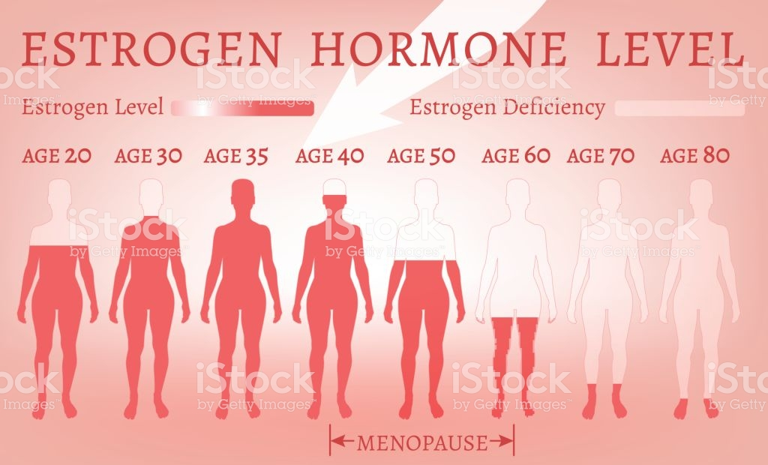
Menopause
What is Menopause?
*Periods have stopped for at least one year
*Low levels of estrogen and progesterone
*Average age is 52 in the United States (range is 45- 58)
*Can no longer get pregnant

Slide 5
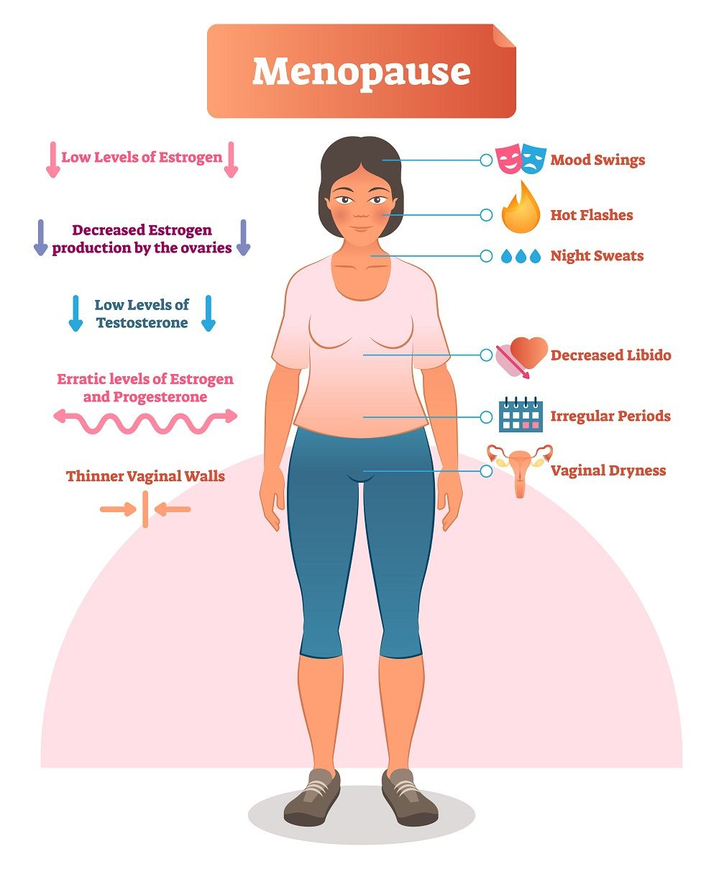
Menopause
Menopause
Hot flashes
Vaginal dryness
Moodiness
Sleep disturbances
Weight gain

Slide 6
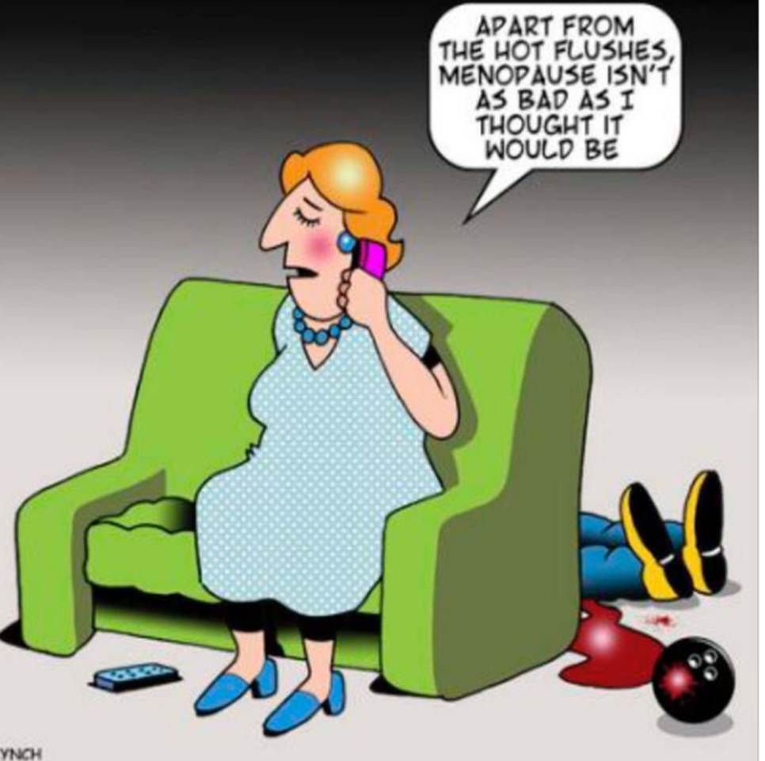
Menopause

Slide 7
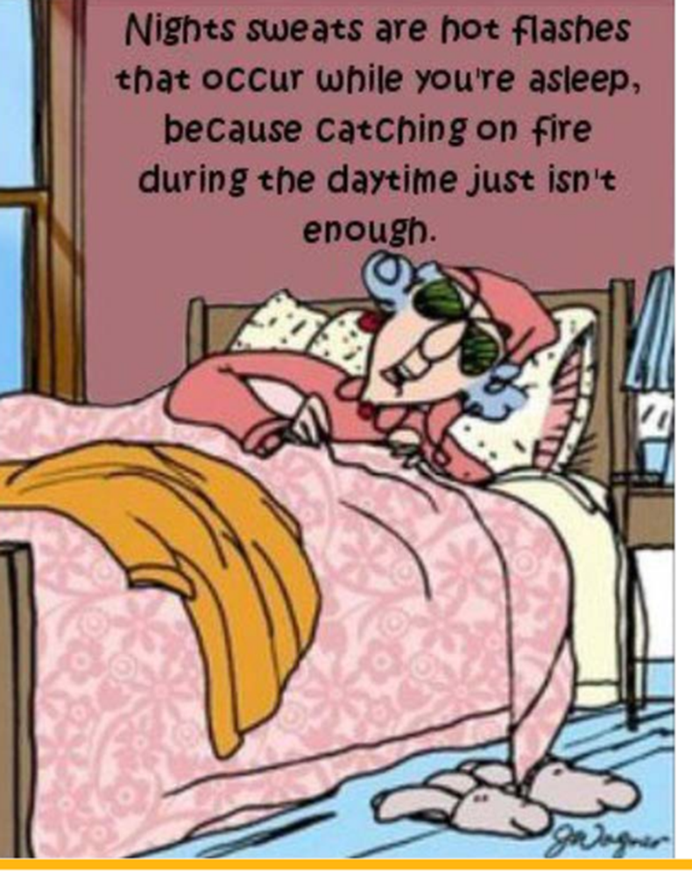
Menopause

Slide 8
Menopause
COMPLICATIONS OF MENOPAUSE
slower metabolic function
osteoporosis, or weaker bones with reduced mass and strength
mood or sudden emotional changes
painful intercourse
urinary incontinence
cataracts
heart or blood vessel disease

Slide 9
Menopause
TREATMENTS
You may need treatment if your symptoms are severe or affecting your quality of life.
There are medications to reduce the effect of hot flashes, flushing, night sweats
Other meds for vaginal dryness and hair loss

Slide 10
Menopause
OTHER WAYS TO MANAGE SYMPTOMS
Dress in loose, layered clothing
Keep your bedroom cool and avoid heavy blankets at night
Monitor your calories
Check in with your nutritional needs
Get some exercise daily

Slide 11
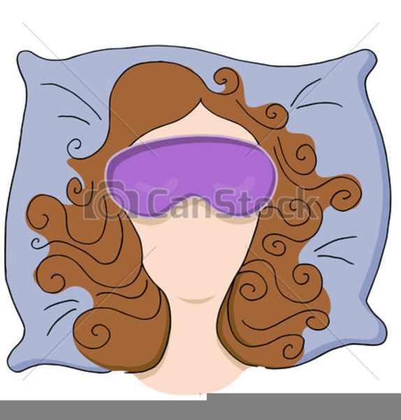
Menopause
OTHER WAYS TO MANAGE SYMPTOMS
Watch your alcohol intake
Stop smoking
Manage sleep issues
Practice relaxation techniques
Take care of your skin- use moisturizer
Stay hydrated!

Slide 12
Menopause
What else can I do to stay healthy after menopause?
Eat a balanced diet
Exercise
Annual visit with healthcare provider

Slide 13
Menopause
BE GOOD TO YOURSELF
YOU DESERVE IT!

Slide 14
Menopause
Questions?

