Slide 1
© 2020 Quartz Health Solutions, Inc. This PowerPoint is considered confidential and proprietary, and may only be distributed with prior written permission from the Quality Management and Population Health (QMPH) and Legal Departments at Quartz Health Solutions, Inc. The QMPH department can be reached at (866) 884-4601. Statements contained in these materials do not constitute medical advice. Individuals should consult with their doctor for healthcare questions and advice. Quartz is a management and administrative services company which provides services for Quartz Health Benefit Plans Corporation, Quartz Health Plan Corporation, Quartz Health Plan MN Corporation, and Quartz Health Insurance Corporation.

Slide 2
Healthy Snacks, Healthy You

Slide 3
Nutritious snacks provide the energy to thrive!

Slide 4
Healthy Snacks, Healthy You
Healthy Snacks Healthy You
How healthy snacks help you thrive
Planning creates success (Homemade snack ideas)
Pre-packaged snack – what to look for / avoid

Slide 5
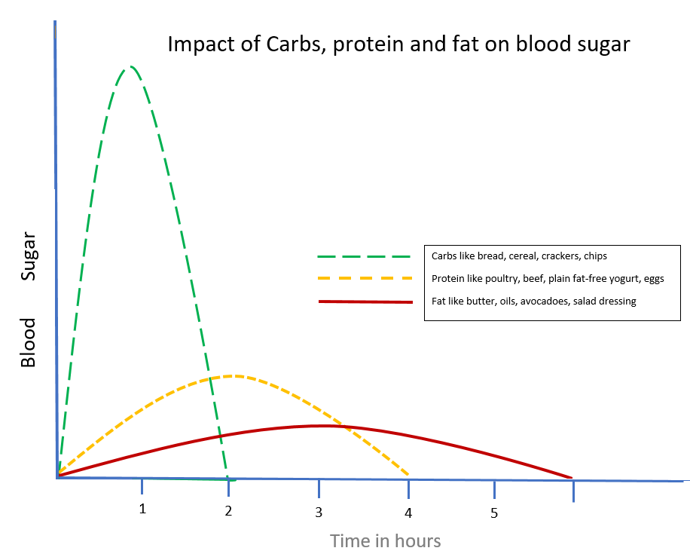
The Breakdown
Healthy Snacks Healthy You

Slide 6
Carbohydrates
Healthy Snacks Healthy You

Slide 7
Healthy Proteins
Healthy Snacks Healthy You

Slide 8
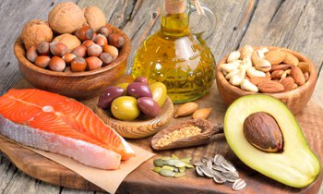
Healthy Fats
Healthy Snacks Healthy You

Slide 9
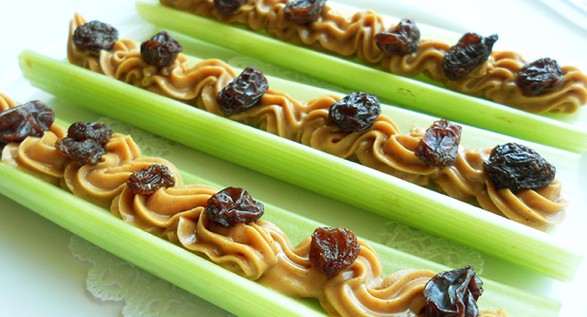
Putting It Together
Healthy Snacks Healthy You

Slide 10
Healthy Snacks Healthy You

Slide 11
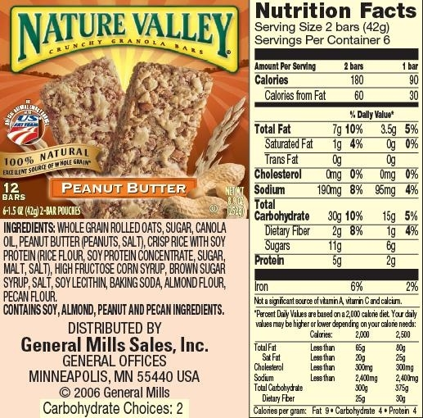
Healthy or Not?
Healthy Snacks Healthy You
Do You Know What Each of These Ingredients Are?
Notice the number of ingredients in this “healthy” snack. We’re spending more money on preservatives and name brand foods, with less valuable nutrients.

Slide 12
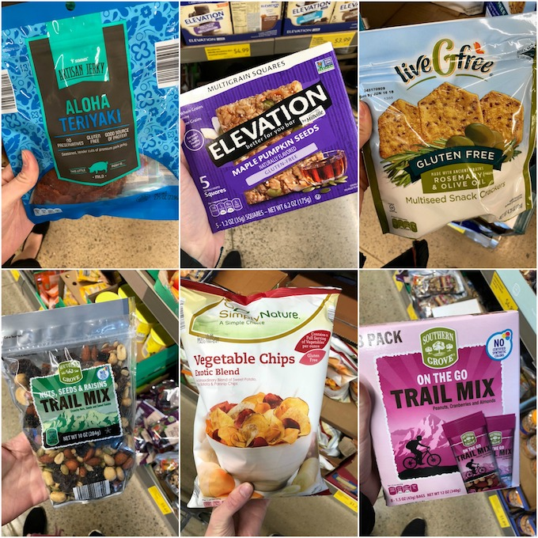
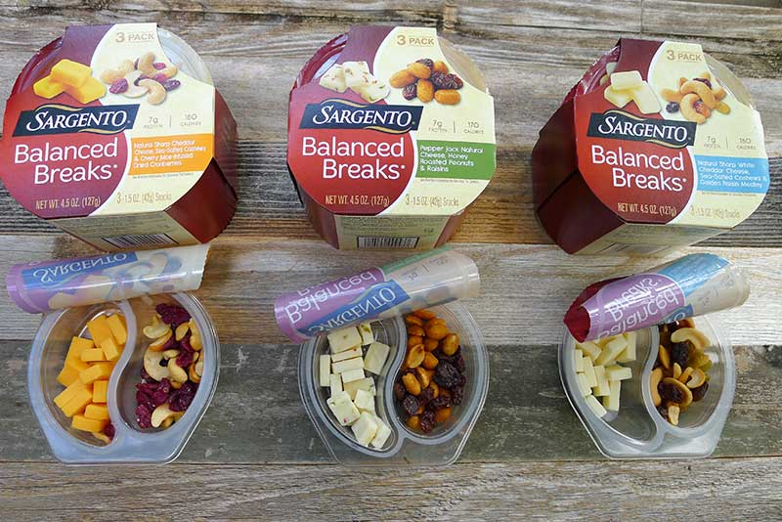
Healthy Grab & Go Snacks
Healthy Snacks Healthy You

Slide 13
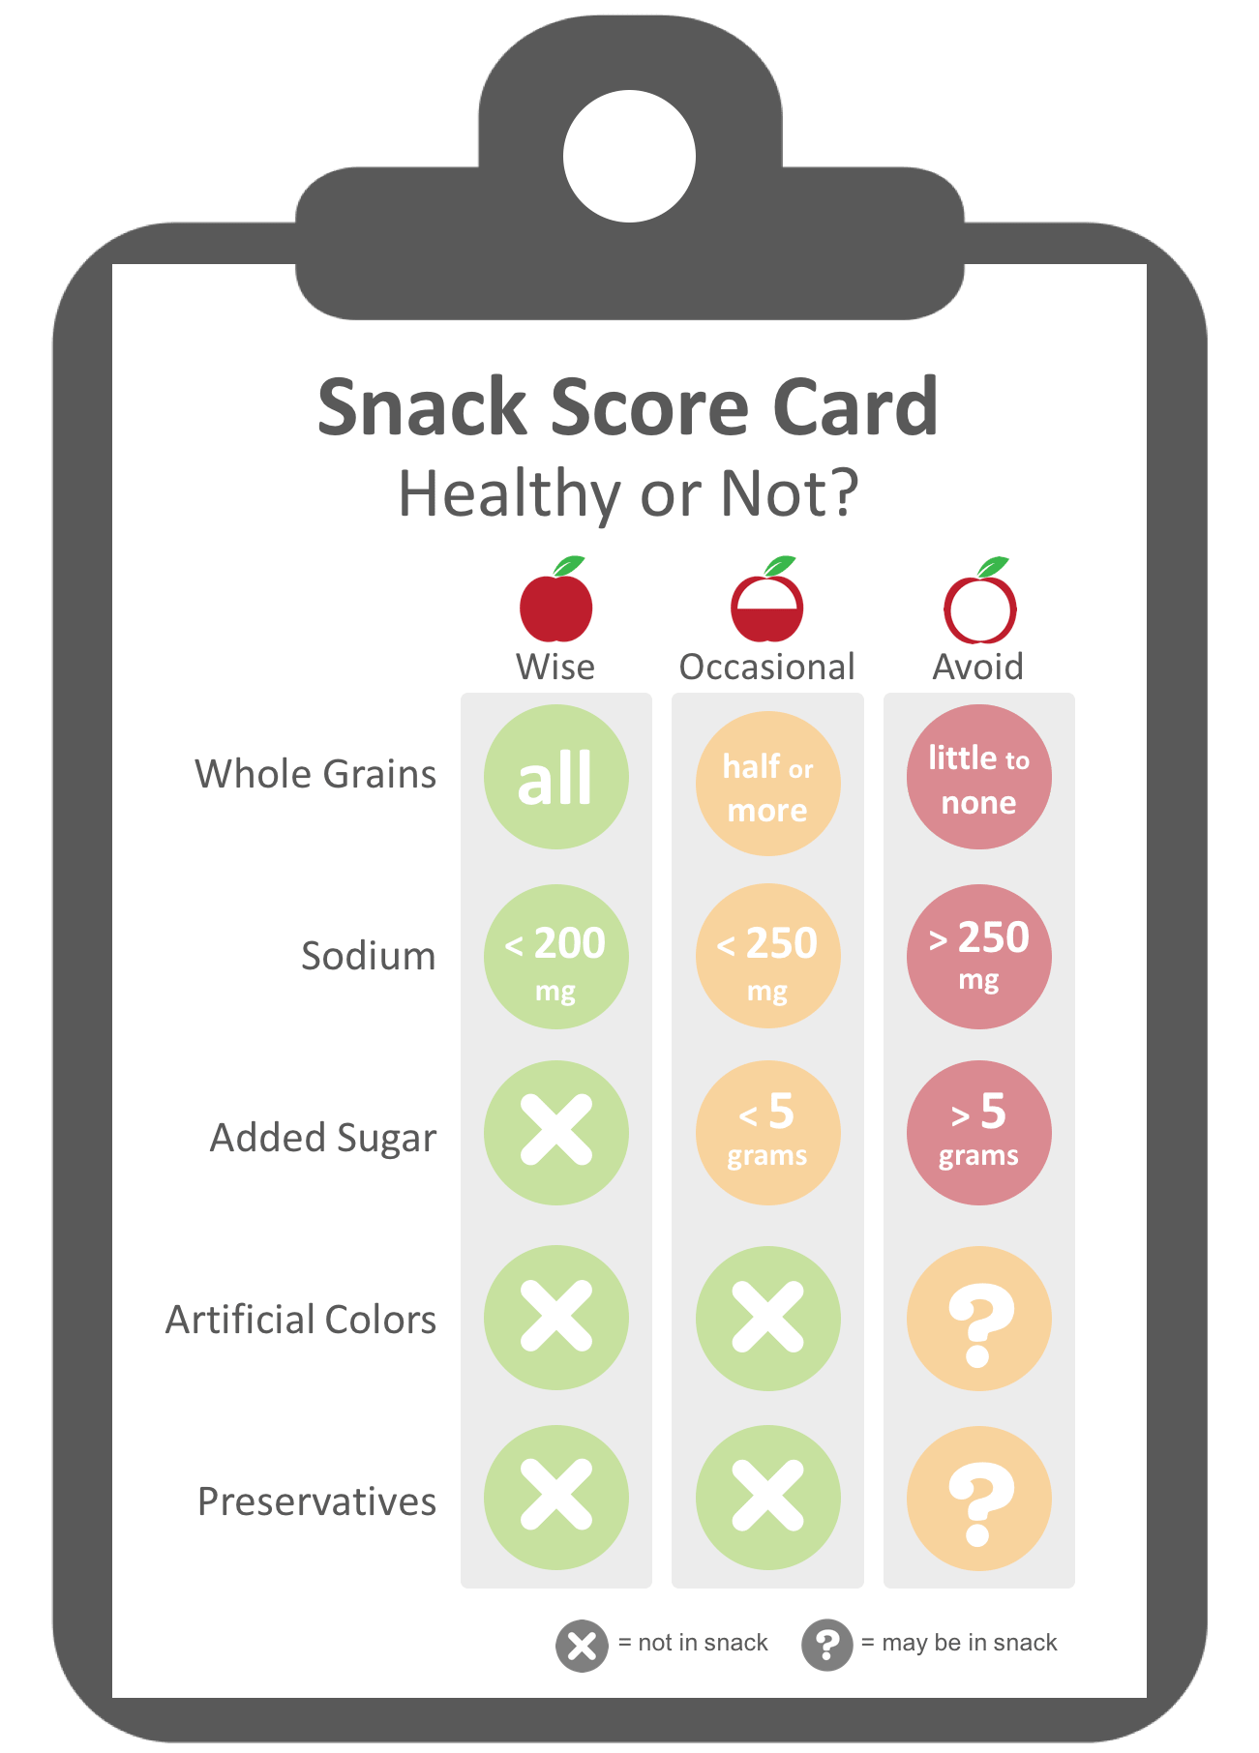
Healthy Snack Score Card
Healthy Snacks Healthy You

Slide 14
Healthy Snacks Help you Thrive!
Healthy Snacks Healthy You

Slide 15
Questions?

