Slide 1
© 2020 Quartz Health Solutions, Inc. This PowerPoint is considered confidential and proprietary, and may only be distributed with prior written permission from the Quality Management and Population Health (QMPH) and Legal Departments at Quartz Health Solutions, Inc. The QMPH department can be reached at (866) 884-4601. Statements contained in these materials do not constitute medical advice. Individuals should consult with their doctor for healthcare questions and advice. Quartz is a management and administrative services company which provides services for Quartz Health Benefit Plans Corporation, Quartz Health Plan Corporation, Quartz Health Plan MN Corporation, and Quartz Health Insurance Corporation.

Slide 2
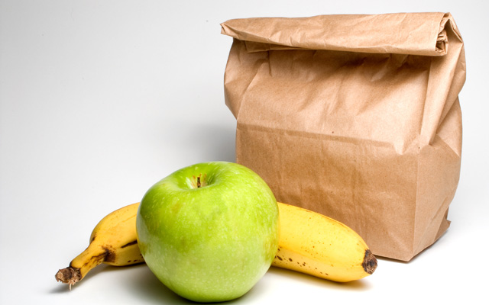
Brown Bag Basics

Slide 3
Agenda
Nutrition benefits of Brown Bag Lunch
Brown bag savings
Anatomy of a healthy lunch
Plan-overs – from dinner to lunch
Apps & tools to make it easy

Slide 4
Benefits of the Brown Bag
You are more in control of your health
Know what you’re putting into your body
Get more nutrients for less money!

Slide 5
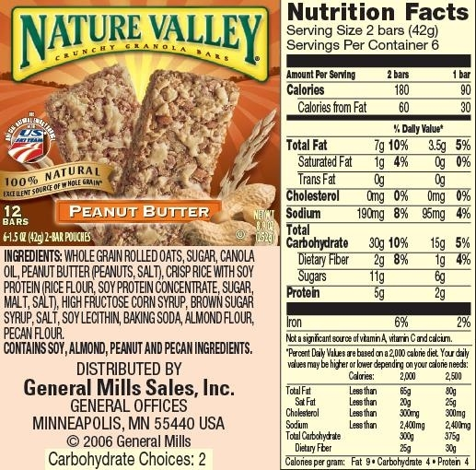
Know what you’re putting in your body
Notice the number of ingredients in this “healthy” snack. We’re spending more money on preservatives and name brand foods, with less valuable nutrients.

Slide 6
More Food, Less Ingredients
1 large cookie
950 calories
17 apples
<950 calories

Slide 7
Looks Can Be Deceiving
Big Mac, medium Fries, and a large soda (32 ounces) = 1160 calories and 44g of fat

Slide 8
Brown Bag Savings Calculator
Average Cost per brown bag lunch $3.50
Average cost of eating lunch out per work day $6.79
Number of workdays you eat out per week 5
Number of years to calculate savings 5
Interest rate you could earn if you invest the savings 10.5%
Total brown bag savings $4,277.00 per year
Total interest earned on savings $1,316.53 per year
Balance of future brown-bag savings account $5,593.53 per year

Slide 9
Brown Bag Savings Calculator
Average Cost per brown bag lunch $3.50
Average cost of eating lunch out per work day $6.79
Number of workdays you eat out per week 5
Number of years to calculate savings 5
Interest rate you could earn if you invest the savings 10.5%
Total brown bag savings $4,277.00 per year
Total interest earned on savings $1,316.53 per year
Balance of future brown-bag savings account $5,593.53 per year

Slide 10
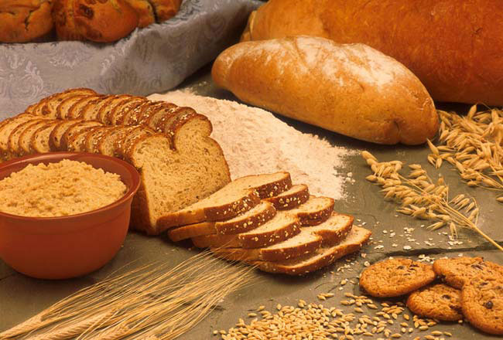
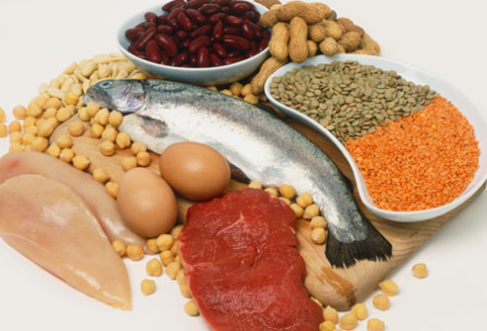
Healthy Lunch Must Haves
Complex Carbohydrates
Lean Protein
Healthy Fat

Slide 11
The Breakdown

Slide 12
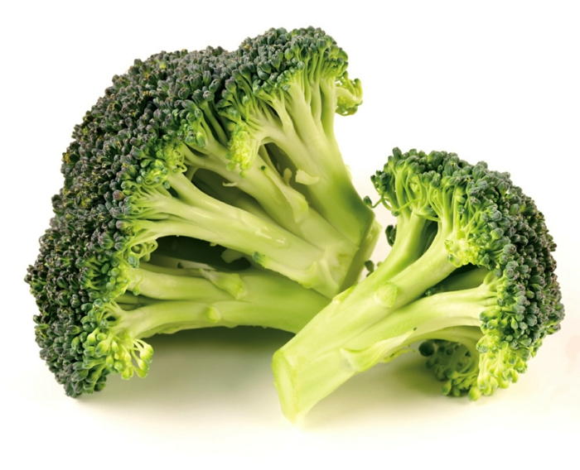
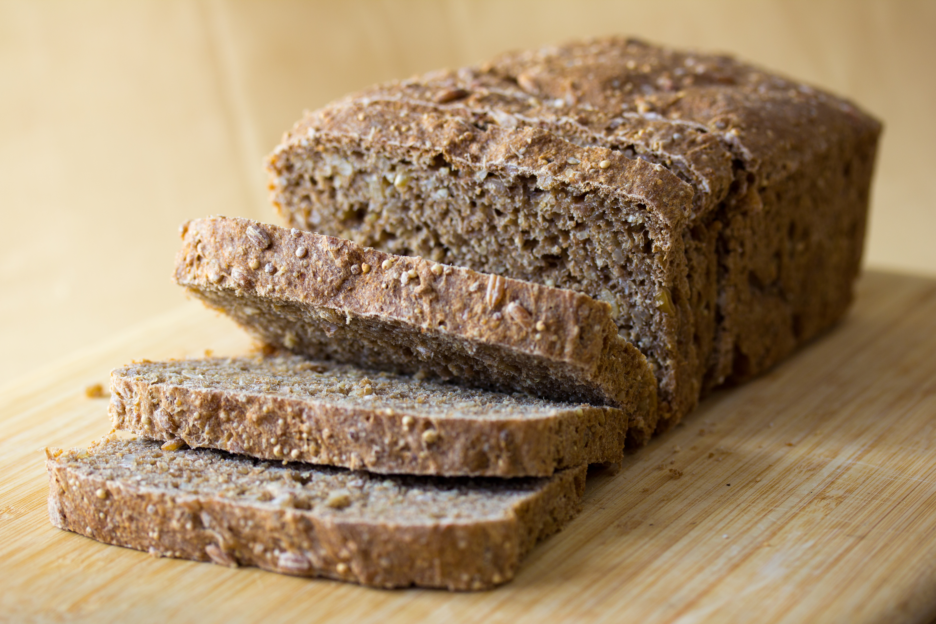
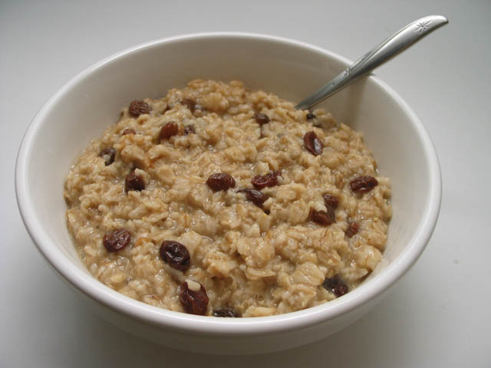
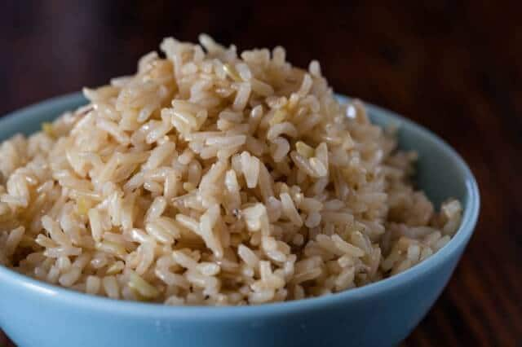
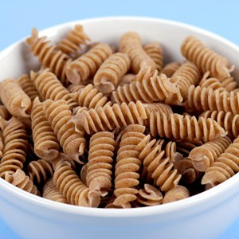
Complex Carbohydrates

Slide 13
Healthy Proteins
Fish
- Fish-offers heart-healthy omega-3 fatty acids
Poultry
- Chicken, turkey, duck and other birds
Beans/Lentils
- Beans contain more protein than any other vegetable protein.
Nuts
- One ounce (1/4 cup or palm full) of almonds gives you 6 grams
of protein
100 % Whole grains
- A slice of whole wheat bread gives you 3 grams of protein and
5 grams of fiber.

Slide 14
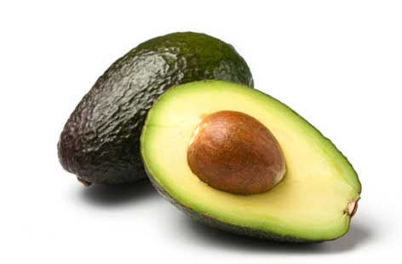
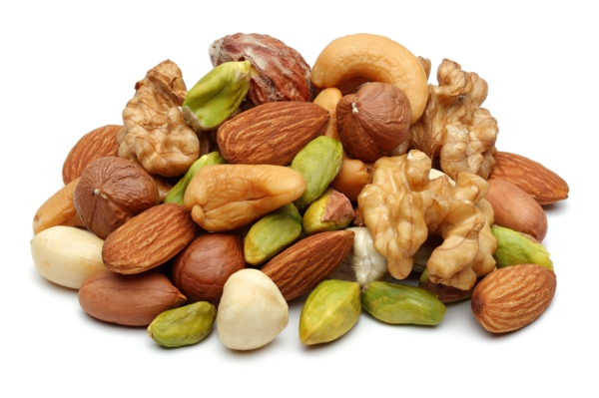
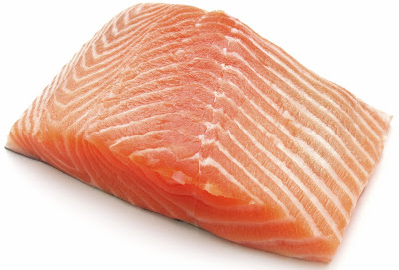
Healthy Fats

Slide 15
Use your handout to help plan your healthy lunch

Slide 16
Meal Plan Week 1
 | Sunday | Monday | Tuesday | Wednesday | Thursday | Friday | Saturday
Lunch | Tomato soup & grilled cheese sandwich | Roasted chicken salad with remainder of grilled veggies. | BBQ Chicken sandwich + veggies + fruit | Taco salad + greek yogurt | Chicken soup + large salad | Leftovers | Avacado & Tomato grilled cheese sandwiches
Dinner | Whole roasted chicken/turkey & grilled vegetables * | BBQ Chicken Pizza * & salad | Taco Tuesday + yellow corn bread, beans & rice | Homemade (Crockpot) Chicken soup * & salad | Corned Beef & Cabbage * (Crockpot) | Fish or pizza & veggie tray | Grilled Rueben sandwich + homemade coleslaw
Notes | Cut & put chicken in BBQ sauce. | Make corn bread while waiting for pizza to cook, thaw taco meat | Prep chix soup & put in crock & in frig. | Prep corned beef & place in crock. Prep ½ of cabbage for cooking. |  |  | Thaw chicken or beef for stir fry

Slide 17
Meal Plan Week 2
 | Sunday | Monday | Tuesday | Wednesday | Thursday | Friday | Saturday
Lunch | Leftovers | Stir fry | Chili | Taco salad | Ham bone soup | Pork Chop Sandwich or salad | Left overs
Dinner | Chicken/Beef stir fry with wild rice | Chili (crockpot) * + blue corn bread + toppings (cilantro & avocado) | Taco Tuesday + beans, blue Corn bread | Ham Bone Soup *(Crockpot) & salad | Pork Chops & Wild Rice & roasted veggies (sweet potato, squash,brocolli, red cabbage) | Fish or pizza & veggie tray | Hamburgers + roasted sweet potatoes
Notes | Cook meat & prep chili in crockpot, make corn bread | Thaw meat for tacos. | Prep ham bone soup in the crock. | Thaw pork chops. |  | Thaw meat for hamburgers

Slide 18
Meal Prep Apps
Mealime (Free)-You can create profiles of everyone you are cooking for, which can list likes, dislikes, general eating habits, allergies, and so on. You can also create profiles for couples, whole families, and so on to make planning a little easier. https://www.mealime.com/
Food Planner (Free)- FoodPlanner is based around recipes. It allows you to browse the web for healthy recipes and download them onto the app. It gives you the nutritional data for the meal and allows you to automatically generate a shopping list. http://www.foodplannerapp.com/
Eat This Much (Free)- Here’s a different approach- If your primary goal is to lose weight, then Eat This Much encourages you to put in your food preferences, how much money you want to spend, your schedule, and how many calories the meals will contain. It will then generate meal plans for you and provide grocery lists for the ingredients. https://www.eatthismuch.com/

Slide 19
Questions?

