Slide 1
© 2020 Quartz Health Solutions, Inc. This PowerPoint is considered confidential and proprietary, and may only be distributed with prior written permission from the Quality Management and Population Health (QMPH) and Legal Departments at Quartz Health Solutions, Inc. The QMPH department can be reached at (866) 884-4601. Statements contained in these materials do not constitute medical advice. Individuals should consult with their doctor for healthcare questions and advice. Quartz is a management and administrative services company which provides services for Quartz Health Benefit Plans Corporation, Quartz Health Plan Corporation, Quartz Health Plan MN Corporation, and Quartz Health Insurance Corporation.

Slide 2
Balance, Positivity and Mindfulness
Balance, Positivity and Mindfulness
Kimberly Hein-Beardsley, MS, LMFT, BCC, CHC
Quality Management and Population Health

Slide 3
Objectives/Agenda
Balance, Positivity and Mindfulness
Be clear on what matters – are you out of balance?
Identify energy drainers
You feel what you think – impact of your mindset
How to cultivate positivity
Mindfulness and stress relief - finding and maintaining your balance
Putting it into practice!

Slide 4
Potential Energy Drainers
Balance, Positivity and Mindfulness
Relationships (interactions with others, conflicts, etc.)
Environment (home, car, wardrobe, etc)
Body, Mind and Spirit (eating habits, exercise habits, health care, emotional needs, hobbies, spirituality, etc.)
Work (job, workload, co-workers, purpose, etc)
Money (bills, saving for the future, spending habits, etc.)

Slide 5
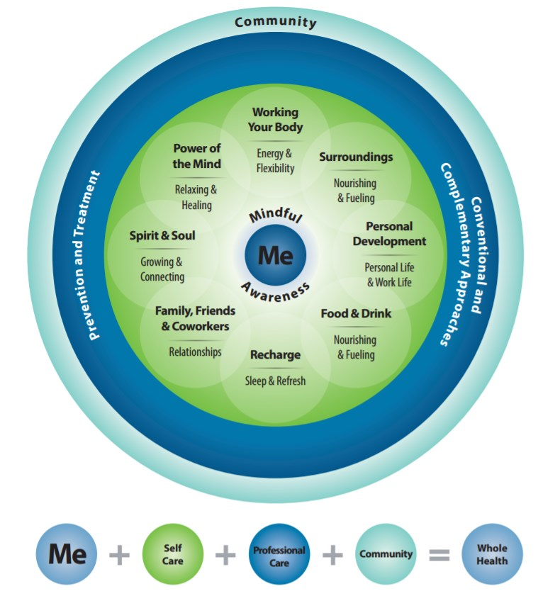
Get Clear on What Matters
Balance, Positivity and Mindfulness

Slide 6
We Feel What We Think
Balance, Positivity and Mindfulness
Is your outlook impacting your
perception of balance?
Change your mind, change your mood.

Slide 7
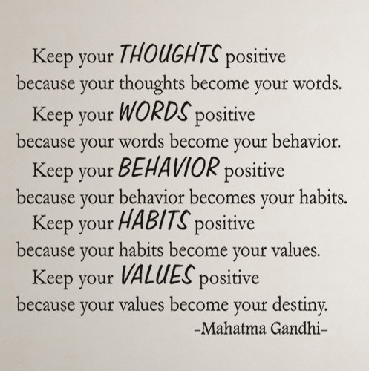
Balance, Positivity and Mindfulness

Slide 8
What is Positivity?
Balance, Positivity and Mindfulness
“The quality, state, or character of being positive.”
Digging deeper…
Positivity is a Mindset or Outlook
Sense of Optimism and Acceptance of what we can/cannot control

Slide 9
Positive vs Negative
Balance, Positivity and Mindfulness
Negative thoughts are things that make us feel down, bad, angry, scared.
Positive thoughts are comforting, reassuring, uplifting, realistic; not rose colored.

Slide 10
Impact of Positivity
Balance, Positivity and Mindfulness
75% of career successes and improvements are predicted by optimism levels, social support, and the ability to view stress as a challenge rather than an obstacle (Only 25% is predicted by IQ.)
But what does this translate to?
Increased job satisfaction
Boost to performance and energy levels
Better work-life balance
Healthier mind and body
Improved stress management
Happiness!

Slide 11
Ways to Cultivate Positivity
Balance, Positivity and Mindfulness
Practice positive self-talk
Recognize your strengths
Celebrate your successes
Comfort yourself when things go wrong (what would you say to uplift someone else?)
3 Gratitude's
Journaling
Random acts of kindness

Slide 12
Affirmations
Balance, Positivity and Mindfulness
I am a good person.
I have many wonderful qualities.
I am working hard to create the life that I want.
I am taking this too seriously and personally.
I can take risks and learn from the experience.
I can handle my own problems.
I will manage my time better today.
I will feel good things about me today.

Slide 13
Meditation and Balance
Balance, Positivity and Mindfulness
Helps with relaxation.
Allows you to think more clearly.
Improves focus.
Provides greater sense of peace.
Great for brain health!

Slide 14
Mindfulness
Balance, Positivity and Mindfulness
Mindfulness means paying attention in a particular way; on purpose, in the present moment, and without judgment.
- Jon Kabat-Zinn, founder of the Mindfulness-Based Stress Reduction (MBSD) program

Slide 15
Mindfulness
Balance, Positivity and Mindfulness
Practicing mindfulness on a daily basis, by focusing on what you are doing in the moment, is a way to train your attention. In addition, it can help you feel more balanced and able to handle stress.
Start by doing just 5 minutes each day, and gradually increase the amount of time as you feel comfortable.

Slide 16
Stress Relief
Balance, Positivity and Mindfulness
Relaxation/Stress Reduction Techniques
Physical Exercise
Yoga
Tai Chi
Meditation (Centering, Mindfulness)
Diaphragmatic Breathing
Progressive Muscle Relaxation
Guided Imagery
Massage and Aromatherapy
Music

Slide 17
Putting it into Practice!
Balance, Positivity and Mindfulness
Identify Goals and Action Steps
What are you going to do today?

Slide 18
Questions?

