Slide 1
© 2020 Quartz Health Solutions, Inc. This PowerPoint is considered confidential and proprietary, and may only be distributed with prior written permission from the Quality Management and Population Health (QMPH) and Legal Departments at Quartz Health Solutions, Inc. The QMPH department can be reached at (866) 884-4601. Statements contained in these materials do not constitute medical advice. Individuals should consult with their doctor for healthcare questions and advice. Quartz is a management and administrative services company which provides services for Quartz Health Benefit Plans Corporation, Quartz Health Plan Corporation, Quartz Health Plan MN Corporation, and Quartz Health Insurance Corporation.

Slide 2
Anxiety, Panic and Stress: Change the Way You Feel by Changing the Way You Think
Anxiety, Panic and Stress
Kimberly Hein-Beardsley, MS, LMFT, BCC, CHC
Quality Management & Population Health

Slide 3
Objective
Anxiety, Panic and Stress
What is the difference between stress, anxiety and panic
Overview of common symptoms of anxiety and panic attacks
Causes and strategies for lessening anxiety
Tips for managing stress

Slide 4
Comparison of Stress, Anxiety and Panic
Anxiety, Panic and Stress
Stress is the “perceived” threat to one’s mind, body, spirit or emotions
Anxiety and panic attacks have many shared symptoms, yet:
Anxiety is generally caused by excessive worry or anticipation about a stressor
A panic attack is intense and often comes on out of nowhere without an obvious trigger

Slide 5
Symptoms of Anxiety and Panic
Anxiety, Panic and Stress
Racing heart/chest discomfort
Trembling
Nausea
Dizziness
Muscle tension
Hot or cold flashes
Sweating
Choking sensation
Feelings of unreality or disorientation
Numbness or tingling sensations
Shallow, rapid breathing/shortness of breath

Slide 6
Common Fears
Anxiety, Panic and Stress
Dying
Going insane
Having a heart attack
Fainting
Losing their breath
Losing control
Embarrassing themselves
Choking

Slide 7
Fight or Flight
Anxiety, Panic and Stress
The body releases high levels of adrenaline and hormones, such as cortisol
May cause your heart to beat faster, blood pressure to rise, and breathing to be faster or more shallow.
Purpose is to prepare the body to either fight the threat or flee
Useful when confronting a real, physical threat (i.e. burning building), but not appropriate for non-physical threats (i.e. public speaking).

Slide 8
How to Survive a Panic Attack
Anxiety, Panic and Stress
Recognize that you are feeling anxious
Give yourself permission to feel anxious – float with it, don’t fight it
Breathe – 2-4 breathing
Use positive self-talk statements
Get busy and distract yourself, burn off nervous energy
Try to find out what is really bothering you

Slide 9
Causes - Medical vs Within My Control
Anxiety, Panic and Stress

Slide 10
Causes - Medical Conditions
Anxiety, Panic and Stress
Cardiovascular problems
Asthma
Seizure disorder
Diabetes
Hypoglycemia
Hyperthyroidism or Hypothyroidism
Problems with inner ear
Certain medications
Legal or illegal drug use

Slide 11
Causes - My Tendencies
Anxiety, Panic and Stress
Being a perfectionist
Inner nervousness
Tendency to over-react
Low self-esteem
Extremely sensitive to criticism
High expectations
Obsessive thinking
Need to appear in control
Tendency to worry about health

Slide 12
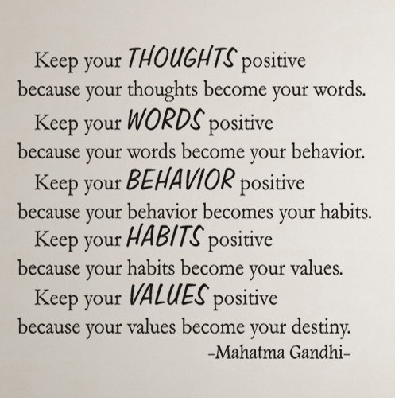
Anxiety, Panic and Stress

Slide 13
Positive vs Negative Self-Talk
Anxiety, Panic and Stress
Negative thoughts are things that make us feel down, bad, angry, scared.
Positive thoughts are comforting, reassuring, uplifting, realistic; not rose colored.

Slide 14
Self-Talk and Negative Thinking
Anxiety, Panic and Stress
Negative thinking is a bad habit that contributes to anxiety
To change our thinking we can:
Catch ourselves having a negative thought
Challenge the validity of that negative thought
Replace it with something positive

Slide 15
Expectations
Anxiety, Panic and Stress
When expectations are too high they create much of our anxiety

Slide 16
Controlling the Controllable
Anxiety, Panic and Stress
Traffic
Weather
My attitude
My behavior
My actions
World events
Globalization
Attitudes of others
Technology
The economy

Slide 17
Anxiety, Panic and Stress
“I’m an old man now, and I have known a great many problems in my life… most of which never happened.” — Mark Twain

Slide 18
Anxiety, Panic and Stress
“What-If” Thinking
Much of what we worry about never comes true
We are anticipating what might happen
Our fears of the situation are often much worse than the situation itself
Try anticipating in a positive way, with a positive outcome, or say, “So, what if…”

Slide 19
Tips for Managing Stress
Anxiety, Panic and Stress
Get moving! Do moderate daily exercise
Eat a well-balanced diet
Limit sugar and caffeine
Avoid tobacco, alcohol and drugs
Get at least 7 hours of sleep at night
Practice deep breathing
At the start of each day, make a list of things to do and then prioritize
Get up and move around once each hour at work
Write a daily positive affirmation on a post-it and read it to yourself at least twice a day
Make time for relaxation: listening to music, meditation or guided imagery, yoga, reading, deep breathing, ...

Slide 20
Anxiety, Panic and Stress
Effective Relaxation Techniques
Physical Exercise
Hatha Yoga
Tai Chi
Meditation (Centering)
Spiritual Practice
Diaphragmatic Breathing
Progressive Muscular Relaxation
Guided Mental Imagery
Music Therapy

Slide 21
Anxiety, Panic and Stress
Resources and References
Anxiety Disorders Association of America, www.adaa.org

Slide 22
Questions?

