Slide 1
© 2020 Quartz Health Solutions, Inc. This PowerPoint is considered confidential and proprietary, and may only be distributed with prior written permission from the Quality Management and Population Health (QMPH) and Legal Departments at Quartz Health Solutions, Inc. The QMPH department can be reached at (866) 884-4601. Statements contained in these materials do not constitute medical advice. Individuals should consult with their doctor for healthcare questions and advice. Quartz is a management and administrative services company which provides services for Quartz Health Benefit Plans Corporation, Quartz Health Plan Corporation, Quartz Health Plan MN Corporation, and Quartz Health Insurance Corporation.

Slide 2

Winter Blues
Beating the Winter Blues
Kimberly Hein-Beardsley, MS, LMFT, BCC, CHC
Quality Management & Population Health

Slide 3
Winter Blues
“Throughout the centuries, poets have described a sense of sadness, loss and lethargy which can accompany the shortening days of fall and winter… Many of us notice tiredness, a bit of weight gain, difficulty getting out of bed and bouts of “the blues” as fall turns into winter.”
Carol E. Watkins, MD
Northern County Psychiatric Associates, 2004

Slide 4
Winter Blues
Objectives
Comparison of winter blues and seasonal affective disorder (SAD)
Overview of treatment for SAD
Activities to Improve Your Spirits

Slide 5
Winter Blues
What changes do you notice in your mood this time of year?

Slide 6
Winter Blues
Winter Blues or SAD?
The Winter Blues have milder symptoms, which may include a feeling of gloominess, tiredness, and some weight gain
Seasonal Affective Disorder (SAD) is a specific type of depression that is more severe, and can be more debilitating, than the Winter Blues. SAD is diagnosed by a trained professional
The most common type of SAD is called winter depression, which often begins in the fall and can last until spring

Slide 7
Winter Blues
Facts about SAD
SAD is the result of a biochemical imbalance in the brain due to shorter daylight hours and lack of sunlight in the winter months, which seems to throw off a person’s circadian rhythms (internal body clock)
Becomes more common the farther people live north or south of the equator
Exact numbers for individuals with SAD is unknown, but estimated to be as many as half a million people in the United States

Slide 8
Winter Blues
Symptoms of SAD
Fatigue
Increased Sleep
Lack of interest in normal activities
Social withdrawal
Craving foods high in carbohydrates
Increased appetite
Weight gain
Irritability

Slide 9
Winter Blues
2 Question Depression Screening
Over the past two weeks have you ever felt down, depressed, or hopeless?
Have you felt little interest or pleasure in doing things?

Slide 10
Winter Blues
Treatment for SAD
Diagnosed by a trained professional, treatment for SAD may include:
Light Therapy
Medications
Counseling

Slide 11
Winter Blues
Treatment for SAD – Light Therapy
Light is a natural mood elevator
Exposure to light has been reduced due to:
  Spending more time indoors, working and playing; working the night shift
  Traveling by car, plane or train vs. walking or riding in the open air
  Small or few windows in office or factory buildings
  Sunglasses or contact lenses which block near-UV light

Slide 12
Winter Blues
Treatment for SAD – Light Therapy
Light Therapy
  Increased exposure to sunlight
    Spend at least a half hour a day outside, even on cloudy days
    Supplement your sources of artificial light with full-spectrum fixtures
  Light Box – special bright fluorescent lamp (10,000-lux)
  Therapy begins with daily sessions of 10-15 minutes, which are gradually increased to 30-90 minutes each day during winter months (needs to be done regularly)
  Many health care practitioners propose starting light therapy in the fall

Slide 13
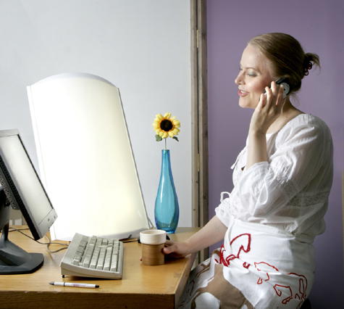

Winter Blues

Slide 14
Winter Blues
Treatment for SAD - Medications
Antidepressant Medications
  It may take two to six weeks before you feel better
  Antidepressants may cause side effects in some people. Usually, side effects will go away in a few weeks
  Do not stop taking your medication or change the dose unless your doctor or nurse tells you to
  Be sure to report to your doctor or nurse whether or not you feel better

Slide 15
Winter Blues
Treatment for SAD - Counseling
Psychotherapy
  Cognitive behavioral therapy (CBT)
    Mood is related to thoughts.
    CBT can help identify and change the thought and behavior patterns that contribute to depression
      Replacing negative thinking
  Interpersonal therapy
    looks at how depression can be connected to and have an impact on relationships. Like cognitive-behavioral therapy, interpersonal therapy has been proven to work well with depression

Slide 16
Winter Blues
Activities to Improve Your Spirits
Get moving! Do moderate daily exercise
Eat a well-balanced diet
Limit sugar and caffeine
Avoid tobacco, alcohol and drugs
Get at least 7 hours of sleep at night
Practice deep breathing
Surround yourself with positive people
Keep a realistic and optimistic attitude
Take time each day to do something you enjoy
Make time for relaxation: listening to music, meditation or guided imagery, yoga, reading, deep breathing, ...

Slide 17
Winter Blues
Activities to Improve Your Spirits
Read novels or magazines
Watch a favorite TV program or go to a movie
Learn a new craft or hobby
Have lunch with friends
Be with animals
Sing in a group
Cook something you enjoy
Visit a museum
Help out others
Play a musical instrument
Have fun!

Slide 18

Winter Blues
Questions?

