Slide 1
© 2020 Quartz Health Solutions, Inc. This PowerPoint is considered confidential and proprietary, and may only be distributed with prior written permission from the Quality Management and Population Health (QMPH) and Legal Departments at Quartz Health Solutions, Inc. The QMPH department can be reached at (866) 884-4601. Statements contained in these materials do not constitute medical advice. Individuals should consult with their doctor for healthcare questions and advice. Quartz is a management and administrative services company which provides services for Quartz Health Benefit Plans Corporation, Quartz Health Plan Corporation, Quartz Health Plan MN Corporation, and Quartz Health Insurance Corporation.

Slide 2
Ready, Set, Stretch

Slide 3



What Activities Do You Enjoy?

Slide 4

Workplace Athlete

Slide 5

Stretch for Health
Stretching is the best way to maintain flexibility & prevent injuries.
Flexibility is the foundation of your physical health and vitality!

Slide 6
Why Stretch?
Improves energy level
Reduces stiffness and pain
Helps reduce stress and muscle tension
May reduce your chance of injury and improves recovery
Improves posture
Improves coordination
Keeps muscles flexible, strong and healthy

Slide 7
Stretching Tips
Check Body Alignment
Warm-up muscles before stretching
Hold a stretch for 15 to 30 seconds
Only stretch to the point of mild discomfort
Breathe normally when stretching

Slide 8
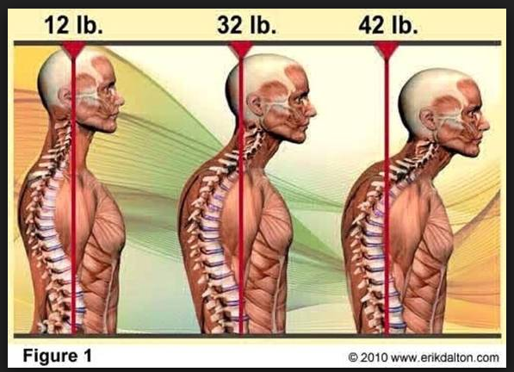
Posture Check & Practice

Slide 9
Let’s Stretch!
Shoulder Raise & Press Down
Shoulder rolls
Ear to Shoulder
Chin Retraction
Single Arm Cross

Slide 10
Let’s Stretch!
Thumbs Rotated With Lat Pull Down
Arched Back Stretch
Reach for the Sky
Hip Stretch (seated)

Slide 11
Let’s Stretch!
Prayer Stretch
Wrist Flexion
Finger Grip & Release
Pinching
Wrist Curls
Wrist Reverse Curls
Forearm Roll
Hammer Exercise

Slide 12
Make It Your Own Workout
Which exercises?
Where?
When?

Slide 13
Stretch for Your Health

