Slide 1
© 2020 Quartz Health Solutions, Inc. This PowerPoint is considered confidential and proprietary, and may only be distributed with prior written permission from the Quality Management and Population Health (QMPH) and Legal Departments at Quartz Health Solutions, Inc. The QMPH department can be reached at (866) 884-4601. Statements contained in these materials do not constitute medical advice. Individuals should consult with their doctor for healthcare questions and advice. Quartz is a management and administrative services company which provides services for Quartz Health Benefit Plans Corporation, Quartz Health Plan Corporation, Quartz Health Plan MN Corporation, and Quartz Health Insurance Corporation.

Slide 2
Portion Distortion

Slide 3
Serving vs Portion Size
Serving - is a standard amount to advise about how much to eat or to tell how many calories and nutrients are in a food.
Portion - is the amount of a food you choose to eat at any one time—which may be more or less than a serving.
Notes:
Source: UW Health.org/Health Facts

Slide 4
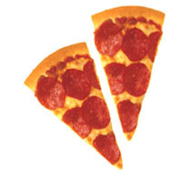
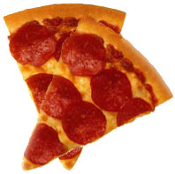
Pizza
20 Years Ago
Today
460 Calories
920 Calories
US Department of Health and Human Services and National Institutes of Health

Slide 5
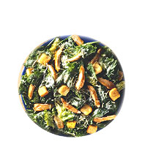
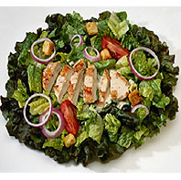
Chicken Caesar Salad
20 Years Ago
Today
390 Calories
790 Calories
US Department of Health and Human Services and National Institutes of Health

Slide 6

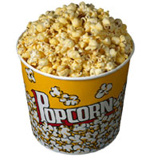
Popcorn
20 Years Ago
Today
270 Calories
1280 Calories
Add another 120 per tablespoon of melted butter
US Department of Health and Human Services and National Institutes of Health

Slide 7
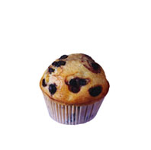
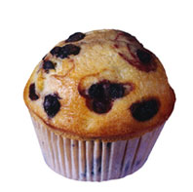
Muffins
20 Years Ago
Today
210 Calories
480 Calories
US Department of Health and Human Services and National Institutes of Health

Slide 8
Obesity Trends* Among U.S. Adults
BRFSS, 1990, 2000, 2010
(*BMI ≥30, or about 30 lbs. overweight for 5’4” person)
1990
2000
2010
No Data <10% 10%–14% 15%–19% 20%–24% 25%–29% ≥30%
Centers for Disease Control and Prevention

Slide 9
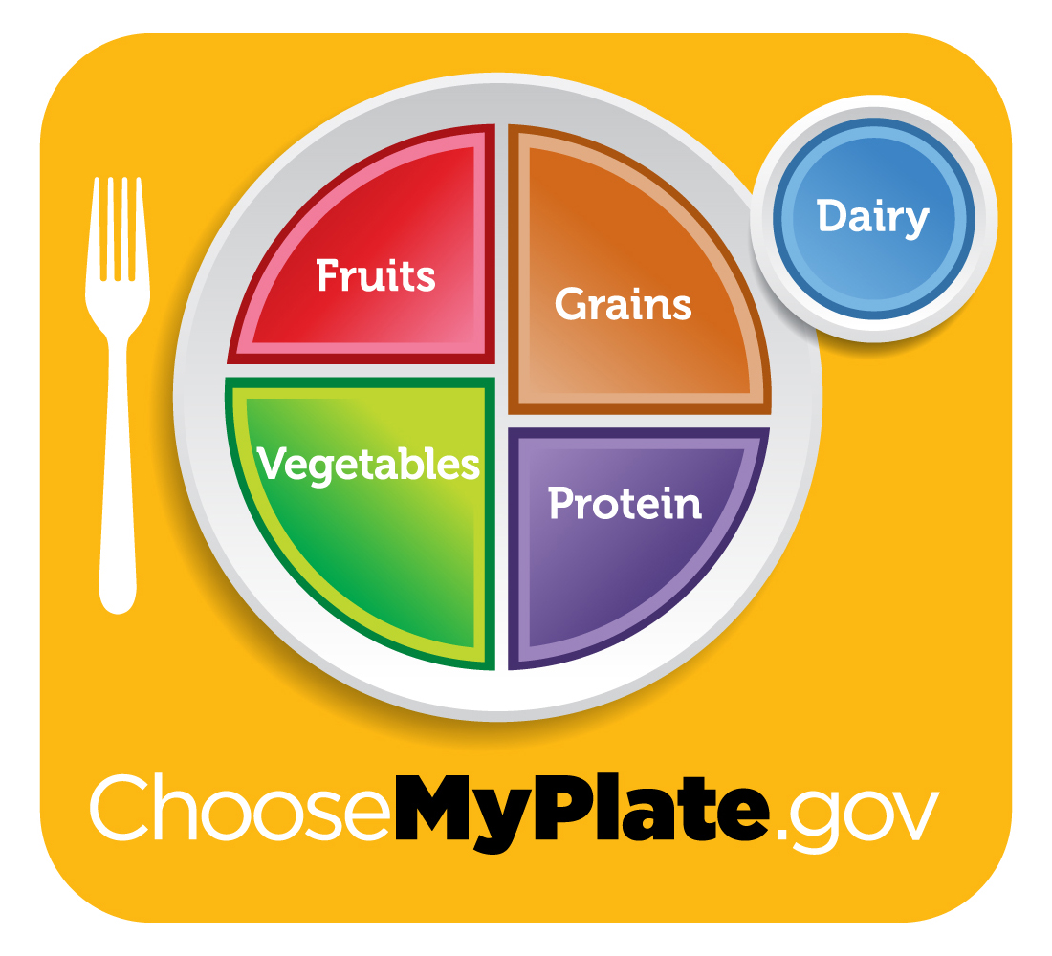
Meal Recommendation
1 cup of Dairy
½ Fruits and Vegetables
¼ Grain
¼ Lean Protein
Note the recommended plate size is 9 inches, and these portions are intended for the average person who exercises less than 30 min/day.
2010 Dietary Guidelines

Slide 10
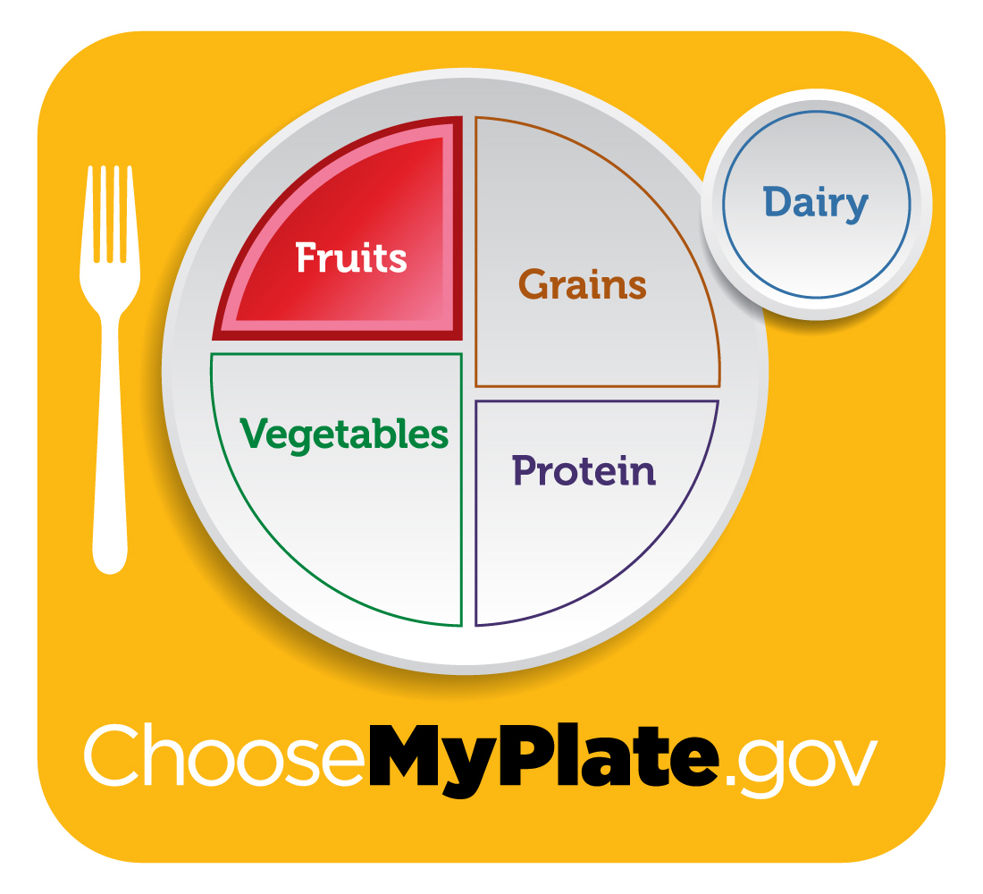
Fruits
Daily Recommendation
Women | 19-30 yrs old 31-50 yrs old 51+ yrs old | 2 cups 1 ½ cups 1 ½ cups
Men | 19-30 yrs old 31-50 yrs old 51+ yrs old | 2 cups 2 cups 2 cups
These recommendations are based on the average adult performing less than 30 min of physical activity/day. 2010 Dietary Guidelines

Slide 11
Fruits
What counts as a cup serving?
Apple: 1 small or ½ large
Grapes: 1 cup whole or cut, 32 seedless
Grapefruit: 1 medium
Orange: 1 large
Dried fruit: ½ cup
100% Fruit juice: 1 cup
Watermelon: 1 small wedge
Pear: 1 medium
Banana: 1 large (8-9 in)
Strawberries: ~8 berries, 1 cup whole or sliced

Slide 12
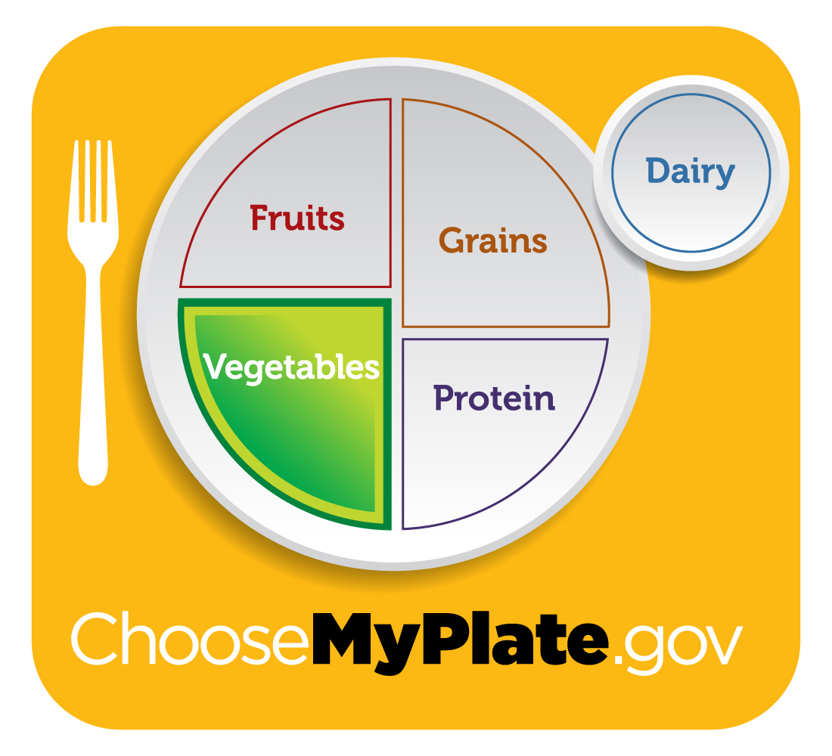
Vegetables
Daily Recommendation
Women | 19-30 yrs old 31-50 yrs old 51+ yrs old | 2 ½ cups 2 ½ cups 2 cups
Men | 19-30 yrs old 31-50 yrs old 51+ yrs old | 3 cups 3 cups 2 ½ cups
These recommendations are based on the average adult performing less than 30 min of physical activity/day. 2010 Dietary Guidelines

Slide 13
Vegetables
What counts as a cup serving?
Greens (kale, spinach, collards): 2 cups raw or 1 cup cooked
Raw leafy greens (lettuce, romaine, spinach): 2 cups raw
Broccoli and cauliflower: 1 cup chopped or florets
Carrots: 1 cup chopped, 2 medium or 12 baby carrots
Corn: 1 cup or 1 large ear (8-9 in)
Cucumbers: 1 cup chopped or sliced
Bell peppers: 1 cup chopped or 1 large (3 in diameter, 3 ¾ long)
Dry beans and peas: 1 cup whole or mashed, cooked

Slide 14
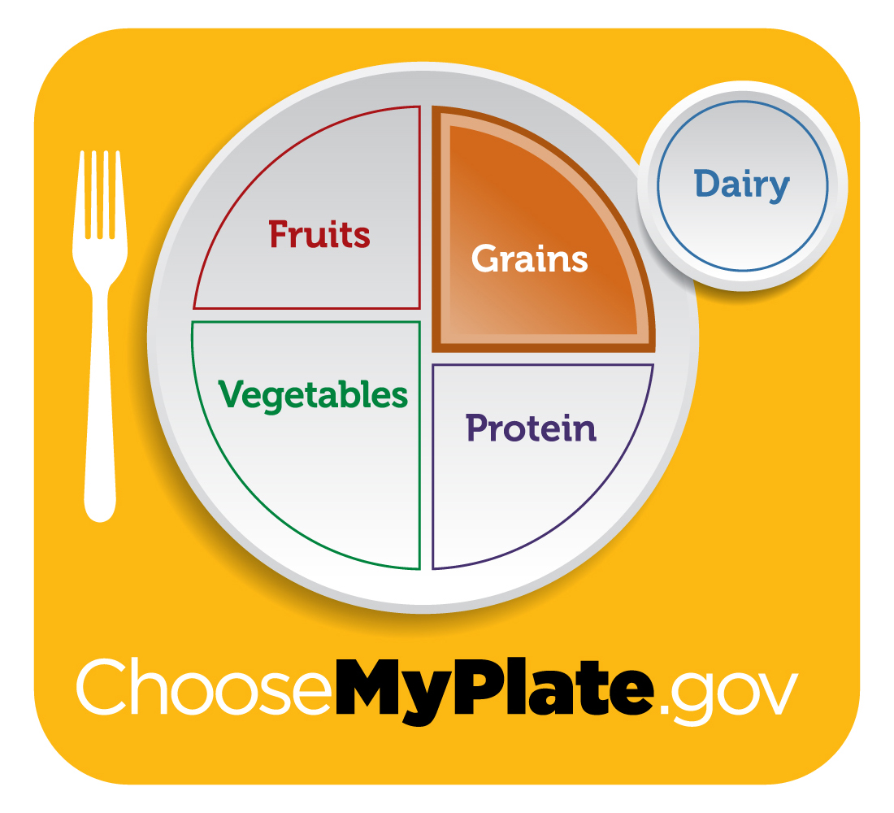
Grains
Daily Recommendation
Women | 19-30 yrs old 31-50 yrs old 51+ yrs old | 6 oz 6 oz 5 oz
Men | 19-30 yrs old 31-50 yrs old 51+ yrs old | 8 oz 7 oz 6 oz
These recommendations are based on the average adult performing less than 30 min of physical activity/day. 2010 Dietary Guidelines

Slide 15
Grains
What counts as an ounce serving?
Breads: 1 regular slice, 1 small slice French
English muffins, ½ muffin
Muffins: 1 small (2 ½ in diameter) Oatmeal: ½ cup cooked, 1/3 cup dry
Popcorn: 3 cups popped
Pancakes: 1 large (4 ½ in diameter) or 2 small (3 in diameter)
Rice: ½ cup cooked or 1 oz dry
Pasta: ½ cup cooked or 1 oz dry
Tortillas: 1 small flour or corn (6 in diameter)
Notes:
*WG = whole grains = 100% whole wheat
* RG = refined grains =wheat, white, sourdough, French

Slide 16
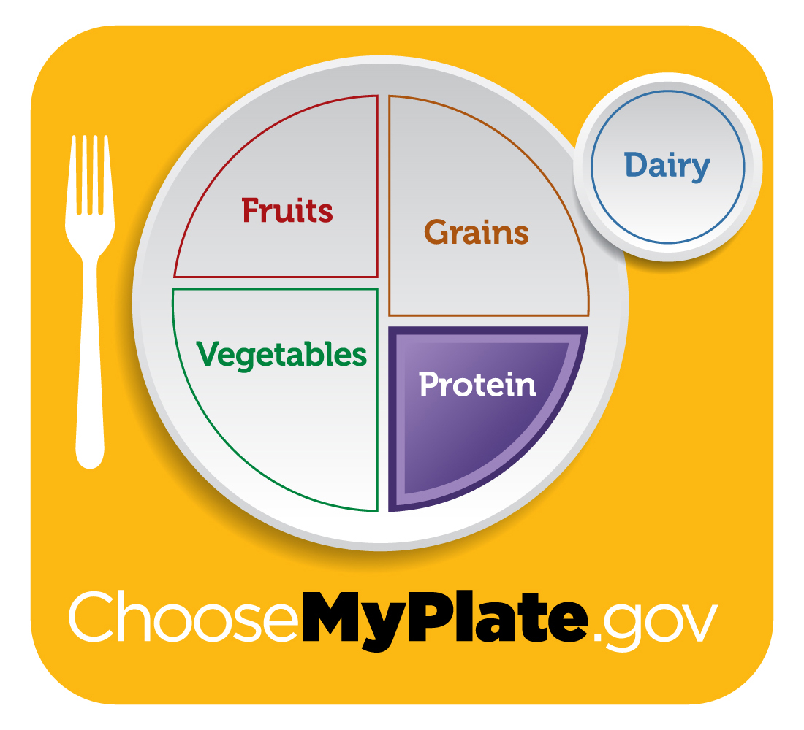
Protein
Daily Recommendation
Women | 19-30 yrs old 31-50 yrs old 51+ yrs old | 5 ½ oz 5 oz 5 oz
Men | 19-30 yrs old 31-50 yrs old 51+ yrs old | 6 ½ oz 6 oz 5 ½ oz
These recommendations are based on the average adult performing less than 30 min of physical activity/day. 2010 Dietary Guidelines

Slide 17
Protein
What counts as an ounce serving?
1 oz of cooked lean beef, pork, chicken, turkey, fish or shell fish
1 large egg
12 almonds
24 pistachios
7 walnut halves
1 Tbs peanut butter or almond butter
¼ cup cooked beans (black, kidney, pinto), peas (chickpeas, lentils, split peas)
1 oz tempeh, cooked
¼ cup roasted soybeans
2 Tbs hummus
¼ cup of tofu

Slide 18
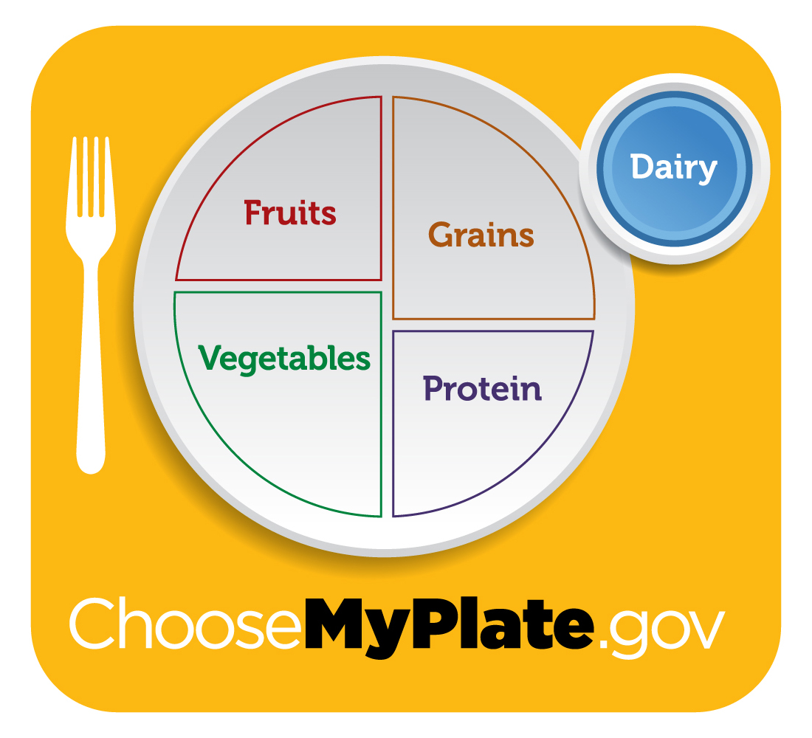
Dairy
Daily Recommendation
Women | 19-30 yrs old 31-50 yrs old 51+ yrs old | 3 cups 3 cups 3 cups
Men | 19-30 yrs old 31-50 yrs old 51+ yrs old | 3 cups 3 cups 3 cups
These recommendations are based on the average adult performing less than 30 min of physical activity/day. 2010 Dietary Guidelines

Slide 19
Dairy
What counts as a cup serving?
Choose low-fat options
1 cup of milk
1 cup calcium-fortified soymilk
1 cup / 8 oz container of yogurt
1 ½ oz hard cheese (cheddar, mozzarella, Swiss and parmesan)
2 cups cottage cheese
1 cup pudding made with milk
1 cup frozen yogurt
1 ½ cups ice cream
1/3 cup shredded cheese
Notes:
2 cups cottage cheese½ cup cottage cheese is equivalent to ¼ cup milk

Slide 20
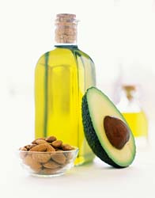
Oils
Daily Recommendation
Women | 19-30 yrs old 31-50 yrs old 51+ yrs old | 6 teaspoons 5 teaspoons 5 teaspoons
Men | 19-30 yrs old 31-50 yrs old 51+ yrs old | 7 teaspoons 6 teaspoons 6 teaspoons
These recommendations are based on the average adult performing less than 30 min of physical activity/day. 2010 Dietary Guidelines

Slide 21
Oils
What counts as a serving?
1 TB of vegetable oils (olive, avocado, peanut, soybean, canola, sunflower)
1 TB of margarine
1 TB of mayonnaise
2 TB of peanut butter
½ medium avocado
Notes:
Limit these foods as the daily recommendation is a maximum, and most Americans reach their limit through foods such as nuts, seeds, dressings and cooking with butter or oil.

Slide 22
Getting Started
Plan of Action
  Use measuring cups & spoons
  Use smaller dishes
  Pre-plate your meals, snacks and desserts
  Look at your plate of food before you start
  Be mindful while you’re
Notes:
Measure food and drinks with measuring cups, then pour it on your plate or glass to see what it looks like. For example, pour a bowl of cereal, then pour that cereal into a measuring cup
Measure food and drinks with measuring cups, then pour it on your plate or glass to see what it looks like. For example, pour a bowl of cereal, then pour that cereal into a measuring cup
- Be mindful while you’re eating, be conscious and visually in-tune with the food leaving your plate and entering your mouth.

Slide 23
Getting Started
Pay attention to hunger
  Stop eating when you feel satisfied, not full
Be mindful
  Notice times of day, places and your mood when you feel hungry
  Pay attention to what you are eating and enjoy it

