Slide 1
© 2020 Quartz Health Solutions, Inc. This PowerPoint is considered confidential and proprietary, and may only be distributed with prior written permission from the Quality Management and Population Health (QMPH) and Legal Departments at Quartz Health Solutions, Inc. The QMPH department can be reached at (866) 884-4601. Statements contained in these materials do not constitute medical advice. Individuals should consult with their doctor for healthcare questions and advice. Quartz is a management and administrative services company which provides services for Quartz Health Benefit Plans Corporation, Quartz Health Plan Corporation, Quartz Health Plan MN Corporation, and Quartz Health Insurance Corporation.

Slide 2
Nutrition Label Reading
Label Reading for Healthy Eating

Slide 3
Nutrition Label Reading
Agenda
How to read a label
Nutrients to limit
How to use a food label to eat healthy

Slide 4
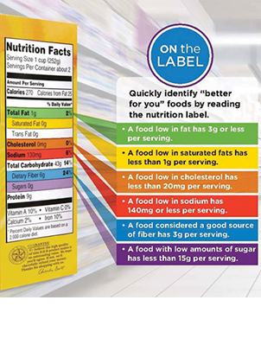
Nutrition Label Reading
Why Read Food Labels?
Serving sizes
Calories
Fat
Vital Nutrients
Sodium (salt)
Cholesterol
Carbs (sugar)
Notes:
Reading labels helps us learn more about the foods we eat.

Slide 5
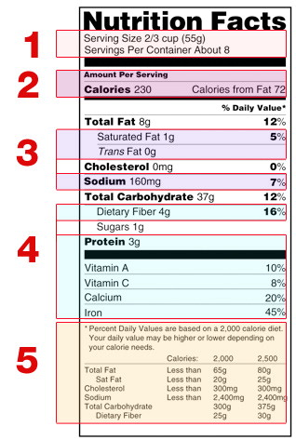
Nutrition Label Reading
Reading a Nutrition Label
Serving size and servings per container
Amount of calories per serving
Here you will find the nutrients you want to limit
Nutrients the body needs
Percent of daily value is based on a 2,000 calorie diet

Slide 6
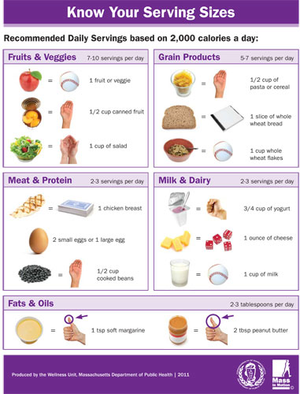
Nutrition Label Reading
Serving Size
Serving size is a standard amount of food listed on the nutrition label
Serving size is based on 2,000 calories a day

Slide 7
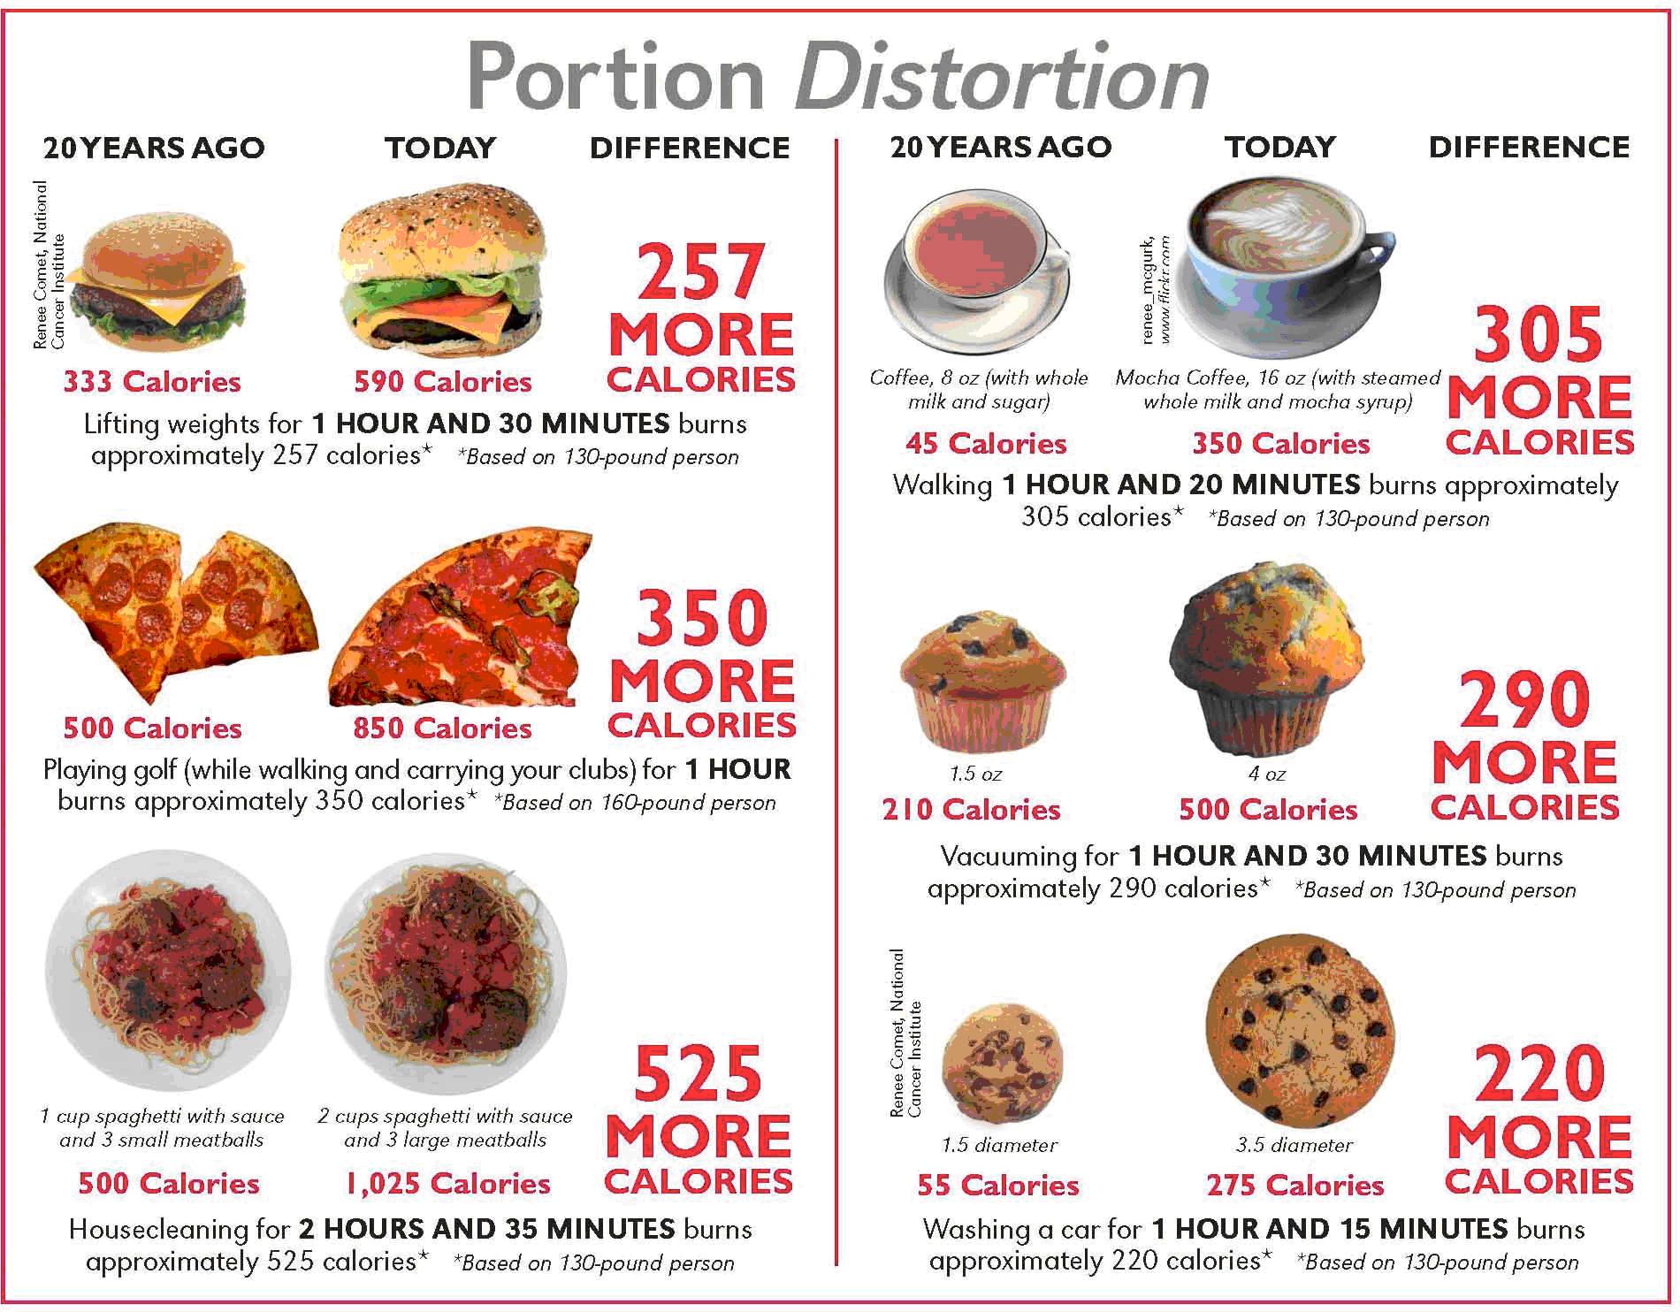
Nutrition Label Reading
Portion Size

Slide 8
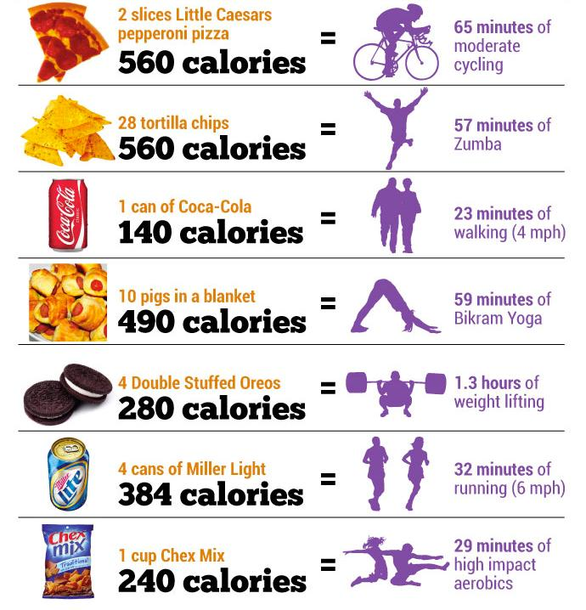
Nutrition Label Reading
Empty Calories

Slide 9
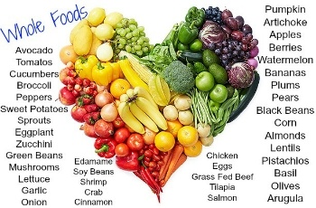
Nutrition Label Reading
Whole Food Calories

Slide 10
Nutrition Label Reading
Test Your Knowledge
What is a high % of daily value?
30%
15%
25%
20%

Slide 11
Nutrition Label Reading
Test Your Knowledge
The amount you eat during a meal is your serving size.
True
False

Slide 12
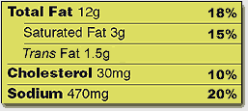
Nutrition Label Reading
Nutrients to Limit
Stay below 100% of the daily value of these nutrients per day.

Slide 13
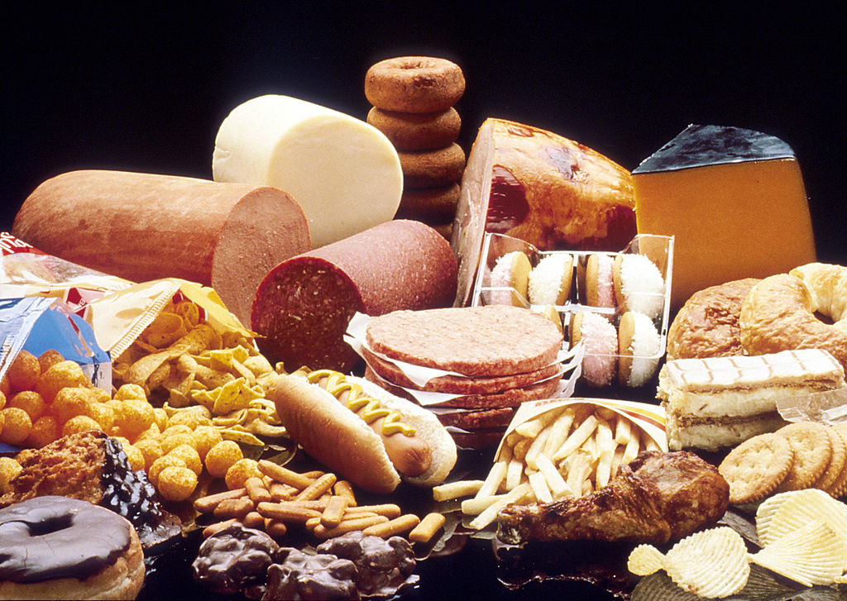
Nutrition Label Reading
Saturated Fats

Slide 14
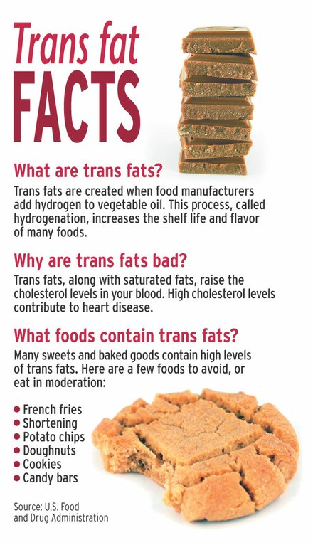
Nutrition Label Reading
Trans fats

Slide 15
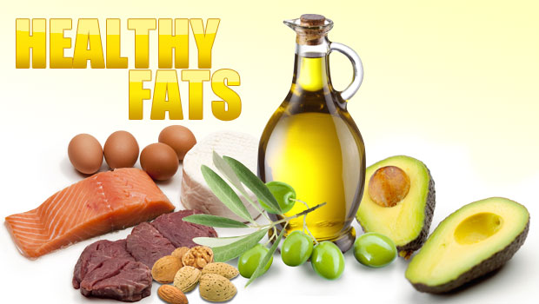
Nutrition Label Reading
Good Fats

Slide 16
Nutrition Label Reading
Test Your Knowledge
What number of calories in a healthy adult diet is the daily value based on?
2500 Calories Per Day
2000 Calories Per Day
1500 Calories Per Day

Slide 17
Nutrition Label Reading
Test Your Knowledge
True Or False:
A Nutrition Facts Label Can List 0 Grams Of Fat Even If The Food Does In Fact Contain Some Fat?
True
False

Slide 18
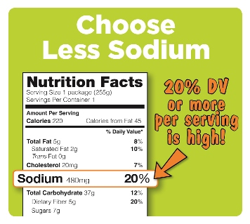
Nutrition Label Reading
Daily Sodium Intake
Consume no more than 2,300 milligrams per day

Slide 19
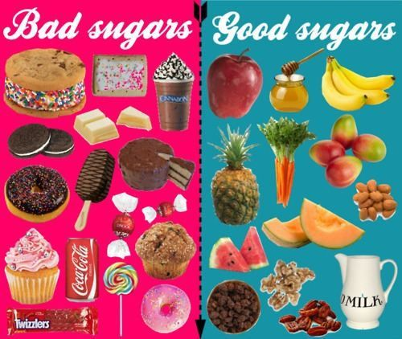
Nutrition Label Reading
Simple Sugars

Slide 20
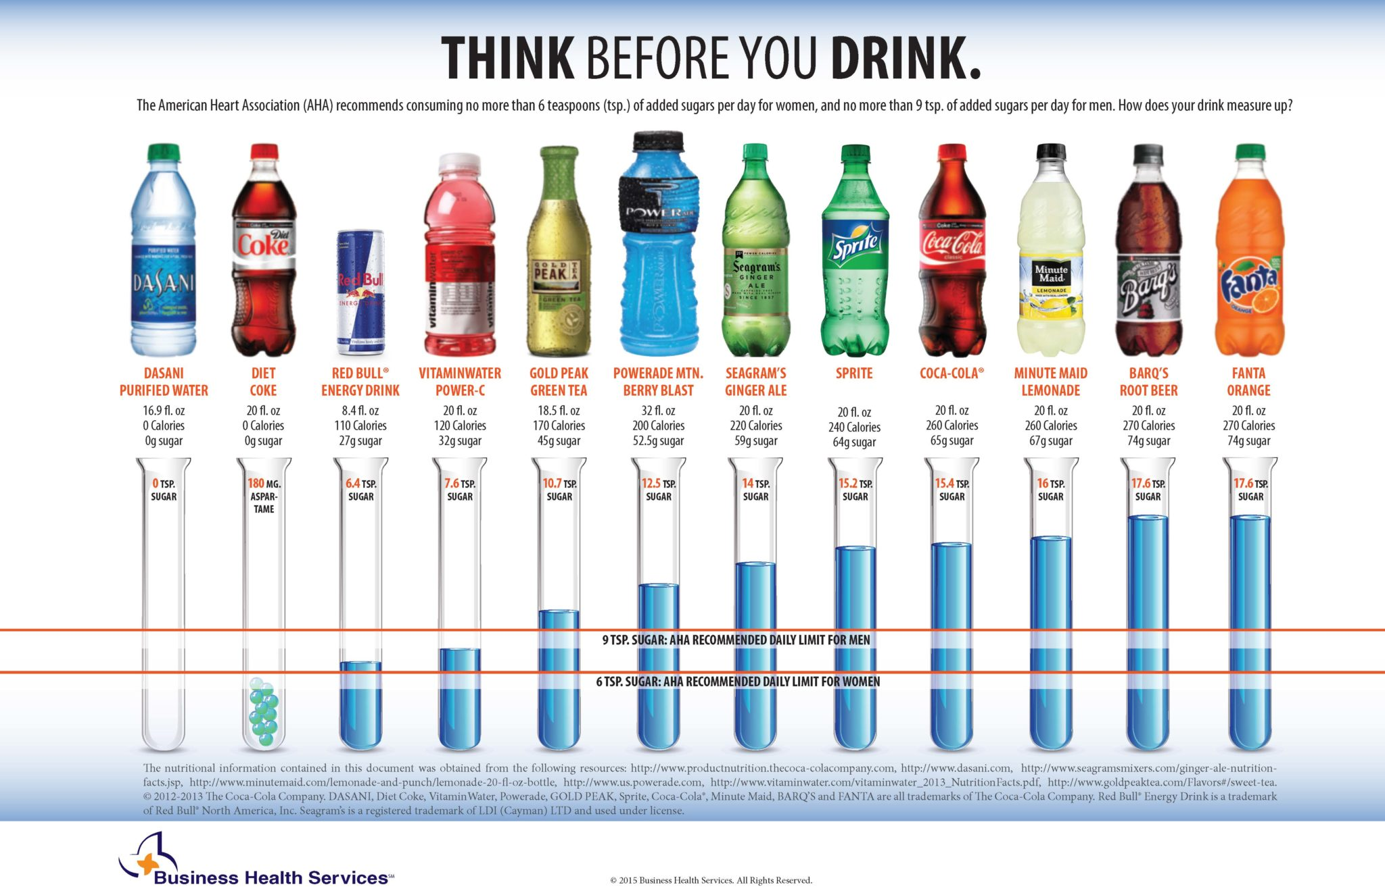
Nutrition Label Reading
How Much is Too Much?

Slide 21
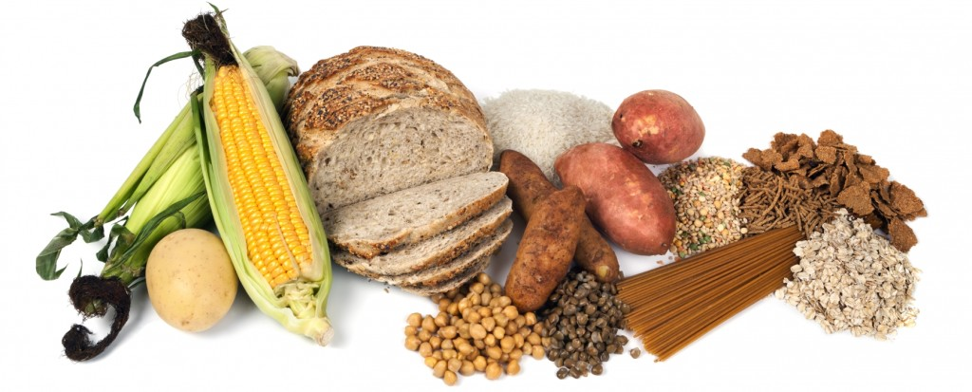
Nutrition Label Reading
Complex Carbohydrates

Slide 22
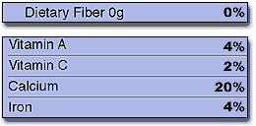
Nutrition Label Reading
Nutrients to Meet Daily Goal
Get 100% of these nutrients each day.

Slide 23
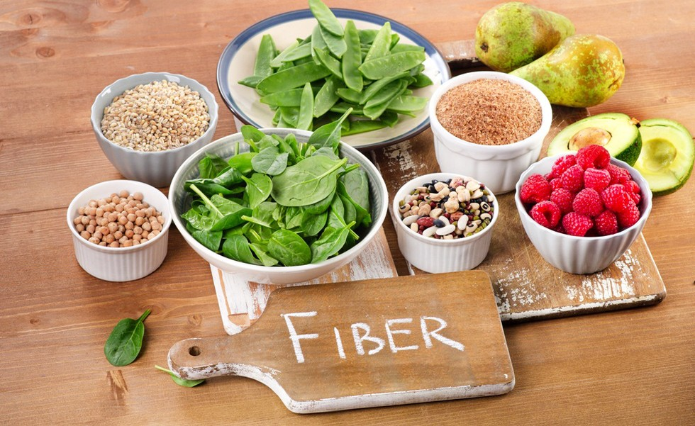
Nutrition Label Reading
High Fiber Foods

Slide 24
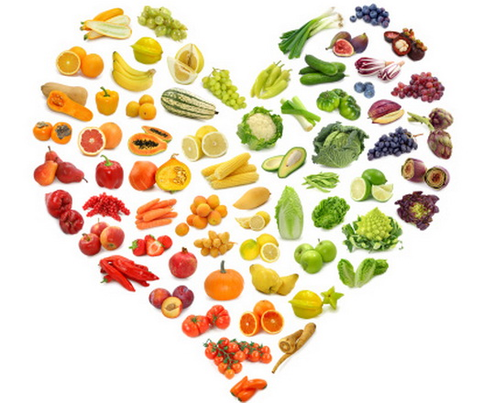
Nutrition Label Reading
Add color everyday!

Slide 25
Nutrition Label Reading
Your Turn
How do you get a variety of colors in your day?

Slide 26
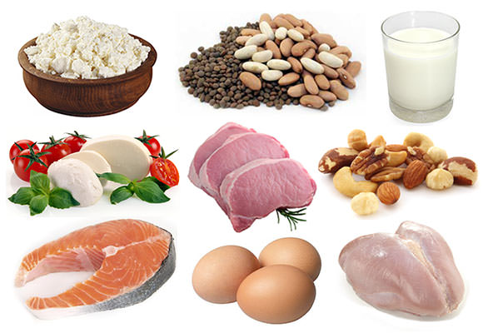
Nutrition Label Reading
Protein

Slide 27
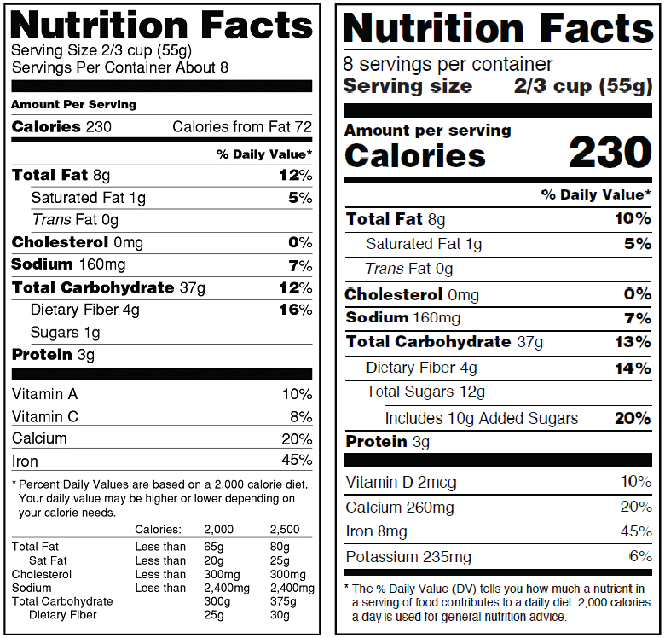
Nutrition Label Reading
Old Label
New Label

Slide 28
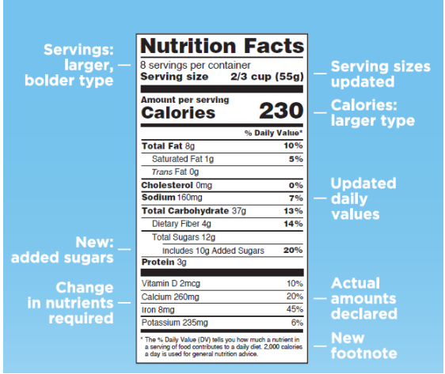
Nutrition Label Reading
New Label – What’s different?

Slide 29
Nutrition Label Reading
Questions

Slide 31
Resources
American Heart Association- http://www.heart.org/HEARTORG/HealthyLiving/HealthyEating/Nutrition/Understanding-Food-Nutrition-Labels_UCM_300132_Article.jsp#.WLXdZxiZO8U
Food and Drug Administration- https://www.fda.gov
Choose My Plate - https://www.choosemyplate.gov/protein-foods
Massachusetts Department of Public Health - http://www.mass.gov/eohhs/gov/departments/dph/
Renee Comet National Cancer Institute- https://visualsonline.cancer.gov/details.cfm?imageid=2616
Type of Carbohydrates | Simple Carbohydrate VS Complex Carbohydrate | Fat Burning Center. (n.d.). Retrieved March 23, 2017, from https://fatburningflatbelly.com/fat-burning-center/simple-carbohydrate-vs-complex-carbohydrate/
Williams, C. (2016, April 26). Foods High in Protein (Protein Rich Foods). Retrieved March 23, 2017, from http://lethow.com/health/foods-high-in-protein/
Stephanie. (2014, May 06). Retrieved March 23, 2017, from http://ourwellnessrevolution.com/add-healthy-fats-diet/
Saturated Fat – Not Guilty! (n.d.). Retrieved March 23, 2017, from http://www.theissnscoop.com/saturated-fat-not-guilty/
Notes:
Have all graphics been sourced here?

