Slide 1
© 2020 Quartz Health Solutions, Inc. This PowerPoint is considered confidential and proprietary, and may only be distributed with prior written permission from the Quality Management and Population Health (QMPH) and Legal Departments at Quartz Health Solutions, Inc. The QMPH department can be reached at (866) 884-4601. Statements contained in these materials do not constitute medical advice. Individuals should consult with their doctor for healthcare questions and advice. Quartz is a management and administrative services company which provides services for Quartz Health Benefit Plans Corporation, Quartz Health Plan Corporation, Quartz Health Plan MN Corporation, and Quartz Health Insurance Corporation.

Slide 2
Navigating the
Health System

Slide 3


Slide 4


Slide 5
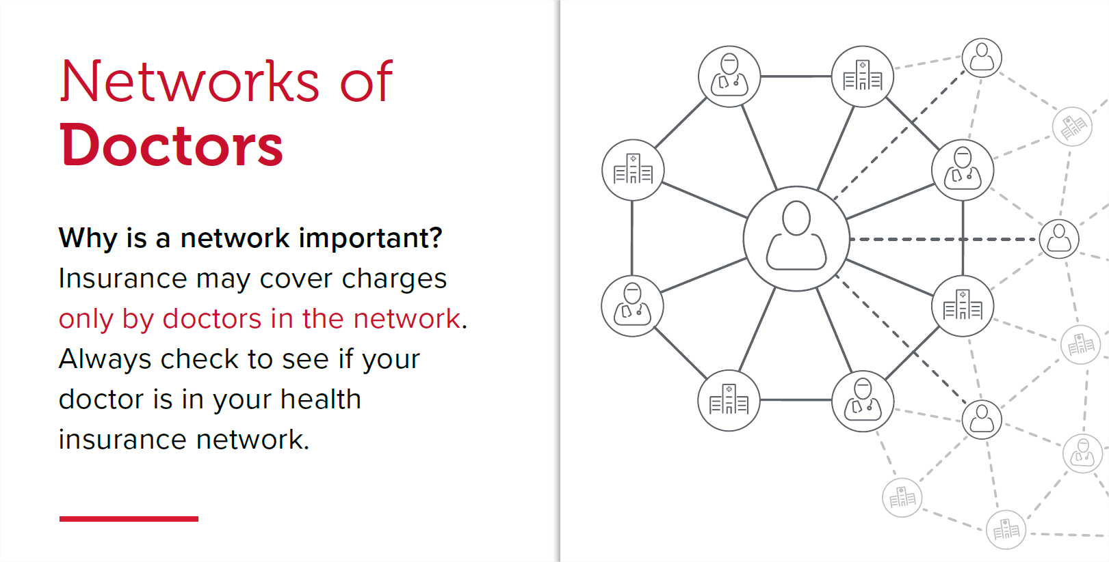

Slide 6
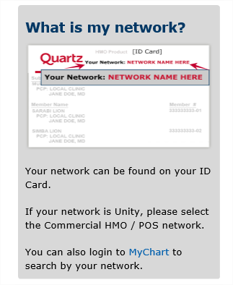
What is my Network?

Slide 7
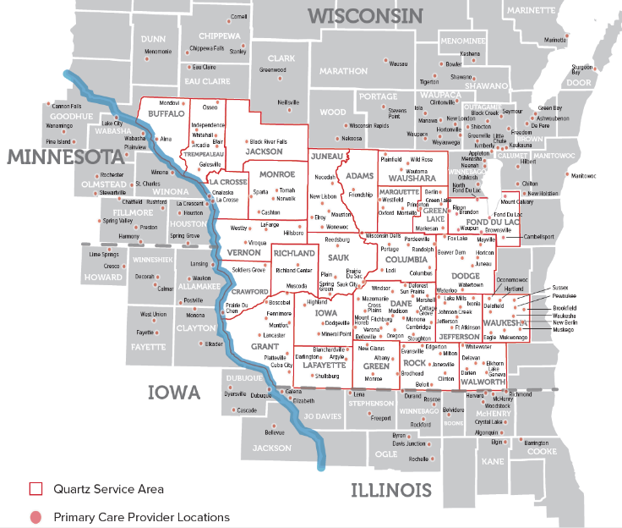



Commercial HMO / POS Network
Offered by Quartz Health Benefit Plans Corporation

Slide 8
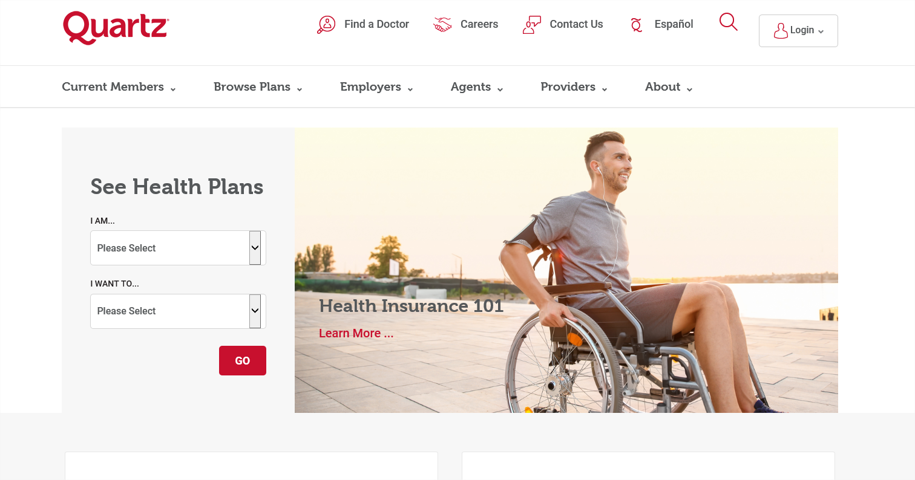
How do I find a doctor?
Visit the Quartz home page at: quartzbenefits.com
Choose “Find a Doctor”

Slide 9
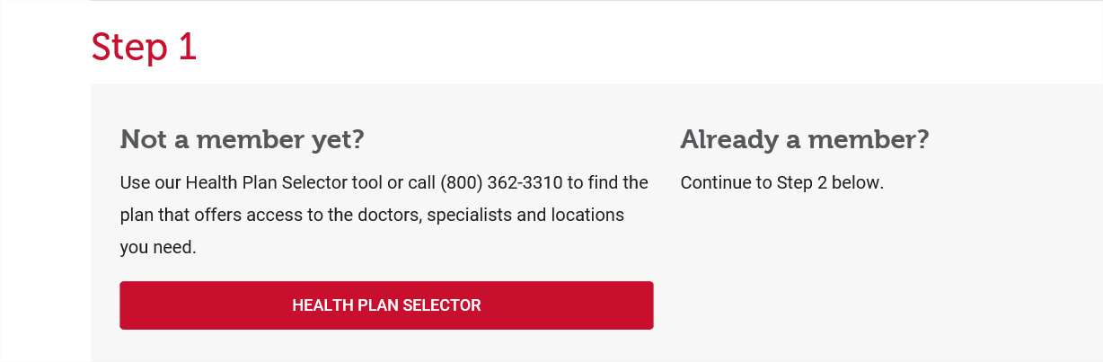
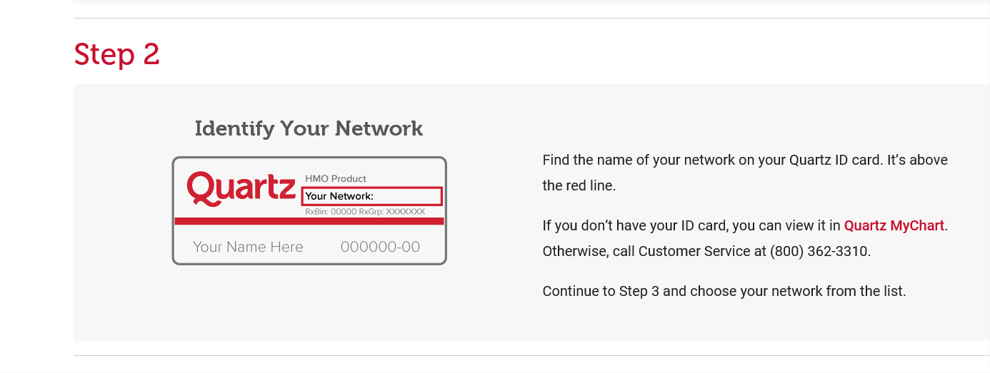
How do I find a doctor?
Follow the “Steps”

Slide 10
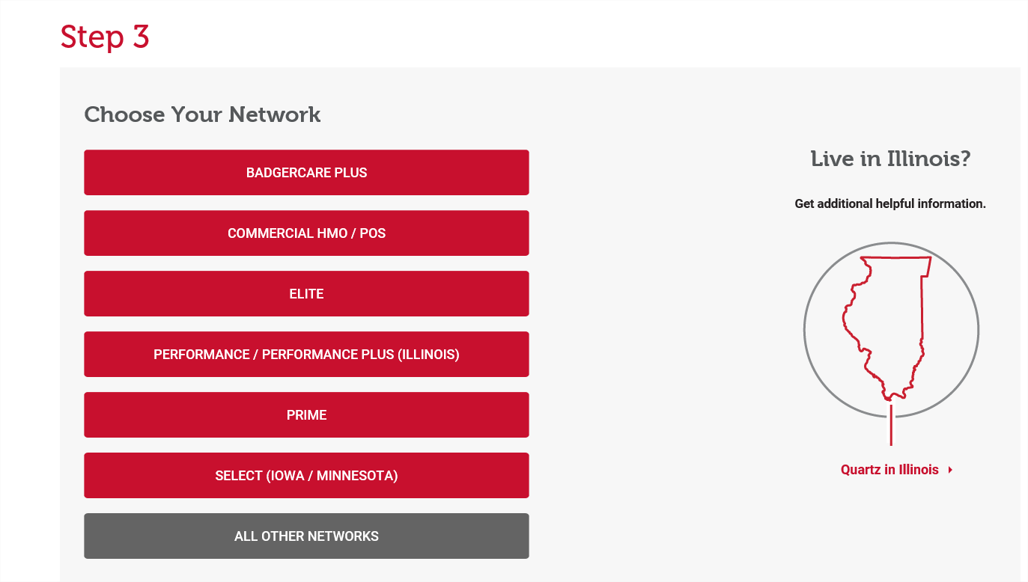
How do I find a doctor?

Slide 11
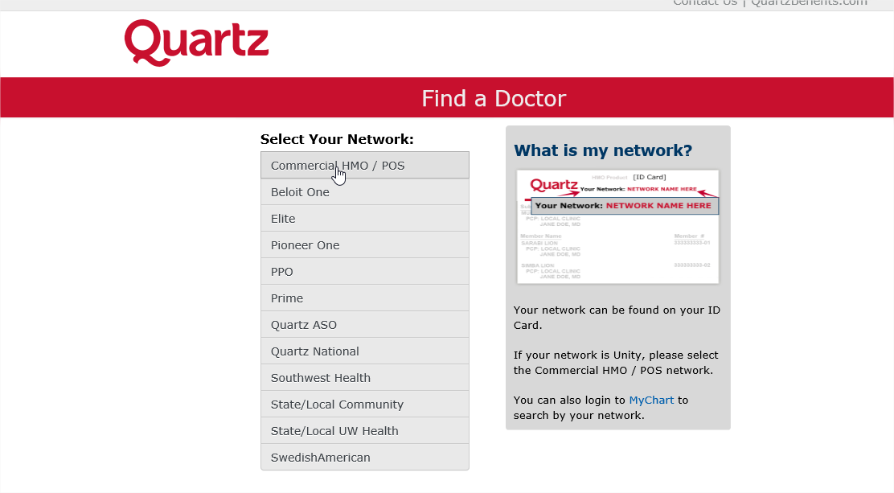
How do I find a doctor?

Slide 12
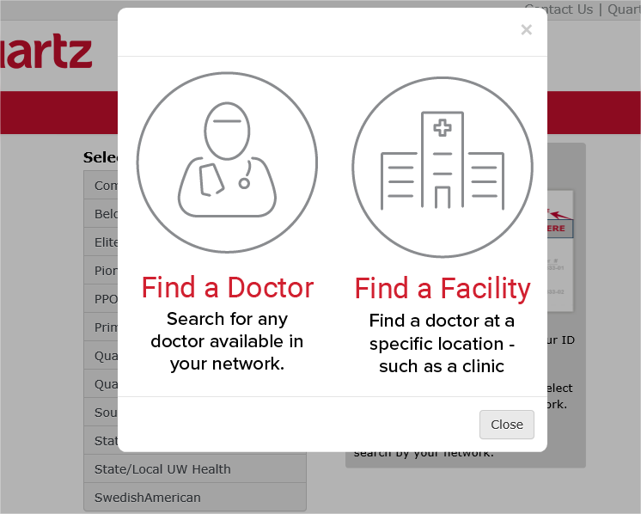
How do I find a doctor?

Slide 13
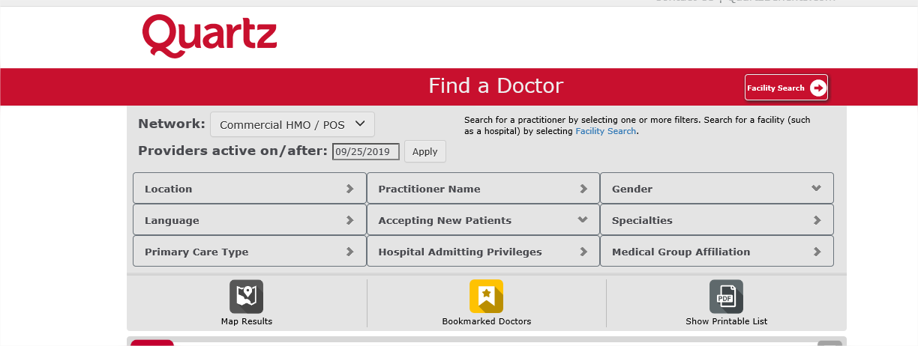
How do I find a doctor?

Slide 14

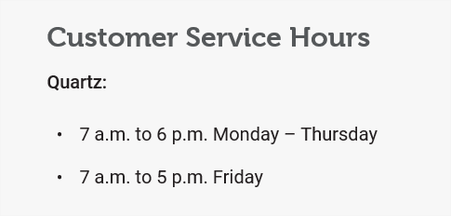
How do I find a doctor?
You can always give us a call

Slide 15


Slide 16


Slide 17
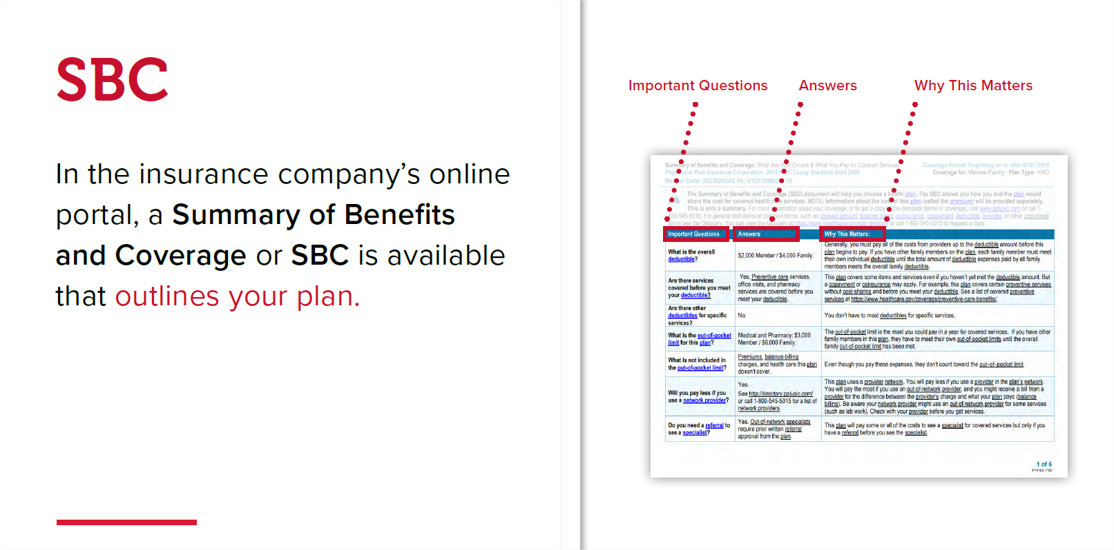

Slide 18


Slide 19
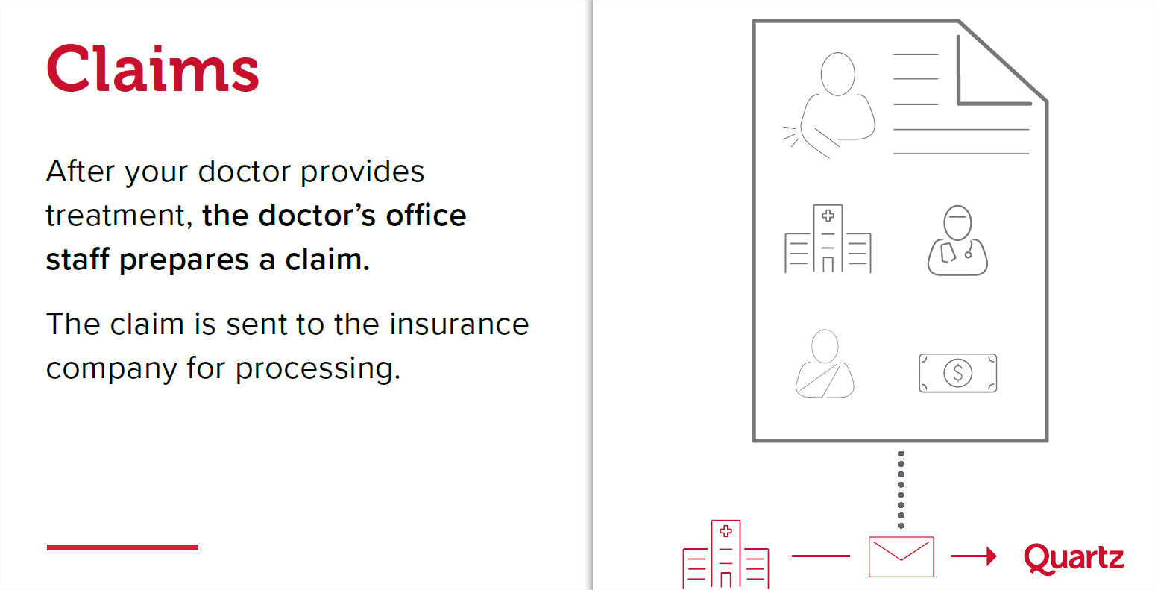

Slide 20
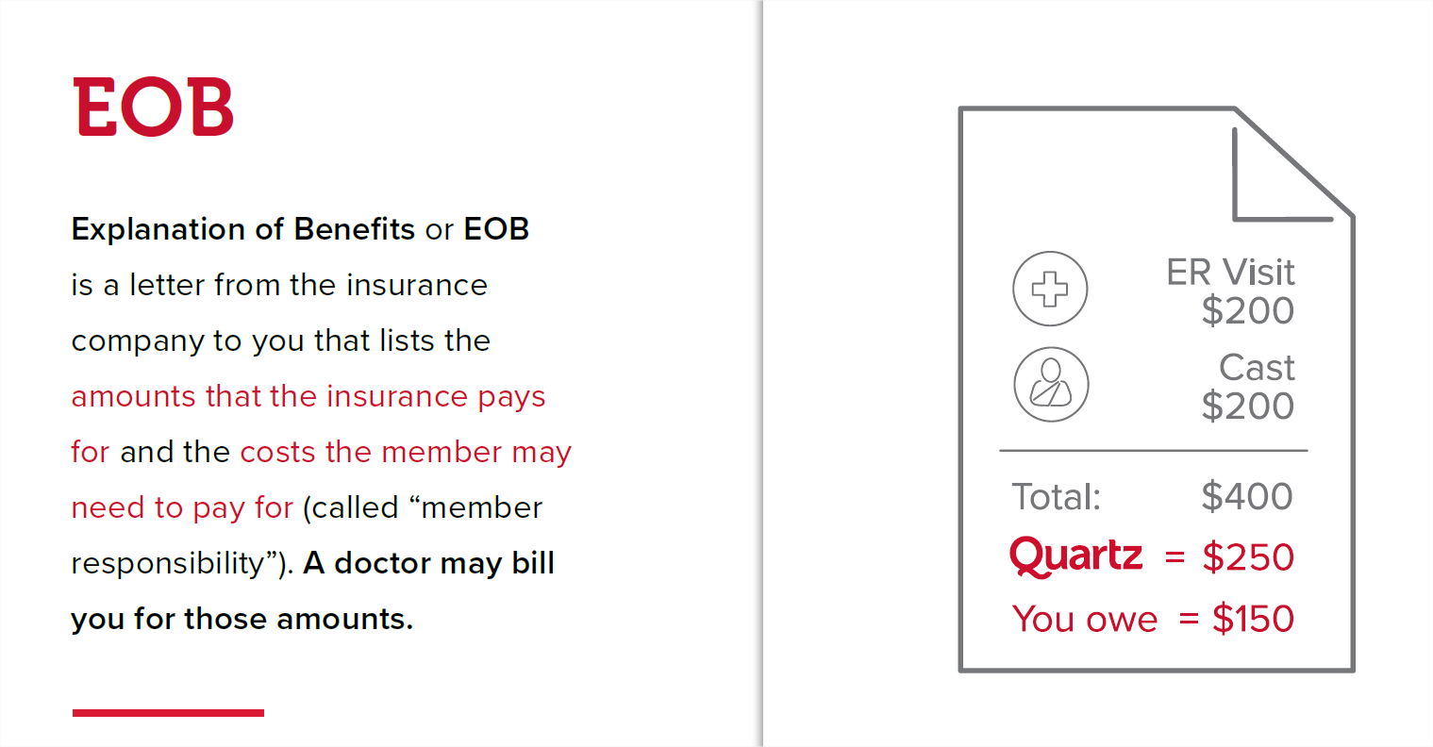

Slide 21
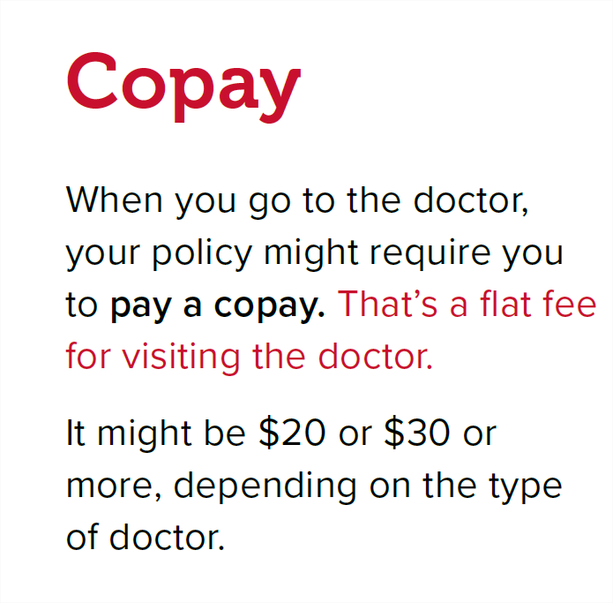
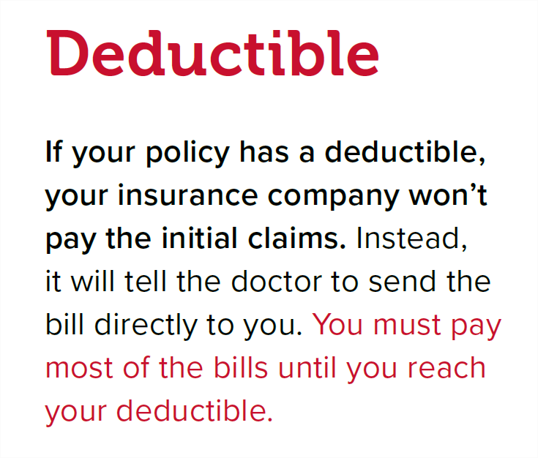
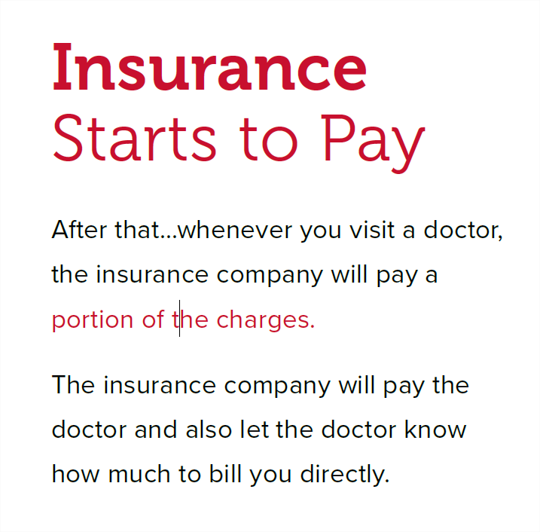
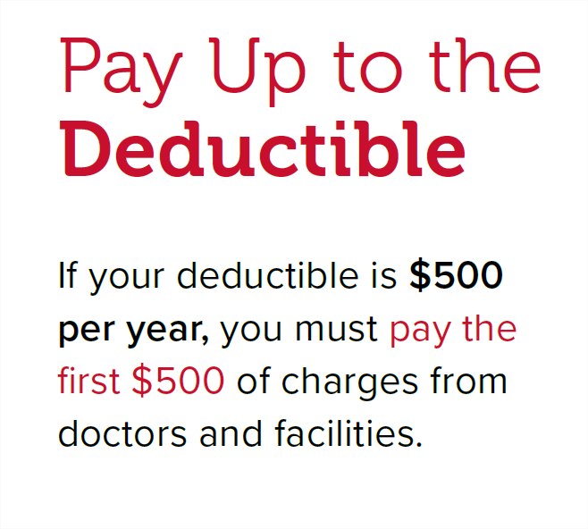

Slide 22
What is Preventive Care?
Preventive care or “Check ups” are regular health exams and tests that can help find problems before they start.
They can help find problems early, when your chances for treatment and cure are better.
By getting the right health services, screenings, and treatments, you are taking steps that help your chances for living a longer, healthier life.
Your age, health and family history, lifestyle choices (i.e. what you eat, how active you are, whether you smoke), and other important factors impact what and how often you need healthcare.
CDC, 2017

Slide 23
What Preventive Care Services are Recommended?
Breast and Cervical Cancer Early Detection
Cholesterol
Colorectal Cancer Screening
High Blood Pressure
Immunizations
Oral Health
Prostate Cancer Screening
Skin Cancer
HIV/AIDS
Viral Hepatitis
CDC, 2017

Slide 24
Things to do before your next check up:
Review your family health history
Find out if you are due for any general screenings or vaccinations
Write down a list of questions to take with you
Consider your future
Your primary care provider is your gate keeper for your care
CDC, 2017

Slide 25
What if I Need Care in a Specialty Department?
You and your primary care doctor will decide if you need to be referred to a specialty department.
In the event you need specialty care, your doctor will assist with arranging an appointment with the specialty department.
Some specialty departments require prior authorization, your doctor will initiate this process.
CDC, 2017

Slide 26
Coordinating Care
Chronic disease and surgery can be a time when you need help navigating the health system.
Many health systems have care coordinators or navigators that can advocate for you and help you understand your care.
Your primary care provider or specialty provider will be able to assist you in connecting with care navigators.
Notes:
Quartz is confident that we are contracted with the best doctors in your area

Slide 27
After Clinic Hours Care:
Emergency Services
Urgent Care
E-visits
On Demand Care

Slide 28
Emergency Services
When you have an illness or injury/trauma that is serious or life-threatening, call 911 or your local emergency number, or go directly to the nearest ER.

Slide 29

Use Emergency Services for:
Alcohol or drug intoxication or overdose
Bone fractures
Changes in vision or trouble speaking
Chest pain/heart attack
Confusion or change in mental status
Dizziness
Loss of consciousness/head injuries
Numbness or weakness on one side/stroke symptoms
Pregnancy-related problems (bleeding or abdominal pain)
Severe abdominal pain
Severe cuts
Severe headache - sudden onset
Sexual assault or domestic violence
Shortness of breath
Suicide attempt or suicidal thoughts or threats
Trauma such as a car accident, fall, drowning, violence, fire or sports/recreational injury

Slide 30
Urgent care is for an illness or injury that is uncomfortable but not life-threatening and does not pose a significant health risk, such as:
Urgent Care
Cuts, scrapes and bruises
Skin rashes, insect bites and minor burns
Fever, colds and flu
Sore/strep throat
Sinus and upper respiratory infections
Ear pain/infection
Sudden back or neck pain
Strains and sprains
Urinary burning
Gundersen Health System, 2019

Slide 31
Virtual Visits e-Visits and Video Visits

Slide 32

E-Visits
E-Visits
An electronic conversation between you and your UW Health provider about a non-emergency medical issue
Get started by logging into MyChart, select “e-Visit” from the Quick Links menu and follow the prompts to get care
You’ll be advised of any costs before your proceed. An e-Visit can save you money compared to an office visit.
You must have a UW PCP
Notes:
Something Quartz provides is access to answers without having to go to the doctor. You can do this through e-visits, which is an electronic conversation with a UW Health provider – you can do this by logging into your MyChart account under the Quick Links menu and follow the prompts to get care. You will be advised of the cost before you proceed.

Slide 33
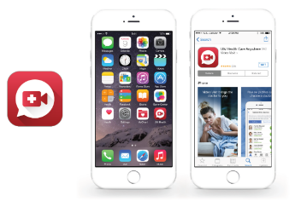
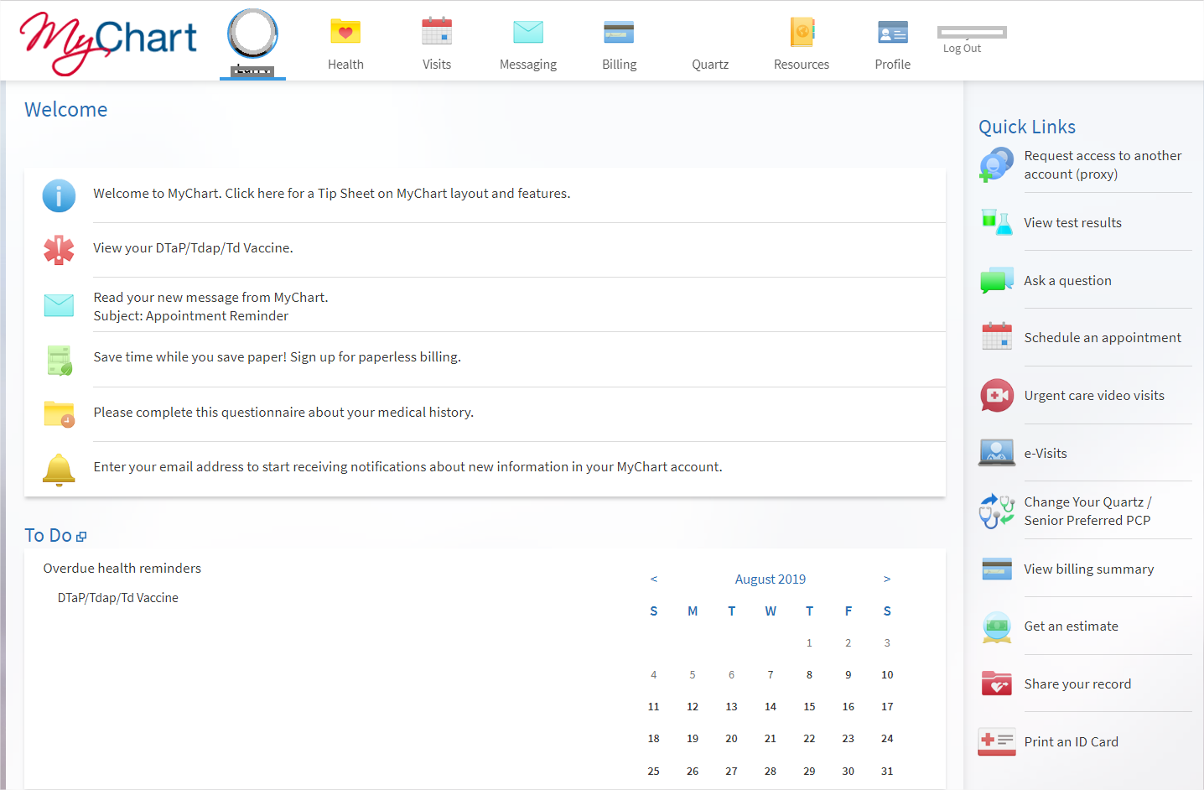
Care Anywhere Video Visits
On Demand Care. Anywhere, anytime. No appointment necessary.
UW Health Care Anywhere Video Visits provide 24/7 on-demand care using your smartphone or tablet.
Access Care Anywhere through the “UW Health Care Anywhere” app or through MyChart.
Depending upon your medical concern, the health care provider can provide a diagnosis, suggest follow-up care and prescribe medication.
Patient Experience Video
Offered by Quartz Health Benefit Plans Corporation
Notes:
Another option for care is our Care Anywhere option – has anyone use this option? It is a great solution to the waiting room at urgent care and provides access to physicians via your smart phone or tablet.

Slide 34

Care Anywhere Video Visits
Exclusive Quartz member benefit
No requirement to have a UW Health PCP
For copay plans, same cost as e-Visits
Deductible plans, including HSA-qualified plans, the cost is $49. This applies to the plan’s Deductible and Out-of-Pocket Limit
Use Video Visits For –
Abdominal Pain
Allergies
Cough
Fever
Ear pain
Stuffy / runny nose
Sore throat
Painful / difficult urination
Nausea and vomiting
Low back pain
Diarrhea
Eye infections
Joint pain
Sprains
Headache
Minor skin problems
Offered by Quartz Health Benefit Plans Corporation
Notes:
UW Care Anywhere Visits are available even if you don’t have a UW Health PCP. For Copay plans these are the same cost as an e-visit – and can be used for Abdominal pain, allergies, cough, etc….(list on slide)

Slide 35


Care Anywhere Video Visits
Download the UW Health Care Anywhere
app or go to uwhealthcareanywhere.org
to set up an account.
Offered by Quartz Health Benefit Plans Corporation
Notes:
We encourage you to upload the app before you need it – or you can go to uwhealthcareanywhere.org

Slide 36
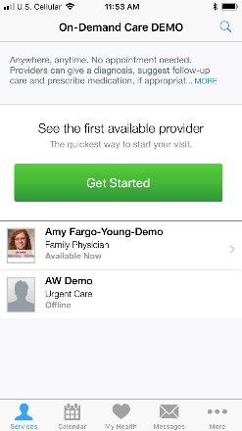
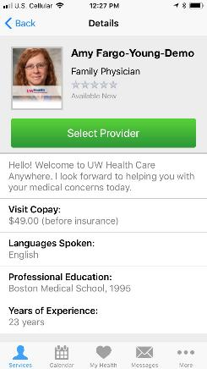
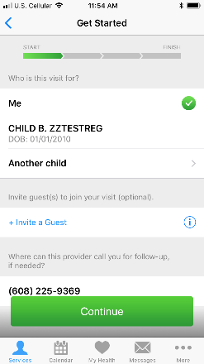
To begin: select the first available or a specific provider
Care Anywhere Video Visits
Offered by Quartz Health Benefit Plans Corporation
Notes:
Here is an example of what this experience looks like including how to choose a doctor

Slide 37
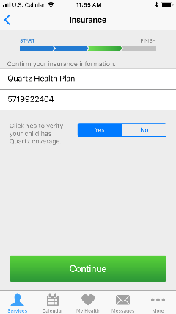
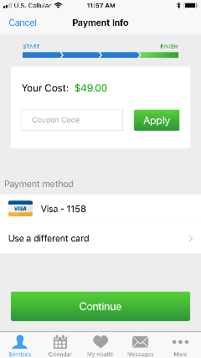
Cost of visit is verified prior to connecting to a provider
Care Anywhere Video Visits
Quartz members enter member ID during enrollment or before a visit
If NOT covered – the patient will pay $49
If covered – the payment screen is revised to reflect the actual amount owed by the patient
Offered by Quartz Health Benefit Plans Corporation
Notes:
The cost of your visit will calculated when you enter your ID number – and you do need to pay your copay before the visit;

Slide 38

Make Healthy Easier
MyChart
Securely, conveniently, manage your health information online
  View health insurance benefits information, check claims status, send a secure message to Customer Service, schedule appointments and more
  Access portions of your medical records, depending on your provider
Simplify your life and save a tree by going paperless.
  Get your premium bills by email and pay online
  Save the hassle and worry of confidential information arriving in your mailbox
Notes:
Ask how many people have MyChart Accounts and what they like about using theirs; share slide, secure, convenient, online access, simplify and paperless appeal

Slide 39
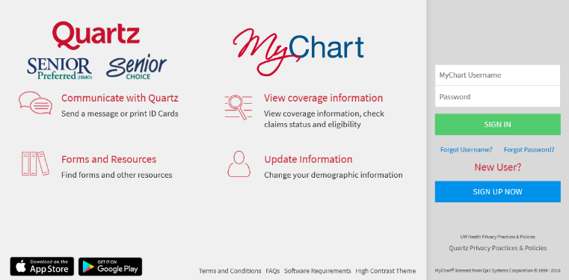
Visit QuartzMyChart.com to get started
MyChart
Offered by Quartz Health Benefit Plans Corporation
Notes:
This slide shows an example of the log in screen – where you can create an account, log in, send a message to Quartz, view your coverage, access forms and resources and update your personal information

Slide 40

Questions?

