Slide 1
This PowerPoint is proprietary and may only be distributed with permission from the Quality Management and Population Health (QMPH) Department at Quartz.
The QMPH department can be reached at (866) 884-4601.

Slide 2
Hydration
Laura Wenman, BS
Quality Management & Population Health Specialist

Slide 3
Test Your Knowledge
What percent of your entire body is water?
  25%
  80%
  60%
  75%

Slide 4
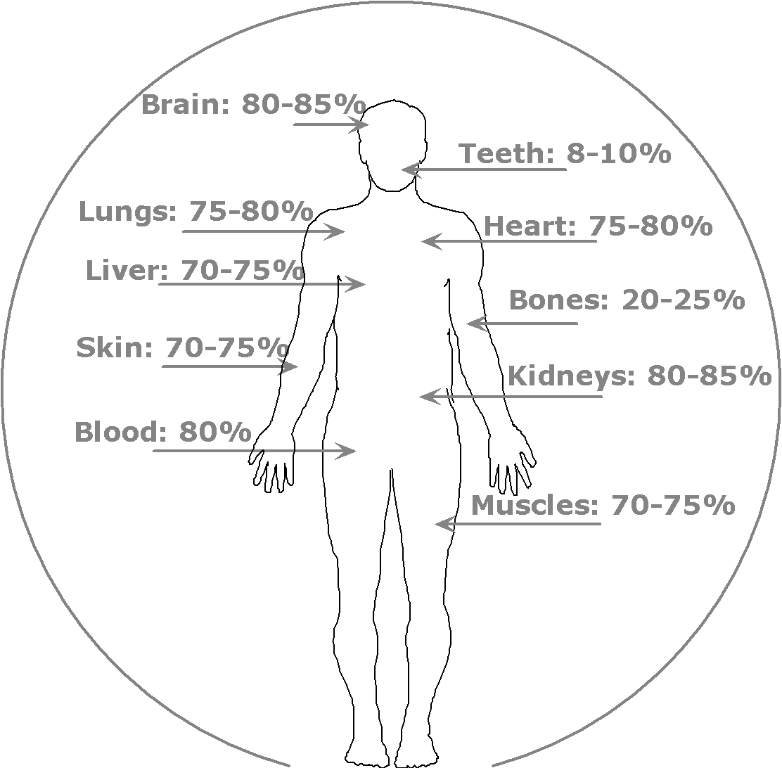
C. 60%
The human body is about 60% water
Some parts of our bodies have higher amounts of water than others

Slide 5
Hydration Benefits
Water is an essential nutrient
  Our bodies can’t make it
Helps the heart deliver blood to organs more easily
Helps the muscles work more efficiently
Helps get rid of waste
Regulates body temperature
Can prevent constipation
Can prevent kidney stones
Can help you lose weight
  Drink a glass of water before eating to help you feel full
Source: www.healthwise.net, www.heart.org

Slide 6
Test Your Knowledge
True or False:
The average individual loses 1,000-2,000 ml (4-8 cups) of fluid during 1 hour of moderate exercise.

Slide 7
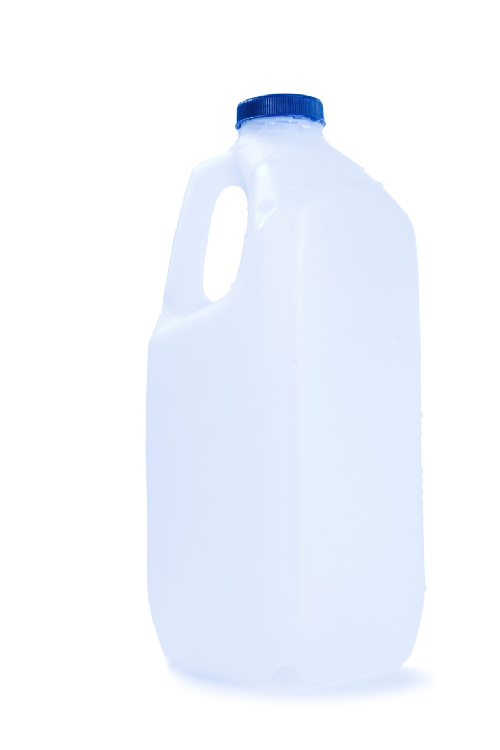
TRUE!
1,000-2,000 ml is 4-8 cups or 33-67 ounces of fluid
Just over a half gallon of liquid
It’s not just sweat, it’s breath, too

Slide 8
How Water is Lost
Water is lost throughout the day through:
  Breath: about 350ml (1.5 cups)
  Sweat: about 500-800 ml/day (2-3 ½ cups)
  Urine: about 1,500 ml/day (6 cups)
  Bowel movements: about 100 ml/day (1/2 cup)
  Moderate Exercise
    1,000-2,000 ml (4-8 cups) every hour
“If you’re thirsty, you are already dehydrated.”
–Dr. John Batson via heart.org
Sources: http://en.wikipedia.org/wiki/Fluid_balance, http://en.wikipedia.org/wiki/Dehydration

Slide 9
How Much Water is Enough
There’s no clear cut answer
Many variables
  Where you live, clothing, intensity and duration of a workout, if you have a medical condition, if you have an illness, what other foods you eat, if you’re breast-feeding
Pay attention to the color of your urine
Pay attention to your own body
According to the Institute of Medicine, an adequate intake is:
  roughly 13 cups or 3 liters for men
  roughly 9 cups or 2.2 liters for women
  8 cups is 1.9 liters
Other suggestions include:
  Drink a glass of water before every meal
  Drink water before, during and after exercise
Source: http://www.healthwise.net/unityhealth/Content/StdDocument.aspx?DOCHWID=abk5466

Slide 10
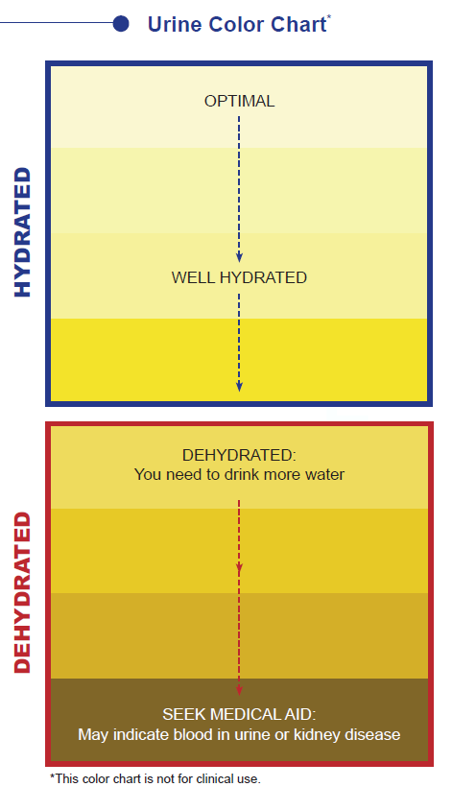
How You Can Tell You’re Hydrated
Pale yellow or clear color
Regular urination throughout
the day
Soft bowel movements
Source: http://usachppm.apgea.army.mil

Slide 11
Test Your Knowledge
True or False:
Food can contribute to your hydration level.

Slide 12
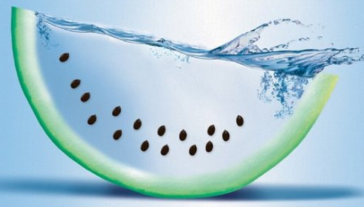
True!
Foods such as fruits and vegetables help keep us hydrated.
  Watermelon
  Oranges
  Cucumbers
  Lettuce
  Celery
  Radishes
  Cantaloupe
  Tomatoes
  Green peppers
  Cauliflower
  Strawberries
  Broccoli
  Grape fruit
  Carrots
http://www.health.com/health/gallery/0,,20709014,00.html

Slide 13
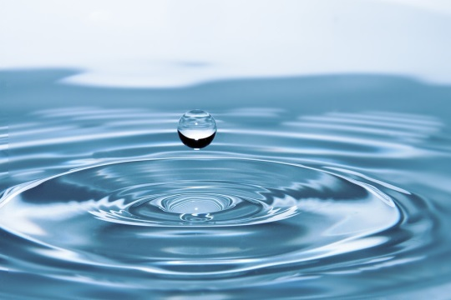
How to Replace What’s Lost
What’s Best
What Also Works
Water!!!
Fruits
Vegetables
Sports drinks
Foods cooked with water
  Soup
  Oatmeal
Source: http://www.healthwise.net, pixabay.com

Slide 14

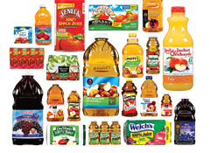
How to Replace What’s Lost
What’s NOT Best
Caffeine
  While some experts say that caffeine doesn’t always dehydrate you, it’s best to stay away if you have concerns about dehydration (i.e. you know you will be outside all day on a hot summer day)
Fruit juices and sugary drinks
  These can be hard on your stomach if you’re dehydrated
Source: commons.wikimedia.org/
Source: consumerreports.org

Slide 15
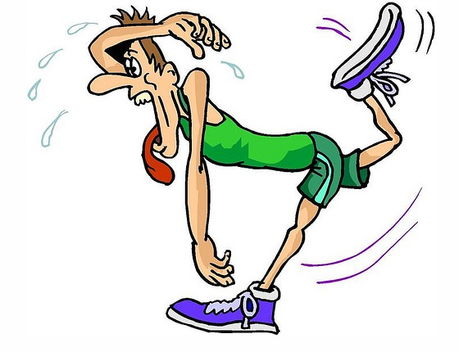
Dehydration: Excessive loss of Body Fluids
Fatigue
Loss of appetite
Flushed skin
Heat intolerance
Light-headedness
Dark-colored urine
Dry cough
Source: http://my.clevelandclinic.org/health/diseases_conditions/hic_avoiding_dehydration
Source: crossfitrgtc.com

Slide 16
Sports Drinks
Purpose
  Designed to replace electrolytes athletes lose during training and competition
Appropriate Use of Sports Drinks
  Most people don’t need sports drinks
  Moderate to intense exercise for more than 60 minutes
Sports drinks have a high sugar and calorie content
  Not intended to be sipped on all day or replace water

Slide 17
Hydration Tips and Tricks
Start your day with a glass of water
Before eating, drink a glass of water
If you feel hungry, drink water. Sometimes, hunger can be confused with thirst.
Drink a glass of water before, during and after you exercise
If you’re having a hard time remembering to drink water, drink on a schedule (i.e. upon waking up, before each meal and in the evening)
If you’re up at night going to the bathroom, try to get your fluid intake during the day
Source: familydoctor.org

Slide 18
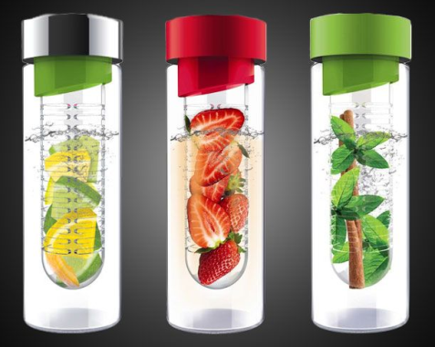
Hydration Tips and Tricks
Flavor your water with fruit, herbs or vegetables
  i.e. oranges, mint, cucumber
Carry a water bottle with you throughout the day
Buy a larger water bottle
Start a hydration challenge with a co-worker
Drink water at restaurants – it’s free!
Limit caffeine and alcohol
  These increase urine output
  and may increase dehydration
Use an infuser
Source: pinterest
Source: familydoctor.org

Slide 19
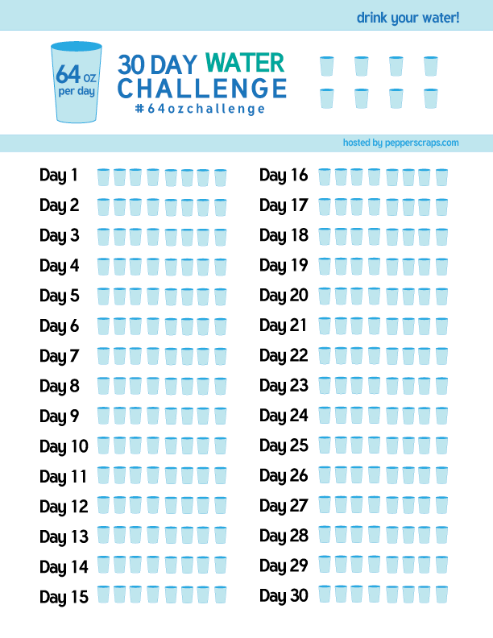
Start a Water Challenge

