Slide 1
© 2020 Quartz Health Solutions, Inc. This PowerPoint is considered confidential and proprietary, and may only be distributed with prior written permission from the Quality Management and Population Health (QMPH) and Legal Departments at Quartz Health Solutions, Inc. The QMPH department can be reached at (866) 884-4601. Statements contained in these materials do not constitute medical advice. Individuals should consult with their doctor for healthcare questions and advice. Quartz is a management and administrative services company which provides services for Quartz Health Benefit Plans Corporation, Quartz Health Plan Corporation, Quartz Health Plan MN Corporation, and Quartz Health Insurance Corporation.

Slide 2
Winter Stress, Depression, and the Holidays
Kimberly Hein-Beardsley, MS, LMFT, BCC, CHC
Quality Management & Population Health

Slide 3
Holiday Depression and Stress
“The holiday season is a time full of joy, cheer, parties, and family gatherings. However, for many people, it is a time of self-evaluation, loneliness, reflection on past failures, and anxiety about an uncertain future.”
National Mental Health Association

Slide 4
Signs of Depression and Stress
Fatigue
Irritability
Difficulty sleeping
Headaches
Excessive drinking
Over-eating

Slide 5
Causes of Holiday Depression and Stress
Relationships: misunderstandings or conflict, inability to be with one’s family and friends (loneliness)
Finances: Overspending on gifts, travel, food and entertainment, unrealistic expectations
Physical Demands: Shopping, social gatherings, meals, house guests
Retrieved from http://www.uwhealth.org/health/topic/special/quick-tips-reducing-holiday-stress/av2118.html

Slide 6
Tips for Coping with Holiday Depression
and Stress
Keep expectations manageable, be realistic
Leave the past in the past and look toward the future
Do something for someone else, volunteer
Enjoy activities that are free
Forget about perfection, don’t compare yourself to others

Slide 7
Tips for Coping with Holiday Depression
and Stress
Be aware that drinking too much will only increase feeling down or depressed
Try something new
Spend time with supportive and caring people, seek support
Save time for yourself!
Acknowledge your feelings
Take a breather

Slide 8
Tips for Coping with Holiday Depression
and Stress
Set differences with others aside
Stick to a budget
Plan ahead, make a list, schedule activities in advance
Learn to say “no”
Don’t abandon healthy habits
Rethink solutions
Seek professional help if you need it

Slide 9
Tips for Coping in the Workplace
Volunteer your services
Balance your time and commitments – manage your time effectively
Get up and stretch or walk around for a few minutes
Talk with your Human Resources Department about Employee Assistance Programs (EAP)

Slide 10
Holiday Stress or Depression?

Slide 11
2 Question Depression Screening
Over the past two weeks have you ever felt down, depressed, or hopeless?
Have you felt little interest or pleasure in doing things?

Slide 12
Winter Blues or SAD?
The Winter Blues have milder symptoms, which may include a feeling of gloominess, tiredness, and some weight gain
Seasonal Affective Disorder (SAD) is a specific type of depression that is more severe, and can be more debilitating, than the Winter Blues. SAD is diagnosed by a trained professional
The most common type of SAD is called winter depression, which often begins in the fall and can last until spring

Slide 13
Facts about SAD
SAD is the result of a biochemical imbalance in the brain due to shorter daylight hours and lack of sunlight in the winter months, which seems to throw off a person’s circadian rhythms (internal body clock)
Becomes more common the farther people live north or south of the equator
Exact numbers for individuals with SAD is unknown, but estimated to be as many as half a million people in the United States

Slide 14
Symptoms of SAD
Fatigue
Increased Sleep
Lack of interest in normal activities
Social withdrawal
Craving foods high in carbohydrates
Increased appetite
Weight gain
Irritability

Slide 15
Treatment for SAD
Diagnosed by a trained professional
Light Therapy
Medications
Antidepressants
It may take two to six weeks before you feel better.
Antidepressants may cause side effects in some people. Usually, side effects will go away in a few weeks.
Do not stop taking your medication or change the dose unless your doctor or nurse tells you to.
Be sure to report to your doctor or nurse whether or not you feel better.
Counseling

Slide 16
Treatment for SAD – Light Therapy
Light Therapy - Light is a natural mood elevator
Increased exposure to sunlight
Spend at least a half hour a day outside, even on cloudy days
Supplement your sources of artificial light with full-spectrum fixtures
Light Box – special bright fluorescent lamp (10,000-lux)
Therapy begins with daily sessions of 10-15 minutes, which are gradually increased to 30-90 minutes each day during winter months (needs to be done regularly)
Many health care practitioners propose starting light therapy in the fall

Slide 17
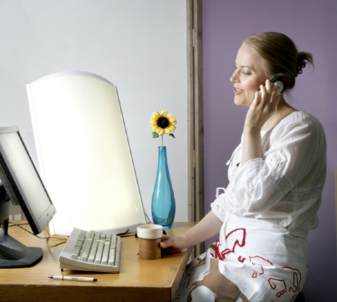

Slide 18
Activities to Improve Your Spirits
Get moving! Do moderate daily exercise
Eat a well-balanced diet
Limit sugar and caffeine
Avoid tobacco, alcohol and drugs
Get at least 7 hours of sleep at night
Practice deep breathing
Surround yourself with positive people
Keep a realistic and optimistic attitude
Take time each day to do something you enjoy
Make time for relaxation: listening to music, meditation or guided imagery, yoga, reading, deep breathing, ...

Slide 19
Activities to Improve Your Spirits
Read novels or magazines
Watch a favorite TV program or go to a movie
Learn a new craft or hobby
Have lunch with friends
Be with animals
Sing in a group
Cook something you enjoy
Visit a museum
Help out others
Play a musical instrument
Have fun!

Slide 20
Questions?

