Slide 1
© 2020 Quartz Health Solutions, Inc. This PowerPoint is considered confidential and proprietary, and may only be distributed with prior written permission from the Quality Management and Population Health (QMPH) and Legal Departments at Quartz Health Solutions, Inc. The QMPH department can be reached at (866) 884-4601. Statements contained in these materials do not constitute medical advice. Individuals should consult with their doctor for healthcare questions and advice. Quartz is a management and administrative services company which provides services for Quartz Health Benefit Plans Corporation, Quartz Health Plan Corporation, Quartz Health Plan MN Corporation, and Quartz Health Insurance Corporation.

Slide 2
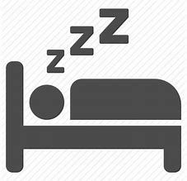
Good Night, Sleep Tight
“Good Night, Sleep Tight!”

Slide 3
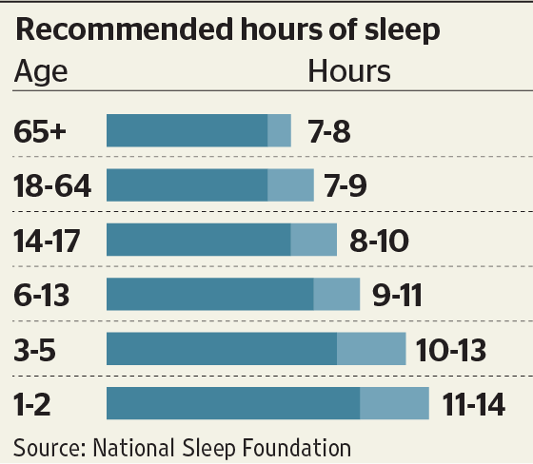
How much sleep is “enough”?
Good Night, Sleep Tight

Slide 4
Good Night, Sleep Tight
Why you need that much sleep and what happens if you do not get enough sleep
What can hinder getting enough sleep
Overview
Tips for better sleep
Benefits of getting adequate sleep

Slide 5

Good Night, Sleep Tight
Drivers who are tired cause more than 80,000 motor vehicle accidents and about 850 deaths each year!
Did you know?

Slide 6
Good Night, Sleep Tight
Physical & mental health
Relationships
What is the Risk?
Productivity
Memory
Increased appetite – weight gain
Greater risk of diabetes
Sickness
Safety at work and driving

Slide 7

Good Night, Sleep Tight
Driving drowsy
is just as
dangerous
as driving drunk!
Did you know?

Slide 8
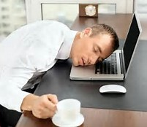
Good Night, Sleep Tight
Signs of Sleepiness
Apathy
Slowed speech
Inability to multitask
Hallucinations
Micro-sleeps
5-10 seconds of “nodding off”

Slide 9
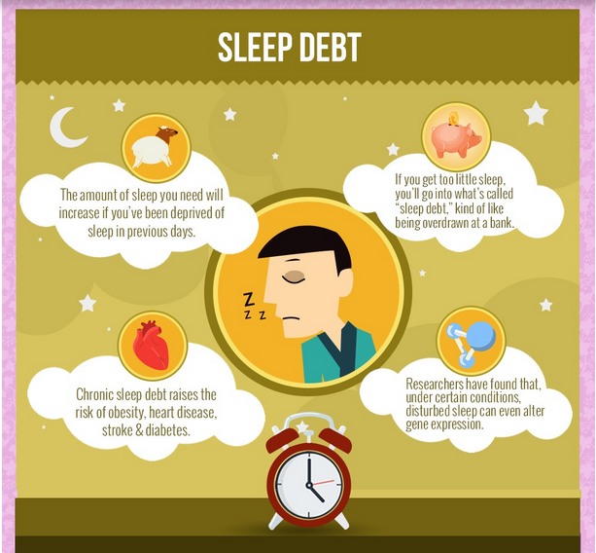
Good Night, Sleep Tight

Slide 10
Good Night, Sleep Tight
Sleep Self-Assessment
Answer “TRUE” or “FALSE” to the following 5 statements
1. I go to bed and wake up at about the same time each day.
TRUE or FALSE

Slide 11
Good Night, Sleep Tight
2. I do not drink caffeinated beverages within a couple hours of bedtime.
TRUE or FALSE
Sleep Self-Assessment

Slide 12
Good Night, Sleep Tight
3. My sleep environment is free of distractions (pets, cell phone, television, computer, snoring partner, lights).
TRUE or FALSE
Sleep Self-Assessment

Slide 13
Good Night, Sleep Tight
4. It takes me less than 30 minutes to fall asleep at night.
TRUE or FALSE
Sleep Self-Assessment

Slide 14
Good Night, Sleep Tight
5. I exercise for at least 30 minutes at least 4 days per week.
TRUE or FALSE
Sleep Self-Assessment

Slide 15
Good Night, Sleep Tight
If you answered “FALSE”
to any of those 5 statements
you may not be getting enough sleep, which can affect
your quality of life.
Sleep Self-Assessment Results

Slide 16

Good Night, Sleep Tight
Stimulants such as caffeine (coffee, soda, energy drinks) cannot make up for the effects of severe sleep deprivation.
Did you know?

Slide 17
Good Night, Sleep Tight
High blood pressure
Emotional disorders (anxiety, depression, bipolar disorder)
Obesity
Diabetes
Alcohol and drug abuse
What disrupts sleep?

Slide 18

Good Night, Sleep Tight
What disrupts sleep?
Digital Toxicity
decreases melatonin

Slide 19
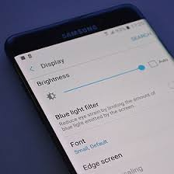
Good Night, Sleep Tight
Reducing Digital Toxicity
Protect Yourself & Your Sleep
Keep screen devices out of the bedroom
  TV
  Computer/tablet
  Cell phone
Turn on blue light filter on devices such as computers and cell phones
Read a book (not on a device)

Slide 20
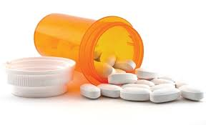
Good Night, Sleep Tight
Some medications may interfere with sleep.
(Check with your doctor.)
Did you know?

Slide 21



Good Night, Sleep Tight
Who is at risk?
Groups that are at particular risk for sleep deprivation
Night shift workers
Physicians
Truck drivers
Parents
Teenagers

Slide 22
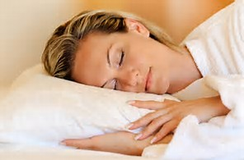
Good Night, Sleep Tight
Tips for Better Sleep
Stick to a similar sleep / wake schedule each day
Avoid heavy meals near bedtime
Avoid caffeine near bedtime
Limit daytime naps
Do not bring electronic devices into the bedroom
Include physical activity in your daily routine

Slide 23
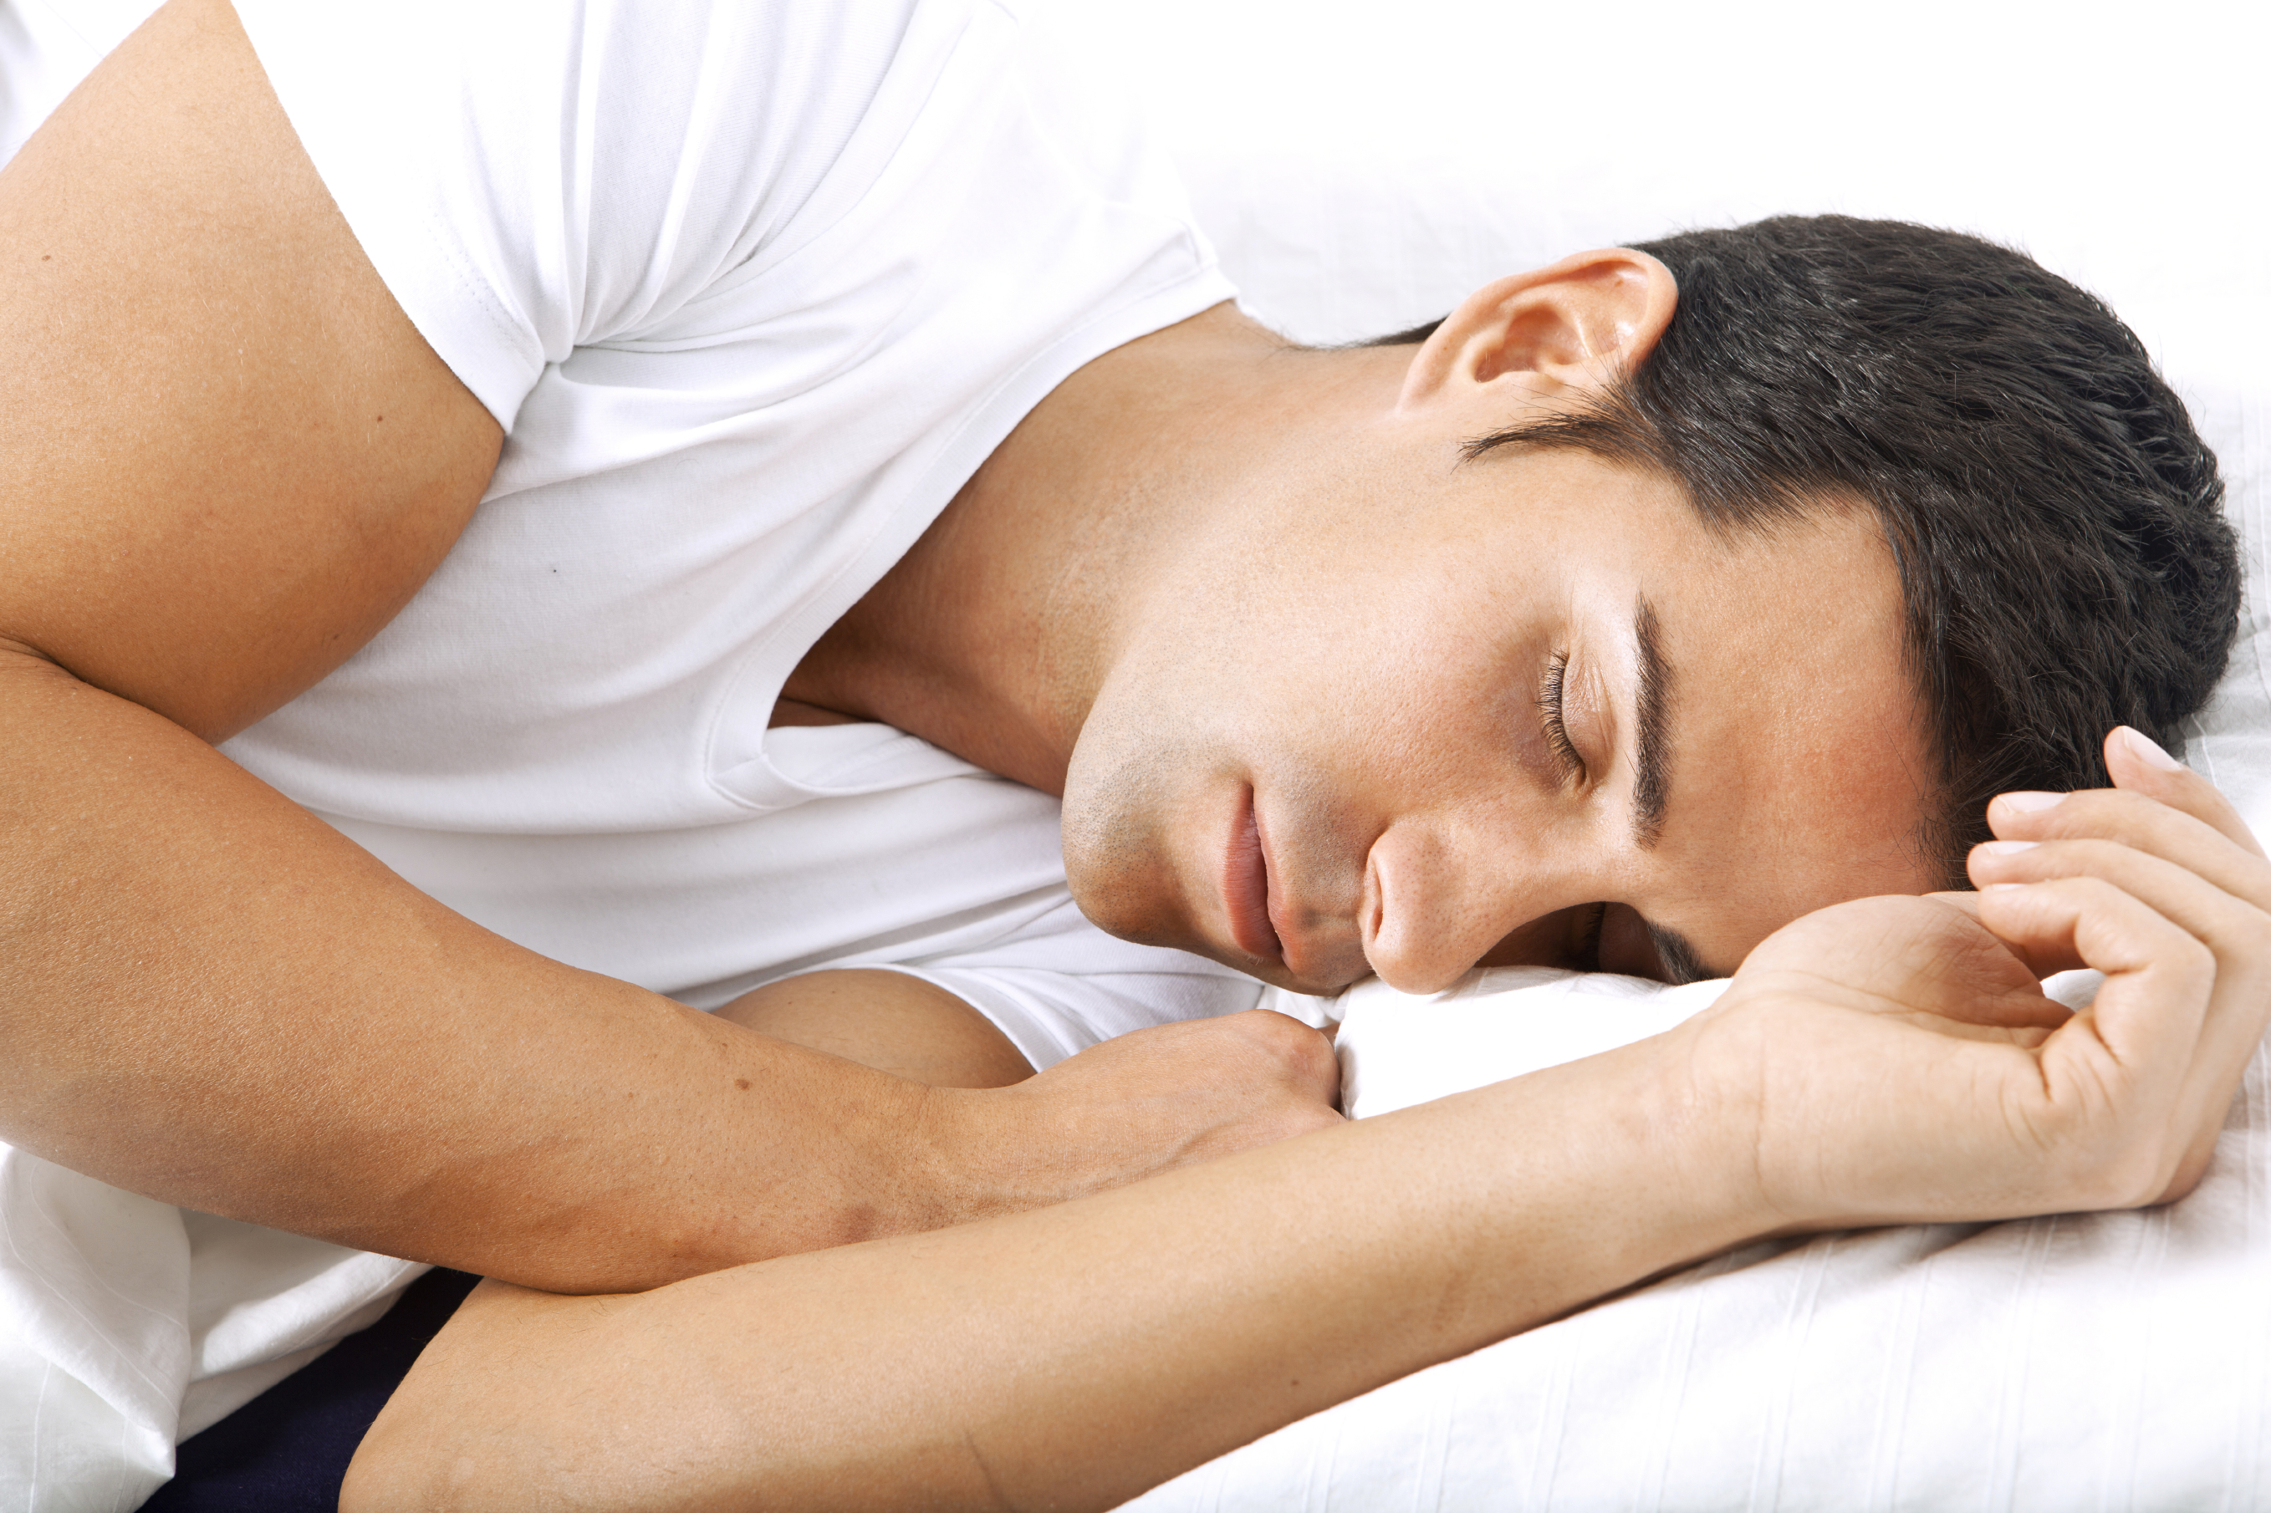
Good Night, Sleep Tight
Tips for Better Sleep
Create a restful environment
  Cooler bedroom temperature at night
  Darkened room
Manage worries
  Keep a notepad & pen next to your bed to jot down your thoughts
Meditation

Slide 24
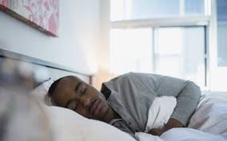
Good Night, Sleep Tight
Tips for Better Sleep
Minimize the use of prescription sleep aids.
Consume a serving of any of the following foods close to your bedtime: kiwi, walnuts, almonds, peanut butter, or tart cherry juice.
Cut back on your dietary sodium.

Slide 25
Good Night, Sleep Tight
Sources
https://www.webmd.com/sleep-disorders/guide/sleep-requirements
https://www.healthypeople.gov/2020/topics-objectives/topic/sleep-health
http://www.apa.org/topics/sleep/why.aspx
https://medicalxpress.com/news/2014-01-mistimed-disrupts-rhythms-genes-humans.html
https://www.webmd.com/sleep-disorders/features/power-down-better-sleep#1
https://www.mayoclinic.org/healthy-lifestyle/adult-health/in-depth/sleep/art-20048379
http://drannwellness.com/how-to-improve-your-sleep/
Thank you for joining us:
“Good Night, Sleep Tight!”

