Slide 1
© 2020 Quartz Health Solutions, Inc. This PowerPoint is considered confidential and proprietary, and may only be distributed with prior written permission from the Quality Management and Population Health (QMPH) and Legal Departments at Quartz Health Solutions, Inc. The QMPH department can be reached at (866) 884-4601. Statements contained in these materials do not constitute medical advice. Individuals should consult with their doctor for healthcare questions and advice. Quartz is a management and administrative services company which provides services for Quartz Health Benefit Plans Corporation, Quartz Health Plan Corporation, Quartz Health Plan MN Corporation, and Quartz Health Insurance Corporation.

Slide 2
Welcome to Exercise At Your Desk

Slide 3
Agenda
Exercise at Your Desk
Breathing & Posture
Exercise with Bands
Stretching

Slide 4
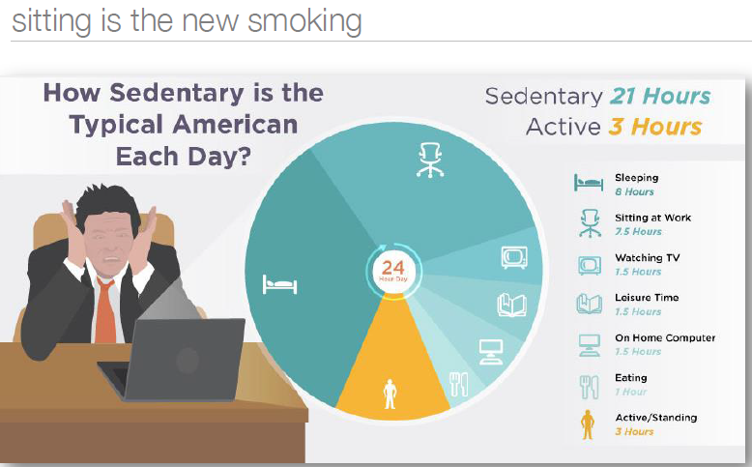
Why Move?
Exercise at Your Desk
http://www.juststand.org/tabid/800/language/en-US/default.aspx 00

Slide 5
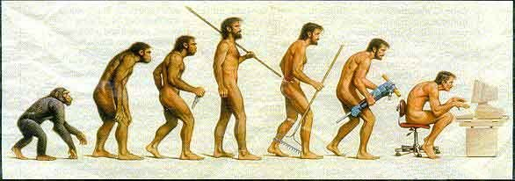
How Has Work Changed?
Exercise at Your Desk
http://www.juststand.org/tabid/800/language/en-US/default.aspx 00

Slide 6
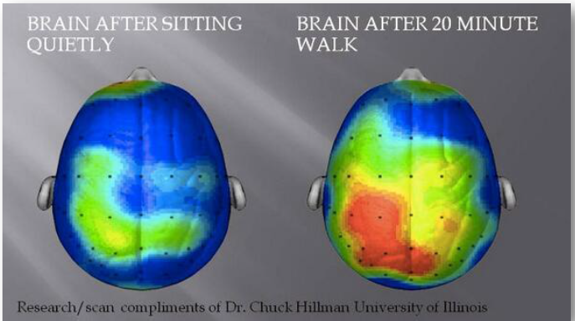
Impact of movement on brain function
Exercise at Your Desk

Slide 7
Breathing
Exercise at Your Desk

Slide 8
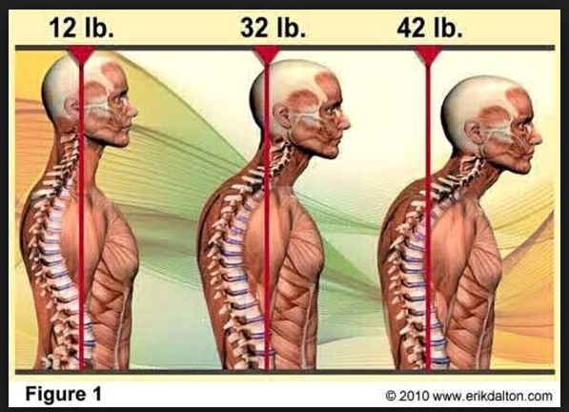
Posture
Exercise at Your Desk

Slide 9
Strengthening Exercises
Exercise at Your Desk
Safety Tips
Perform only the exercises that feel comfortable to you.
Check your band for tiny holes before each use.
Be aware of proper body alignment
(think alignment of ears, shoulders, hips, knees
and feet as we practice the exercises).
Exhale during the work portion of an exercise.

Slide 10
Stretching Exercises
Exercise at Your Desk
Stretching Tips
Body alignment
Warm muscles up before stretching
Hold a sustained stretch for 20 to 30 seconds
Only stretch to the point of mild discomfort
Breathe normally when stretching

Slide 11
Questions?

