Slide 1
© 2020 Quartz Health Solutions, Inc. This PowerPoint is considered confidential and proprietary, and may only be distributed with prior written permission from the Quality Management and Population Health (QMPH) and Legal Departments at Quartz Health Solutions, Inc. The QMPH department can be reached at (866) 884-4601. Statements contained in these materials do not constitute medical advice. Individuals should consult with their doctor for healthcare questions and advice. Quartz is a management and administrative services company which provides services for Quartz Health Benefit Plans Corporation, Quartz Health Plan Corporation, Quartz Health Plan MN Corporation, and Quartz Health Insurance Corporation.

Slide 2
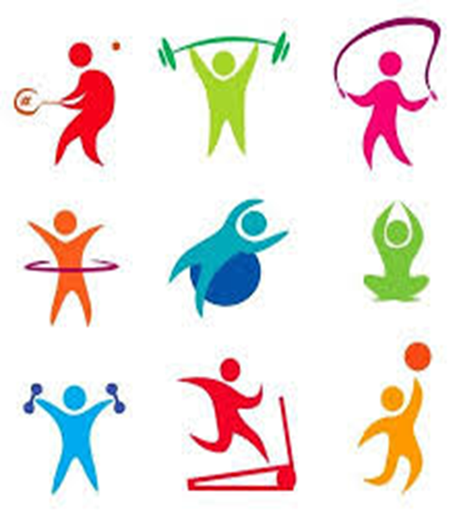
Exercise 101
Exercise 101

Slide 3
Exercise 101
Overview
Learn the different types of exercise
Learn the benefits of the different types
See examples of the exercises
Think about how to fit some ‘activity’ into your lifestyle
Set a goal for yourself!

Slide 4
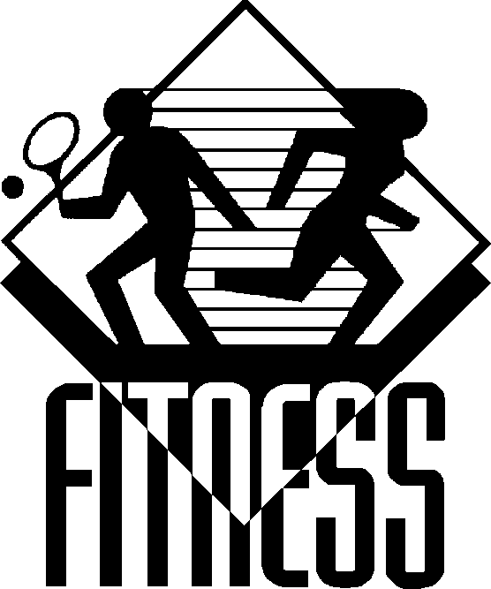
Exercise 101
Benefits of Exercise
1.Control your weight
2. Reduce risk of heart disease
3. Lowers blood sugar levels
4. Improve your mood
5. Strengthen your bones & muscles
6. Improve balance
7. Sharpen your brain
8. Improve sleep
9. Reduce the risk of some cancers
10. Decrease cortisol
= a pretty good list of benefits!

Slide 5
Exercise 101
How to add exercise to your life
1. Add movement ( activity) to your normal daily lifestyle
Meet friends for a walk instead of a coffee at a restaurant
Walk to the library
Ride your bike to work or lunch
Keep shoes in your car in case you have 10 minutes

Slide 6
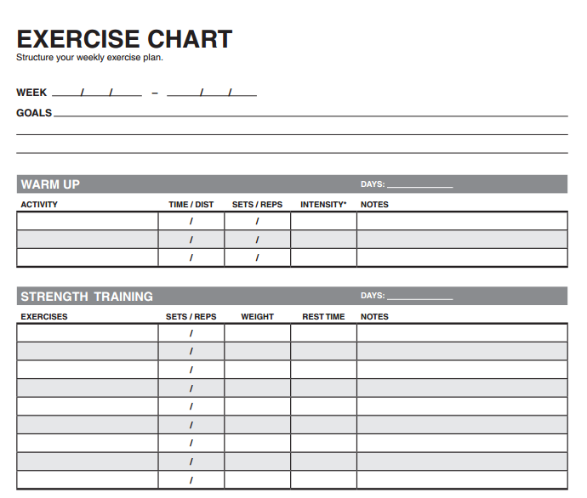
Exercise 101
How to add exercise to your life
2. Keep track of your progress
Accountability helps you stay motivated
Use fitness tracker or a log
Find a friend
Schedule exercise

Slide 7
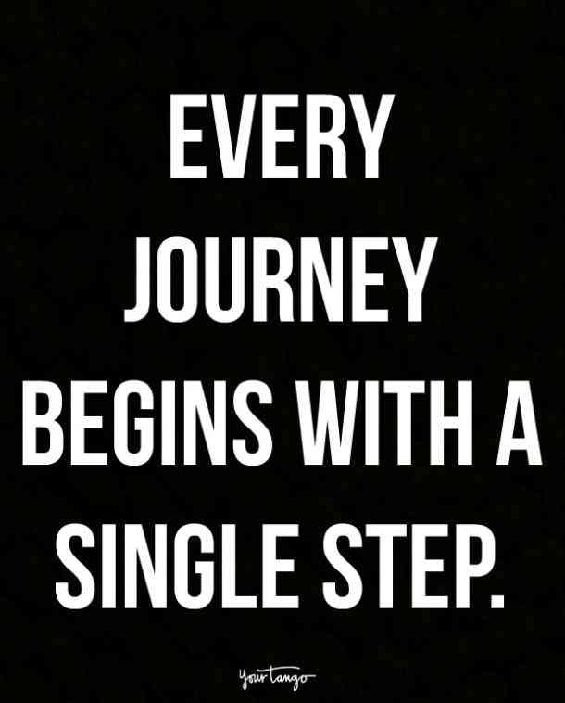
Exercise 101
How to add exercise to your life
Mix it up
Keep it fun
Challenge yourself to new classes or a new sport
Find indoor activities as well

Slide 8
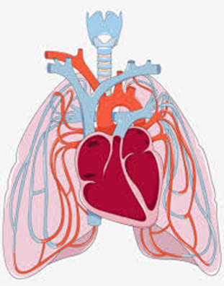
Exercise 101
3 TYPES OF EXERCISES
1. AEROBIC EXERCISE

Slide 9
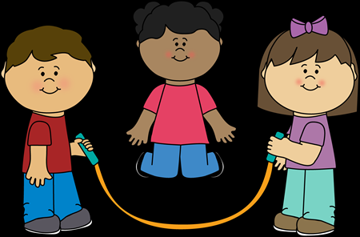
Exercise 101
Aerobic Exercise
What is aerobic exercise?
When you move your arms and legs, you’ll quickly notice your body's responses. You'll breathe faster and more deeply. This maximizes the amount of oxygen in your blood. Your heart will beat faster, which increases blood flow (carrying all that oxygen) to your muscles and back to your lungs.
As your body adapts to this type of exercise, you become more fit and stronger.

Slide 10
Exercise 101
Examples of Aerobic Exercise

Slide 11
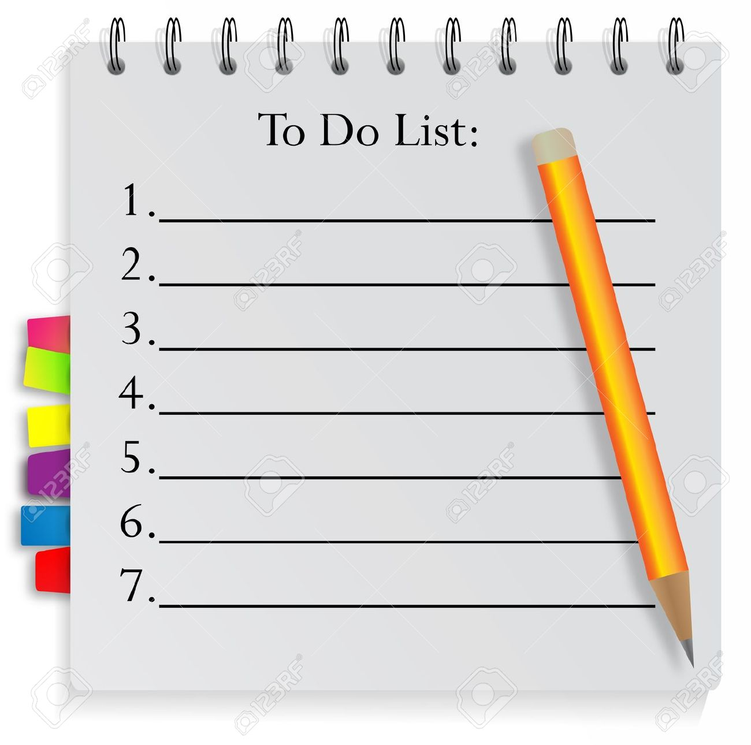
Exercise 101
How Do I Get Started?
If you've been inactive for a long time or if you have a chronic health condition, get your doctor's OK before you start
When you are ready, start slowly. You can walk 5 minutes in the morning and maybe 5 minutes in the evening. Then add a minute to your walks.
Then pick up the pace!

Slide 12
Exercise 101
How Much Exercise Do I Need?
American Heart Association Recommends:

Slide 13
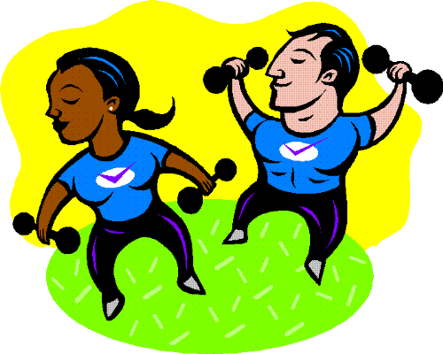
Exercise 101
3 TYPES OF EXERCISES
1. Aerobic Exercise
2.Resistance Training /Strength Work

Slide 14
Exercise 101
Resistance Training /Strength Work
Has a specific effect on body composition
Can help reduce fat; create leaner muscle mass which:
helps to keep bones dense and strong
burns more calories
Frequency: At least two nonconsecutive days per week of resistance training is a good rule of thumb, according to the American College of Sports Medicine
Examples:
* Working out with free weights (such as hand weights, dumbbells or barbells)
* Use weight machines,
* Use resistance bands
* Do body-resistance exercises, such as push-ups, squats and chin-ups

Slide 15
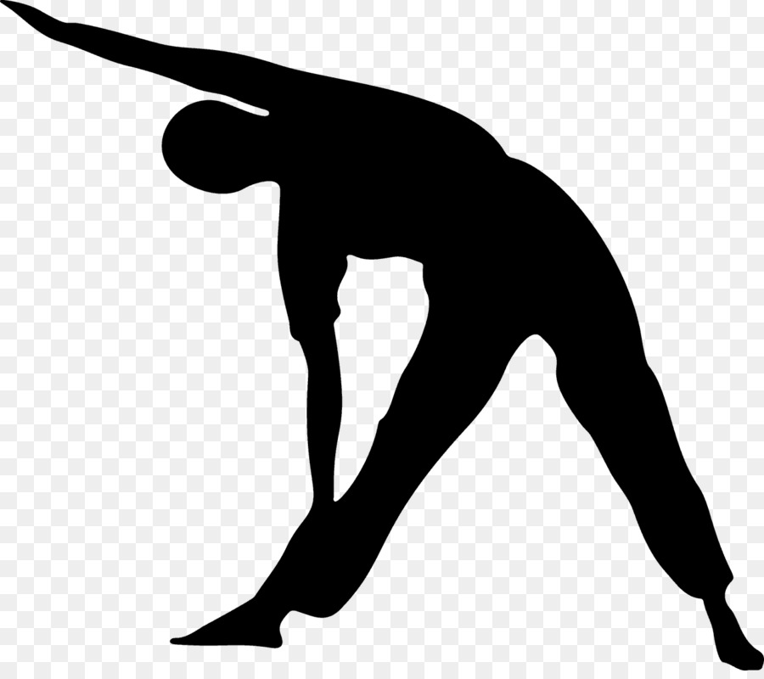
Exercise 101
3 TYPES OF EXERCISES
1. Aerobic Exercise
2.Resistance Training /Strength Work
3. STRETCHING, FLEXIBILITY & BALANCE

Slide 16
Exercise 101
Stretching, Flexibility & Balance
Benefit musculoskeletal health, which enables you to stay flexible and free from joint pain, cramping and other muscular issues. That flexibility is a critical part of being able to maintain aerobic exercise and resistance training
How much: Every day and before and after other exercise.
Examples: Your doctor can recommend basic stretches you can do at home, or you can find DVDs or YouTube videos to follow (though check with your doctor if you’re concerned about the intensity of the exercise). Tai chi and yoga also improve these skills, and classes are available in many communities.

Slide 17
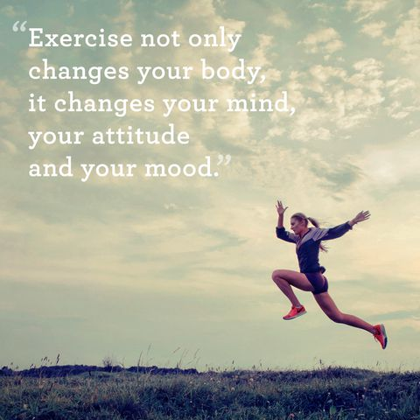
Exercise 101

Slide 18
Exercise 101
FINAL ACTIVITY
What is your plan to add some activity or increase the amount of activity in your life?
Are you ready to make a goal?

Slide 19
Exercise 101
Aerobic
Strength Training
Stretching

Slide 20
Questions?

