Slide 1
© 2020 Quartz Health Solutions, Inc. This PowerPoint is considered confidential and proprietary, and may only be distributed with prior written permission from the Quality Management and Population Health (QMPH) and Legal Departments at Quartz Health Solutions, Inc. The QMPH department can be reached at (866) 884-4601. Statements contained in these materials do not constitute medical advice. Individuals should consult with their doctor for healthcare questions and advice. Quartz is a management and administrative services company which provides services for Quartz Health Benefit Plans Corporation, Quartz Health Plan Corporation, Quartz Health Plan MN Corporation, and Quartz Health Insurance Corporation.

Slide 2
Clean Eating

Slide 3
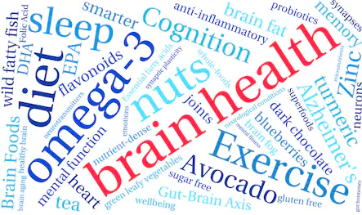
Clean Eating

Slide 4
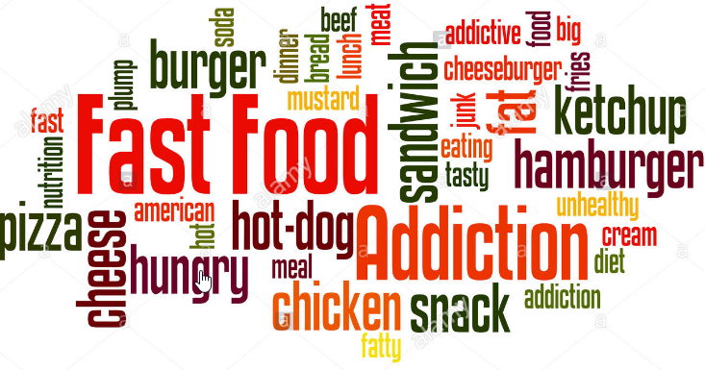
Processed Foods

Slide 5
Agenda
What is Clean Eating?
What about Processed Foods?
Four Simple Steps to Clean Eating

Slide 6
What is Clean Eating?

Slide 7
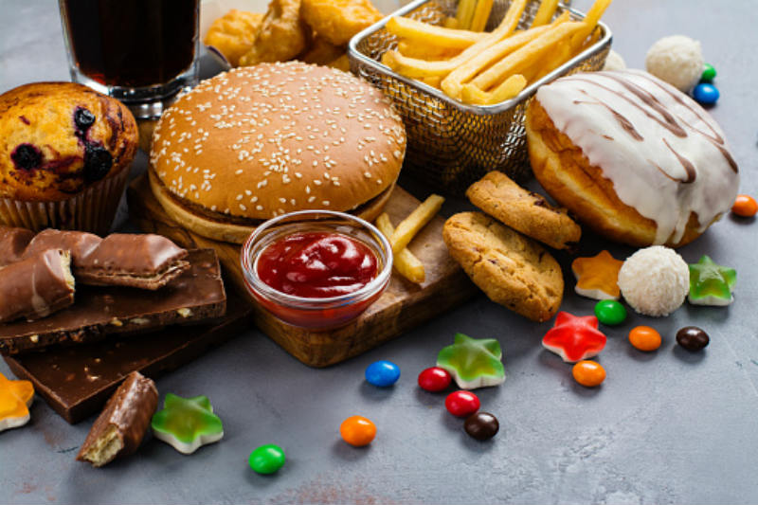
What about Processed Foods?

Slide 8
Limit Added Sugar

Slide 9
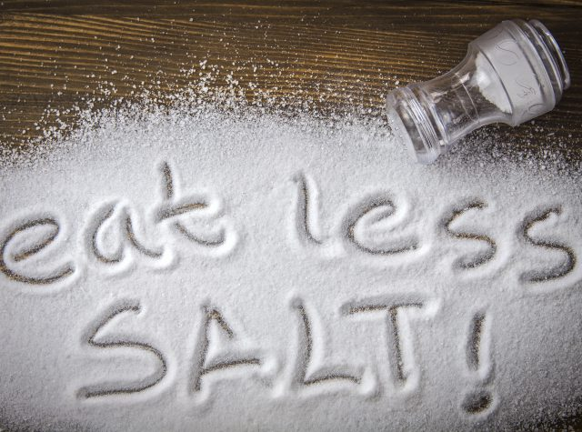
Reduce Sodium
Strive for 1500 – 2300 mg of sodium per day

Slide 10
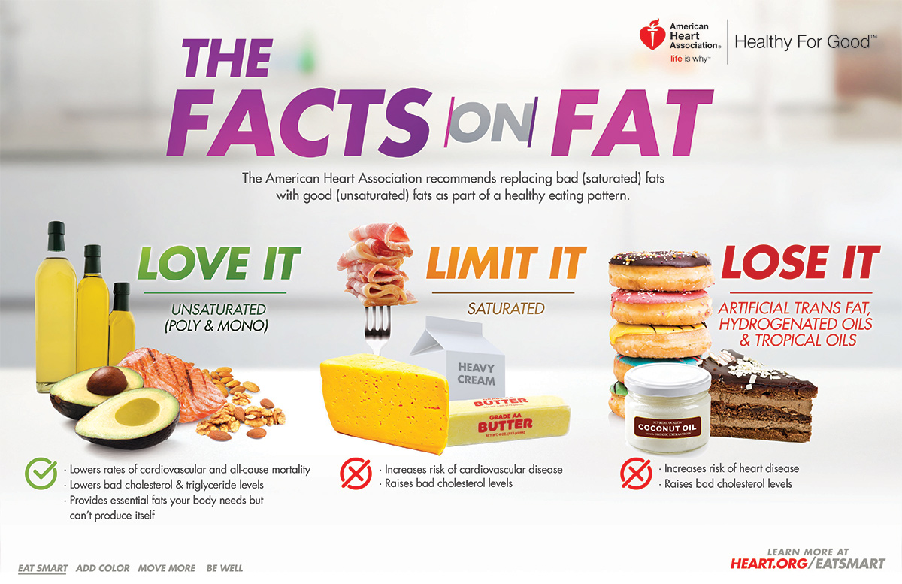
Limit Unhealthy Fats

Slide 11
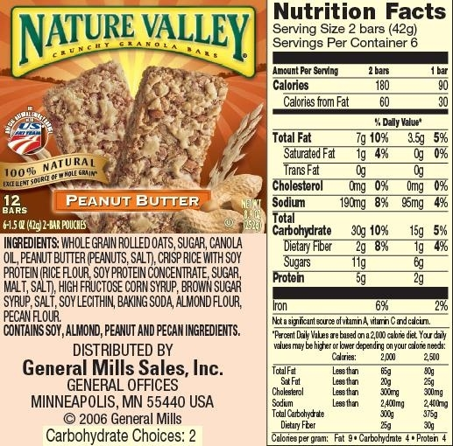
Label Lingo

Slide 12
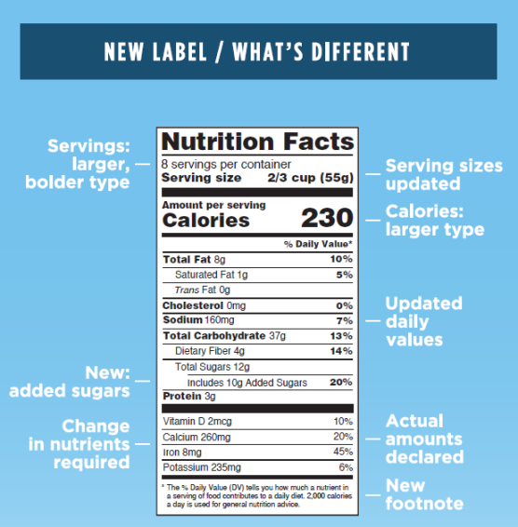
Label Lingo

Slide 13
Four Simple Steps to Clean Eating

Slide 14
Step 1: Eat Fruits & Veggies

Slide 15
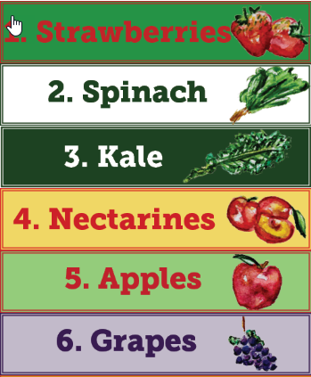
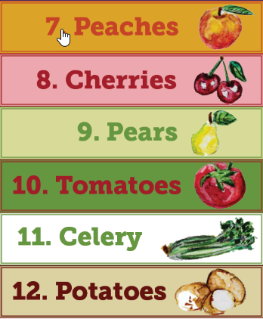
The Dirty Dozen

Slide 16
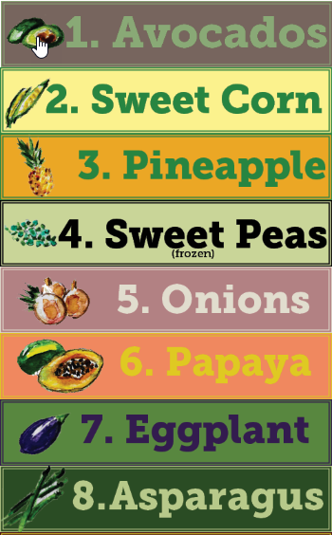
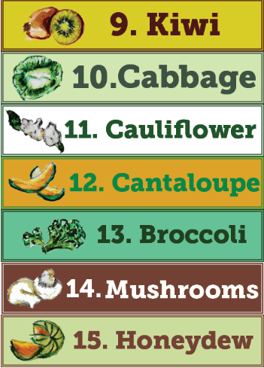
The Clean 15

Slide 17
Step 2: Eat Lean Protein

Slide 18
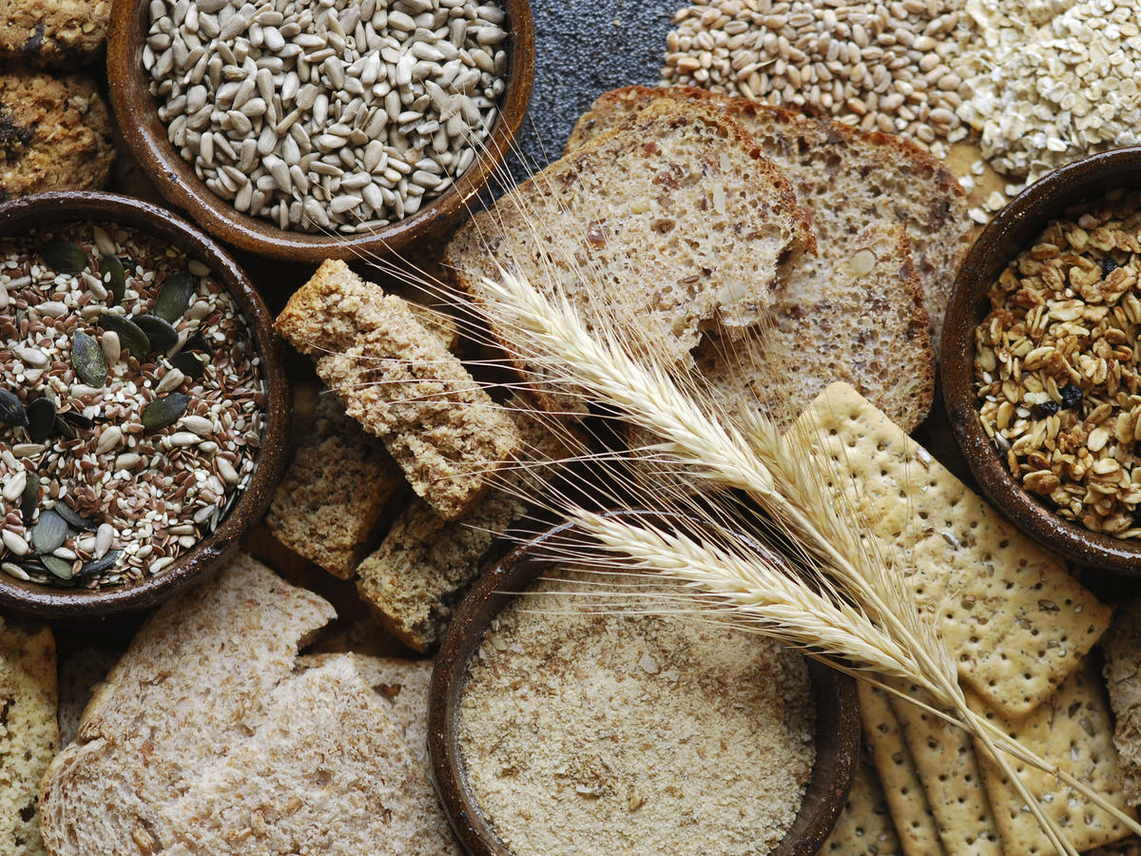
Step 3: Go 100% Whole Grain

Slide 19
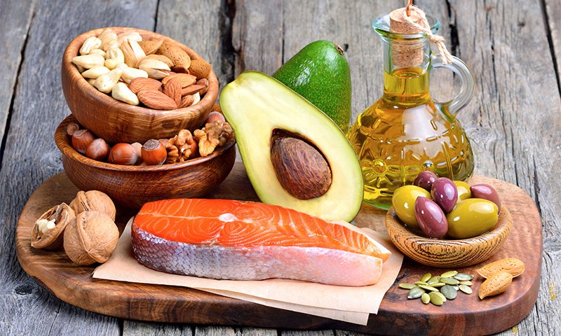
Step 4: Eat Healthy Fats

Slide 20
Clean Eating for a Lifetime!

