Slide 1
© 2020 Quartz Health Solutions, Inc. This PowerPoint is considered confidential and proprietary, and may only be distributed with prior written permission from the Quality Management and Population Health (QMPH) and Legal Departments at Quartz Health Solutions, Inc. The QMPH department can be reached at (866) 884-4601. Statements contained in these materials do not constitute medical advice. Individuals should consult with their doctor for healthcare questions and advice. Quartz is a management and administrative services company which provides services for Quartz Health Benefit Plans Corporation, Quartz Health Plan Corporation, Quartz Health Plan MN Corporation, and Quartz Health Insurance Corporation.

Slide 2
Managing Stress: Achieving Work/Life Balance
Achieving Work/Life Balance
Kimberly Hein-Beardsley, MS, LMFT, BCC, CHC
Quality Management and Population Health

Slide 3
Achieving Work/Life Balance
Objectives
What is Stress?
Identify stressors
Home
Work
Where to go from here?
What are your priorities?
Identify Goal and Action Steps
Putting it into practice!
Tips for managing stress

Slide 4
What is Stress?
Achieving Work/Life Balance
A “perceived” threat (real or imagined) to one’s mind, body, spirit or emotions.

Slide 5
Achieving Work/Life Balance
The Impact of Stress
The often-times conflicting demands of work and home can cause excessive stress.
Problems at home can frequently have an impact on a person’s ability to perform at work. The same goes for problems at work impacting the home.

Slide 6
Signs of Stress
Achieving Work/Life Balance
Lack of energy
Feeling depressed, anxious or irritable
Difficulty concentrating or focusing
Upset stomach
Headaches or muscle tension
Loss of interest in activities
Sleep problems
Self-medicating with alcohol or drugs

Slide 7
Stressors at Home
Achieving Work/Life Balance
Relationships (interactions with others, conflicts, etc.)
Environment (home, car, wardrobe, etc)
Body, Mind and Spirit (eating habits, exercise habits, health care, emotional needs, hobbies, spirituality, etc.)
Money (bills, saving for the future, spending habits, etc.)

Slide 8
Stressors at Work
Achieving Work/Life Balance
Uncertain about job security
Lack of resources at work (time, money, staff)
Inadequate training
Poor time management and organizational skills
Difficult relationships with co-workers
Unclear expectations for job performance

Slide 9
Short Term Effects of Stress
Achieving Work/Life Balance
Increased heart rate
Increased blood pressure
Increased rate of breathing
Increased muscle tension
Increased perspiration
Increased metabolic activity

Slide 10
Long Term Effects of Stress
Achieving Work/Life Balance
Hypertension (high blood pressure)
Chronic pain (muscle tension)
Suppressed immune system
Colds and flu
Symptoms of disease or illness
General sense of fatigue
Insomnia
Depression

Slide 11
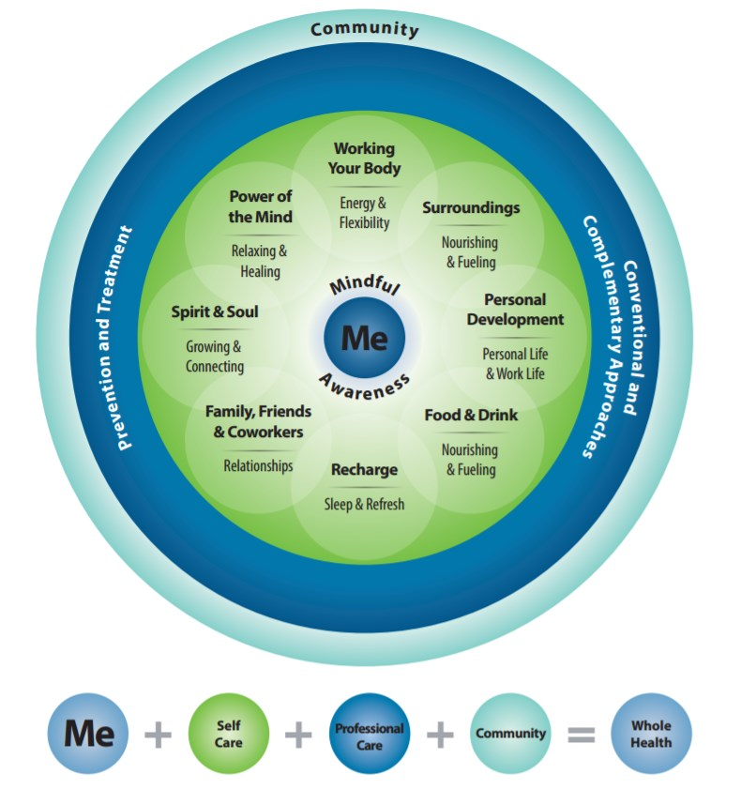
Achieving Work/Life Balance
Get Clear on What Matters

Slide 12
Tips for Managing Stress
Achieving Work/Life Balance
Get moving!
Eat a well-balanced diet
Limit sugar and caffeine
Avoid tobacco, alcohol and drugs
Get at least 7 hours of sleep at night
Practice deep breathing
At the start of each day, make a list of things to do and then prioritize
Get up and move around once each hour at work
Write a daily positive affirmation on a post-it
Make time for relaxation

Slide 13
Tips for Managing Stress, cont’d
Achieving Work/Life Balance
Break tasks into smaller, more manageable steps
Delegate
Develop good time management skills
Communicate effectively
Learn to be assertive
Don’t over-commit
Take responsibility
Surround yourself with positive people
Keep a realistic and optimistic attitude
Take time each day to do something you enjoy
Have fun!

Slide 14
Achieving Work/Life Balance
Effective Coping Skills
Reframing
Comic Relief
Time Management
Communication Skills
Information Seeking
Journaling
Hobbies
Social Support Groups

Slide 15
Achieving Work/Life Balance
Effective Relaxation Techniques
Physical Exercise
Hatha Yoga
Tai Chi
Meditation (Centering)
Spiritual Practice
Diaphragmatic Breathing
Progressive Muscular Relaxation
Guided Mental Imagery
Music Therapy

Slide 16
Achieving Work/Life Balance
Positive Effects of Techniques
Reduces muscle tension
Builds up body defenses
Prevents burn out
Improved concentration
Greater ability to handle problems
More efficiency in daily activities

Slide 17
Achieving Work/Life Balance
Steps Towards Balance
Identify Goals and Action Steps

Slide 18
Putting it into Practice
Achieving Work/Life Balance
What are you going to do today?

Slide 19
Questions?

